Slide 1
Holy Trinity Church of England Primary School, Sunningdale.
Our School Curriculum
Believe. Achieve. Inspire.

Slide 2
Principles and Purpose
At Holy Trinity we recognise that pupils are the central focus of the school so they grow to become confident, independent and successful learners. This is achieved through access to a school curriculum that includes;
A focus on the primary national curriculum statutory requirements
Access to wider experiences through fun and engaging teaching and learning opportunities
To explore and engage in extra-curricular activities that go beyond school requirements
It is through these three key areas that our school curriculum is made up so it;
promotes the spiritual, moral, cultural, mental and physical development of pupils at the school and of society, and
prepares pupils at the school for the opportunities, responsibilities and experiences of later life.

Slide 3
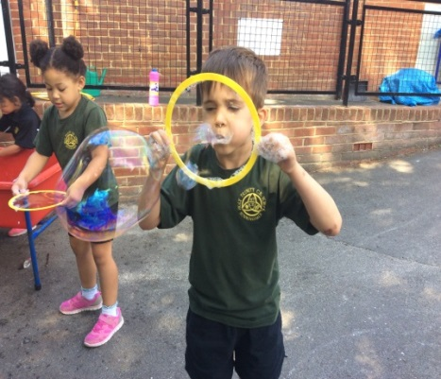
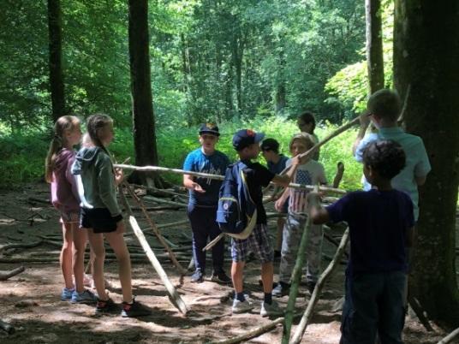
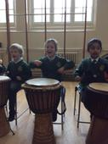
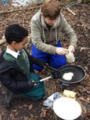
Entitlement and Enrichment
All pupils at Holy Trinity Primary School are entitled to;
Have access to a rich broad and balanced creative curriculum through the national curriculum, the wider curriculum and through extra curricular activities.
Receive high quality teaching that is practical, relevant, stimulating and inspirational.
Learn in a nurturing environment where they feel safe, secure and happy.
Engage in at least 2 educational visits each year.
Have access to sporting activities beyond the physical education curriculum.
Have the opportunity to access a range of clubs and activities before and after school.
Welcome visiting experts in to school or class.
Receive swimming lessons for up to four terms.
Experience outdoor learning through forest school, residential visits and venturing into the local community to access learning and resources.
Feel valued, respected and to have their voice heard.
Leave Holy Trinity with a good education, have fond memories and be equipped for the next stage in their learning journey.

Slide 4
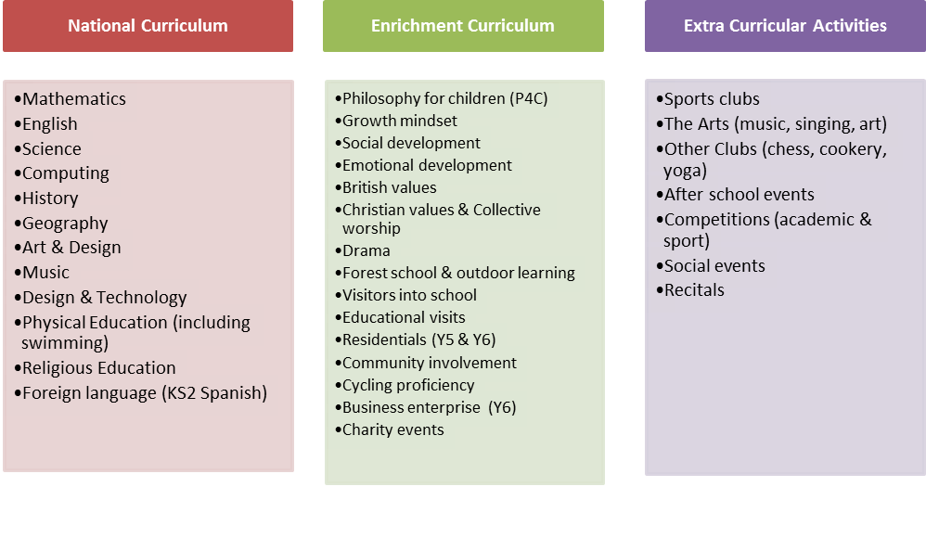
Our School Curriculum

Slide 5
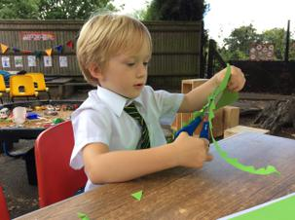
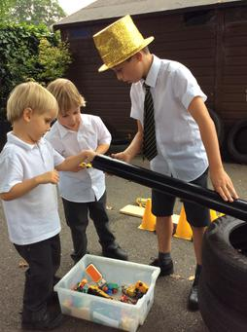
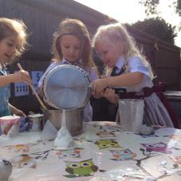
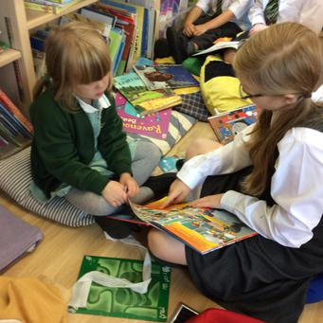
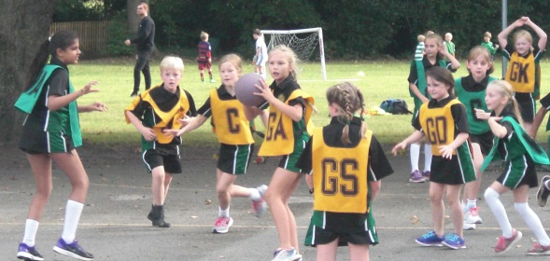
Narrative of Teaching
Topic based approach to learning
Enquiry, exploration, practical and discovery opportunities
Focus on specific statutory learning
Application of knowledge, skills and understanding
Pupil voice, support and learning styles
(P4C & growth mind-set)
Feedback, assessment, review and impact

Slide 6


Review and Evaluate
We want all pupils to be successful and reach their full potential. To do this staff, governors, the Diocese (SIAMS), the local authority and Ofsted monitor pupil and whole school performance. Monitoring is largely carried out by teachers, subject leads, senior leaders and governors to assess curriculum success through:
Book looks
Curriculum coverage analysis
Data progress and attainment
Marking and feedback
Environment & displays
Quality of learning and teaching in lessons
Sharing excellent teaching pedagogy and pupil outcomes
Keep up to date with new initiatives
Provide training and support
The local authority, Ofsted and SIAMS engage in occasional routine inspections to clarify school judgements and to suggest further improvement.

