Slide 1





For more than 20 years, Duarte has developed visual stories for the world’s leading corporate brands, thought leadership forums, and an Academy
Award-winning documentary.
When…
an inspector calls!
Notes:
To view this presentation, first, turn up your volume and second, launch the self-running slide show.

Slide 2

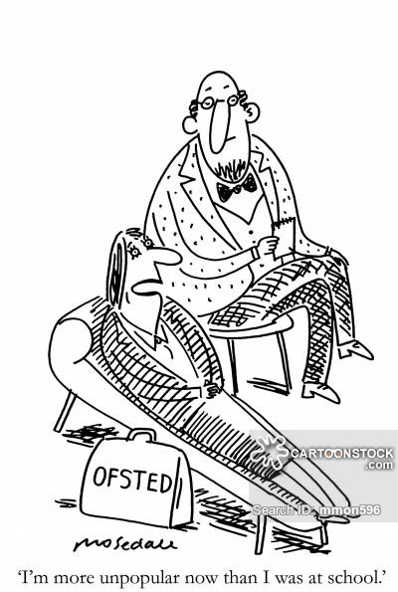
Learning Objectives
FIRST
To prepare and be to able discuss your role as governors
and the impact you have had on your school
SECOND
Ensure you have the appropriate information and
knowledge to support discussions with inspectors
Notes:
To view this presentation, first, turn up your volume and second, launch the self-running slide show.

Slide 3

Inspection Judgements
Leadership and management
Teaching learning and assessment
Personal development, behaviour and welfare
Outcomes for pupils
Overall effectiveness
Notes:
Please make sure that you are aware of the new inspection framework – pay particular attention to page 38 and 39 as well as page 40 and 41 which is mainly about the governors.
Forget looking at the grade descriptors if you have not got all those black bullet points in place

Slide 4

Inspection outcomes are based on…….
Discussion
Documents including data
Observations

Slide 5


Hulk smash scene
Why?

Slide 6

Plan
Prioritize
Practise
Who will you choose and why?

Slide 7

So what must be in it?
Notes:
Be prepared

Slide 8

Equal opportunity?

Slide 9
Creating equal opportunity
What’s your data telling you
Identify the areas to develop
Develop an action plan to improve matters
Hold the HT to account for them
Monitor the improvements /review and plan again
Notes:
We will look at these individually

Slide 10
Test!
The language of learning!
ARE
What is your data telling you?
In line with national expectations
SEN
Typical for their age
Disadvantaged
More
able
EYFS
Closing the gap
EAL & BME
Significantly above or below
KS1 & 2
Mobility children
Starting points
Pupil Premium
Gender
ROL
Cross reference!
Attainment
SATS
Progress
GLD & lowest 20%
Strengths
Areas for improvement (AFI)

Slide 11

British Values/vision
Stakeholders
Identify areas to develop?
Safeguarding/
radicalisation
Assessment system linked to the new national
Curriculum.
Pupil premium and sport funding/finance

Slide 12
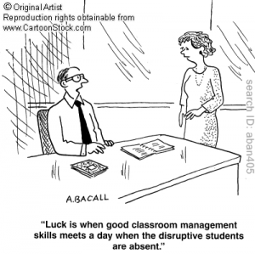
Who has been involved?
Develop an action plan to improve relevant areas
Monitor dates in built
Transparency
Fully costed

Slide 13

Strategic visits to specific staff
Hold the headteacher to account
Knowing what
parents think
Via various committees
Monitor the improvements
Performance management

Slide 14

Purpose? RADaR
Notes:
.
Written impactually – as you sign off the self evaluation you need to know what going on and why things have improved and if not then your new data set is established
Committee/governing body business. Evidence of discussions, decisions, action to be taken, by whom and by when, of governing body responsibilities such as:

Slide 15
So what are you going to do when you get back to school?

Slide 16
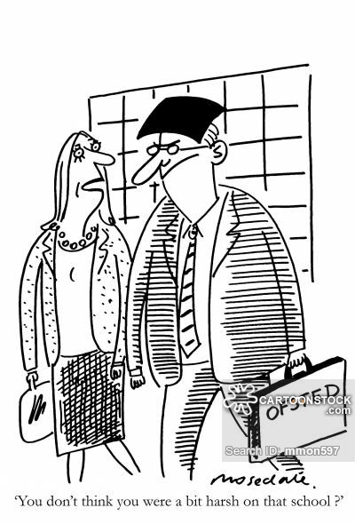
Jamie Hassan
Jamie.hassan959@yahoo.com

