Slide 1

Welcome to Year 5
Mrs Pinkerton, Mrs O’Neill, Miss Bohdjalian and Miss Lazar

Slide 2
Who and when?
 | Monday | Tuesday | Wednesday | Thursday | Friday
AM | Miss Bohdjalian Mrs O’Neill | Miss Bohdjalian Mrs O’Neill | Miss Bohdjalian Mrs O’Neill | Miss Bohdjalian Miss Lazar | Miss Bohdjalian
PM | Miss Bohdjalian | Miss Bohdjalian Mrs O’Neill | Miss Bohdjalian Mrs O’Neill | Miss Bohdjalian | Miss Bohdjalian Miss Lazar

Slide 3
Curriculum
History: Maya civilisation, Anglo-Saxon and Viking settlement
Geography: Mountains, Spain, Dorset
Science: Solar system, Forces, Properties and changes of materials, Life cycles in animals and plants
RE: Christianity and Sikhism
Maths:
  The Calculation Policy – how we teach calculations at each stage
  The Video Resource - practical demonstrations of these calculation strategies in action
Learning Pit: Growth Mindset | Holy Trinity CE Primary School

Slide 4

Behaviour Expectations
Active listening - SHINE
Following instructions
Taking responsibility for their own learning: independence and concentration
Accepting responsibility for behaviour choices: consequences
Reward systems – house points and star of the week

Slide 5


Slide 6
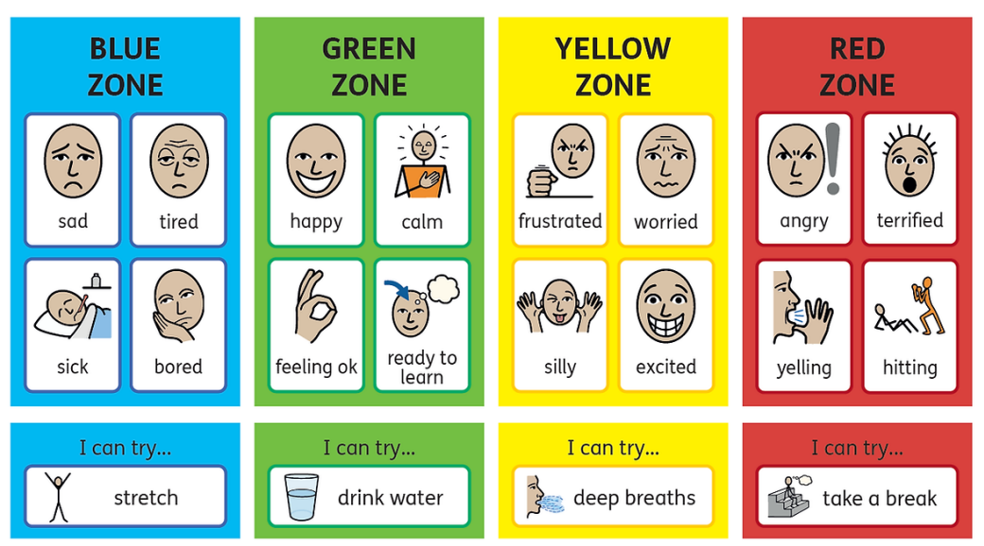
Zones of Regulation
See: The Zones of Regulation | A Curriculum For Emotional Regulation

Slide 7
Morning Routine
Register at 8.45am and choose lunch option
Complete morning activity, read quietly once finished
Homework book into box on Monday – if late, it will not be marked until following week

Slide 8
09.05.25
Word of the Day
perishable
If food is perishable, it is likely to go off after a short amount of time.
Fish Fingers
Vegan Sausage Roll
Jacket Potato
Complete the following subtractions. Use column subtraction and show your method.
6000 – 1546 = ? 3200 – 1457 = ?
5500 – 324 = ? 4000 – 2768 = ?
8002 – 3113 = ? 7605 – 2417 = ?

Slide 9
Reading in Year 5
In school per full term, we focus on two texts to inspire our own writing
  Autumn: Nowhere Emporium
  Spring: Beowulf
  Summer: Secret of the Night Train
Short comprehension sessions to develop inference and deduction
Colour band books are read in class during day, also go home each day
Reading List - 10 recommended books for year 5 pupils to read at home
Class library – the children are welcome to borrow books from our class library by signing them out

Slide 10
Homework
Approximately 2 hours of homework per week, including daily reading and spellings
Maths/English homework will be set on Wednesdays for submission the following Monday
Homework will be given as assignments via Microsoft Teams. It will be a mix of online work via Mathletics and written tasks.
Written work to be completed in pink homework book and not on sheets (unless instructed otherwise)
Spellings will be studied and handed out on Wednesday for testing the following Wednesday

Slide 11
Residential
Wednesday 6th – Friday 8th May 2026
Leeson House Field Studies Centre, Langton Matravers, Swanage
Geography focus
Meeting at the start of summer term

Slide 12
General
Breaktime snack is fruit or dried fruit
Please be sure to send in everything NAMED, including water bottles
Children can have an extra pair of outdoor shoes in their lockers for their daily mile / wet field
No jewellery other than studs and a watch/Fitbit
Please let me know if your child wears a religious adornment

Slide 13
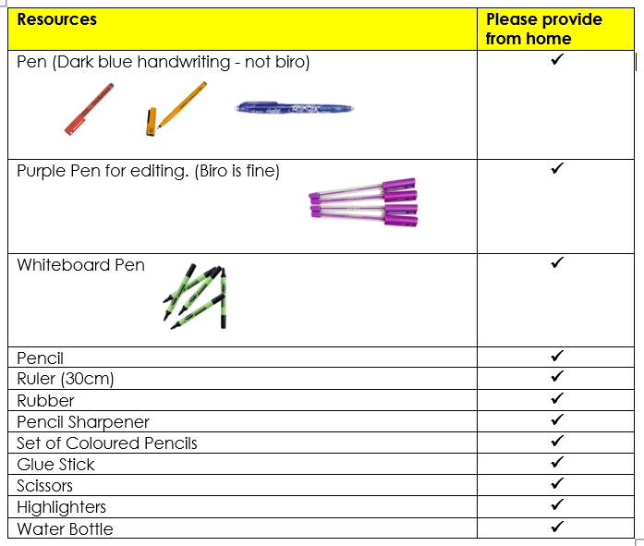
Equipment

Slide 14
Communication
Please use the year5@holytrinityprimary.org as our method of communication.
If you have information about your child being collected by someone different, please let the office know rather than me.
End of day (2 minutes): please wait by ramp until all children have been dismissed.
If longer needed, please make an appointment with me via the class email.

