Slide 1

Welcome to Year
Mrs Janelle Rhodes and
Mrs Shirin Ahmed
Miss Lazar

Slide 2

Welcome
Class 3 is an exciting time for your child as they make the transition from Key Stage 1 into Key Stage 2.
This year your child will learn to be more independent and begin to take responsibility for their learning.
The following pages contain some key information about the year which we hope you will find helpful.

Slide 3
Subjects will be taught as discrete subjects.
Please visit the school website – looking under About Us – Curriculum.
Autumn Term
Christian value: Forgiveness
Friendship and Truthfulness
English: Stone Age Boy, The Crow’s Tale, How to Wash a Woolly Mammoth, Harvest Poetry
Maths: Place Value, Addition and Subtraction, Multiplication and Division
RE: Hinduism and Christianity
Science: Rocks and Soils, Light
History : Stone Age to Iron Age
Geography: Climate Zones

Slide 4
Important Days
PE: Monday (magpies) and Thursday (Gymnastics) These are correct days for September 2026
Homework will be set on Wednesdays via Microsoft Teams for submission the following Monday. Weekly homework will be a mix of online work via Mathletics/Purple Mash and written tasks to complete in a pink homework book.
A Science, History or Geography task may also be set once or twice a term.
Weekly Spelling test on Thursday. New Spelling list will be given every Thursday.
Email: year3@holytrinityprimary.org

Slide 5
On PE days – children can come into school in PE kit and trainers.
For After-school clubs - Children come into school in full uniform and shoes. They will get changed for the clubs so appropriate clothing and footwear is to be brought with them.

Slide 6

Reading
Reading – VERY important and support from home is still very much encouraged.
In school, year 3 will be using whole class guided reading.
Research has proven that it challenges readers of all abilities and allows readers to hear and access language that they may not be able to on their own.
We will continue to develop word reading, comprehension, inference and language skills.
Read a range of texts and topics – breadth is the most important (include comics, newspapers).
Visit the library.
Children will to be responsible for changing their reading book as required.
Children are encouraged to read books from the year 3 suggested reading list – please email in a photo and a certificate will be awarded.

Slide 7
Year 3 Expectations
Please use the year3@holytrinityprimary.org as our method of communication.
If you have information about your child being collected by someone different, please let the office know rather than us as we don’t get the opportunity to read all emails each day.
Water bottles should be named and brought home daily to wash.
Please be sure to send in everything NAMED!

Slide 8
Absence
Please notify the school office by telephone on the day of absence.
If you know your child will be away, please notify the school in advance.
Please ensure prompt dropping off and collecting.
Children can come in from 8.30am. Morning work is set at this time. This time is always a good settling in and organization time for the children to order their lunch, put their bag away and get their things out for the day.

Slide 9
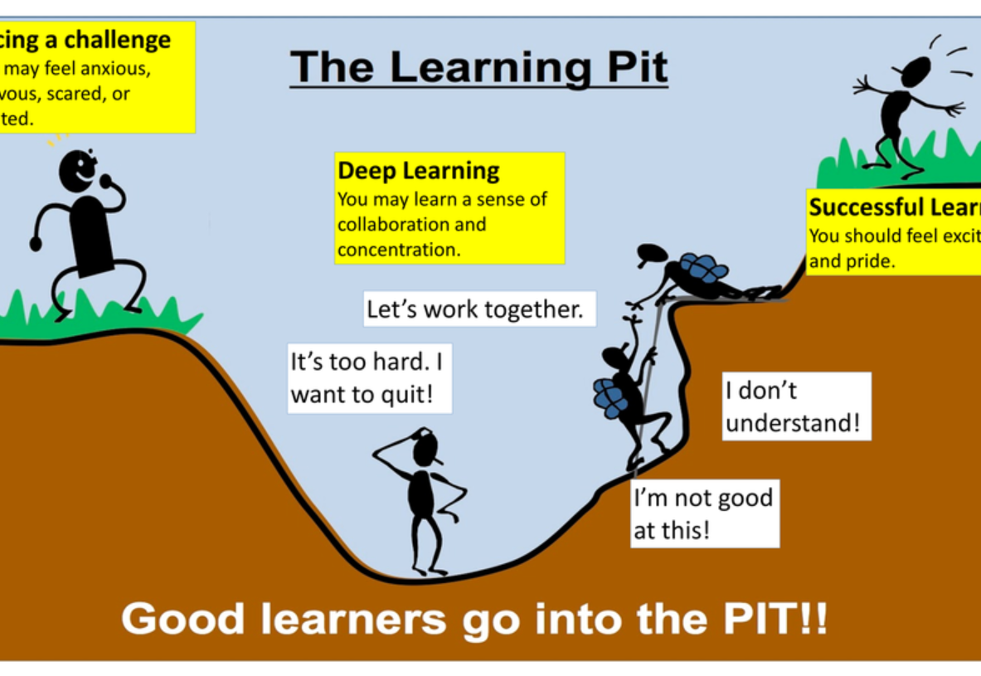

Slide 10
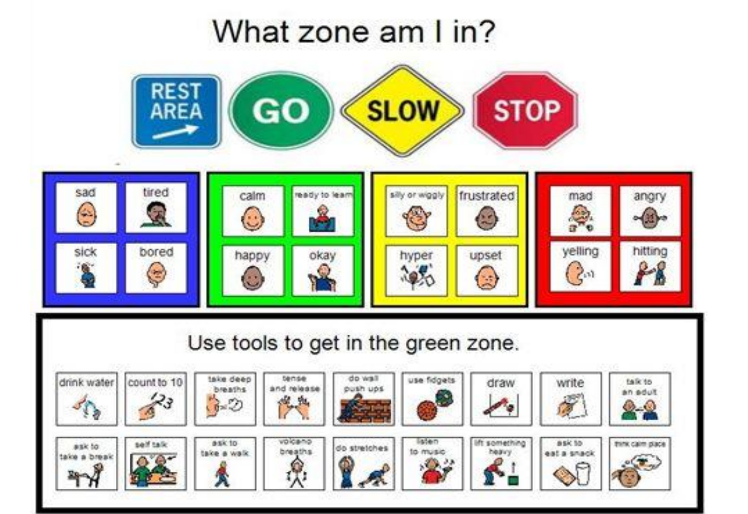

Slide 11
Website
Please take the time to look at the school website.
The Class 3 page will have letters and information updated regularly as well as photographs of our learning taking place.
Dates will be in the school calendar.
Weekly newsletters are available on the website too!
The Learning Pit
The Zones of Regulation (in our Behaviour Policy)
The Calculation Policy – giving parents a clear resource to show how we teach calculations at each stage
The Video Resource which shows practical demonstrations of these calculation strategies in action and will be added to next year

Slide 12

Year 3 is fun!
We are going to have so much fun in Class 3
and are thoroughly looking forward to
teaching your child!
Please bare with us over the first few weeks as we get to know your child.
Any questions? Please email us on
year3@holytrinityprimary.org

