Slide 1
READING
“Reading is the single
most important thing
you can do with your child.”

Slide 2
Why is reading so important?
Links to writing - good readers are usually
good writers.
Develops language and vocabulary.
Develops imagination and creativity.
Reading is about enjoyment .
Opens up children’s worlds and enriches their lives.
Reading is essential in developing a good self image.
Marked advantage in education - accessibility.

Slide 3

Reading at Holy Trinity.
Reading scheme
Guided reading
Reading across the curriculum
Ebooks – Bug Club

Slide 4
Reading at KS2
At KS2 reading becomes about comprehension not decoding. When reading unfamiliar words, strategies for this should be in place already.
Reading punctuation
Reading fluency
Reading for meaning (retrieval)
Inference and deduction

Slide 5
Struggling or Anxious Readers
Start off by reading to them.
Encourage them to read the pictures.
Encourage them to join in with words.
Read a sentence each.
Paired reading – read together, stop reading at the same time as your child when they feel confident to continue by themselves (tap on shoulder)
Encourage your child to do more of the reading, if they are stuck on a word then just carry on reading. (Come back to the stuck word at the end.)
Teach your child the tricky words on the page before it is read.
Read to them, then ask questions.

Slide 6
Struggling or anxious readers - get the enjoyment back
Look at books that interest them
Picture books/ multi modal books
Allow children to read and reread the same book more than once.
Let them see you read and enjoying books.
Non Fiction, magazines, comics- whatever they are interested in.
Listen to audiotapes; read from kindles.
Read to them
Magazines

Slide 7
“For books to have optimum level
of challenge children need to be able to understand
95% of the words.”

Slide 8
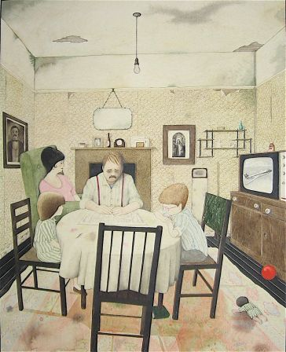
Inference and deduction
What do I know from this picture?
How do
I teach
Inference?
What do I think I know?
What can
you infer
from this
picture?

Slide 9
Inference
Pamela waltzed through the final of the dance contest and the audience’s cheers brought her to the stage for an encore.
“Every step she takes is so perfect and graceful,” Alesha said grudgingly, as she watched Pamela dance.
What is the word in this text that gives the text a whole different meaning?
What inferences can you make regarding Alesha’s feelings towards Pamela?

Slide 10
Our Reading Scheme
Fiction
Non-fiction
True stories
Myths and legends
Graphic novels
Classics
Children choose own books
Children can re-read favourites
Children will be moved on to the next book band when their comprehension at that level is secure.

Slide 11
http://www.booktrust.org.uk/ use the bookfinder tool on this website to find books for specific ages & genres www.oxfordowl.co.uk free ebooks available on this website http://www.lovereading4kids.co.uk http://www.lovereading4schools.co.uk/viewschool/7138/favourite password is brillbooks

Slide 12
“Reading is the single
most important thing
you can do with your child.”

