Slide 1

Friday 12th February

Slide 2
Today I would like you to try and complete these activities but at a time that suits you.
The details you need for today are all on this powerpoint or in the Friday file on the Remote Learning tab (week 4).
Some exercise to wake us up with Joe Wickes or 5 a day - click this link
Registration from 9.30am
Handwriting practise – see slide 3
Mathemagician Challenge – see slide 4
Spelling test – Teams OR together at home (slide 5)
Mathletics activities x2 (today or any other point in the week)
Science – see slide 7
Craft/Science activity – see slide 8 (optional!)

Slide 3
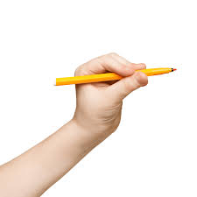
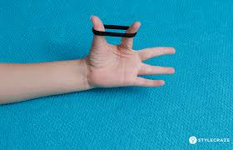
Handwriting:
Today is a 10 minute session with me. You will need an elastic band which I hope you still have in your Friday Fun envelope. Otherwise please try and find a hair band! You will also need your whiteboard, pen and rubber! Please click the link below.
Please click here to watch me!

Slide 4

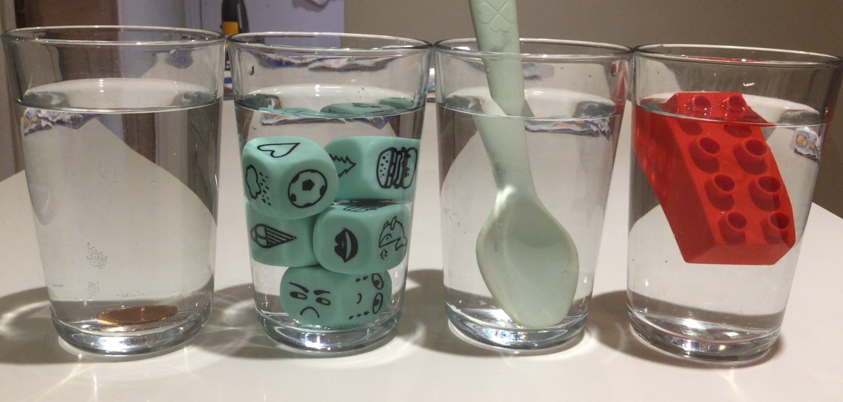
Mathemagician Challenge:
ConfusingCups!!
Your Challenge!!

Slide 5

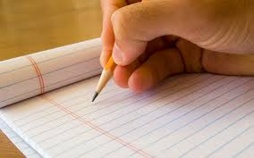
Spelling Tests
Moons – Teams Meeting 10.30am
Stars – Teams Meeting 10.50am
Rockets – Teams Meeting 11.10am
OR – feel free to complete a test at home with mum or dad at a time that suits you!! There is no pressure to attend with me! Please do send me your result though!!

Slide 6

Mathletics:
Please try to complete 1 or 2 activities that have been set for you.

Slide 7
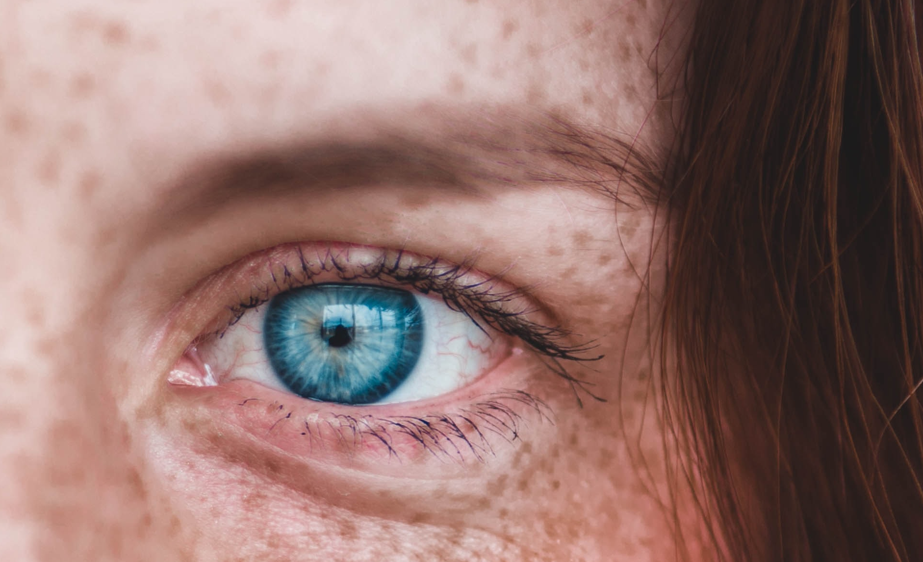
Science:
Sense of Sight
Please watch the story Seven Blind Mice and follow up
with the Sense of Sight PowerPoint and Challenges!!
Here is the labelling of the eye sheet that you will need (or draw it into your home learning book if that is easier.)
Note to parents: Do send any photos of these science challenges and the labelling sheet in for me to check via email and please repeat and reinforce the learning content from the PowerPoint as you complete the challenges. Thank you so much!!

Slide 8
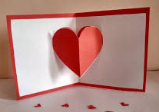
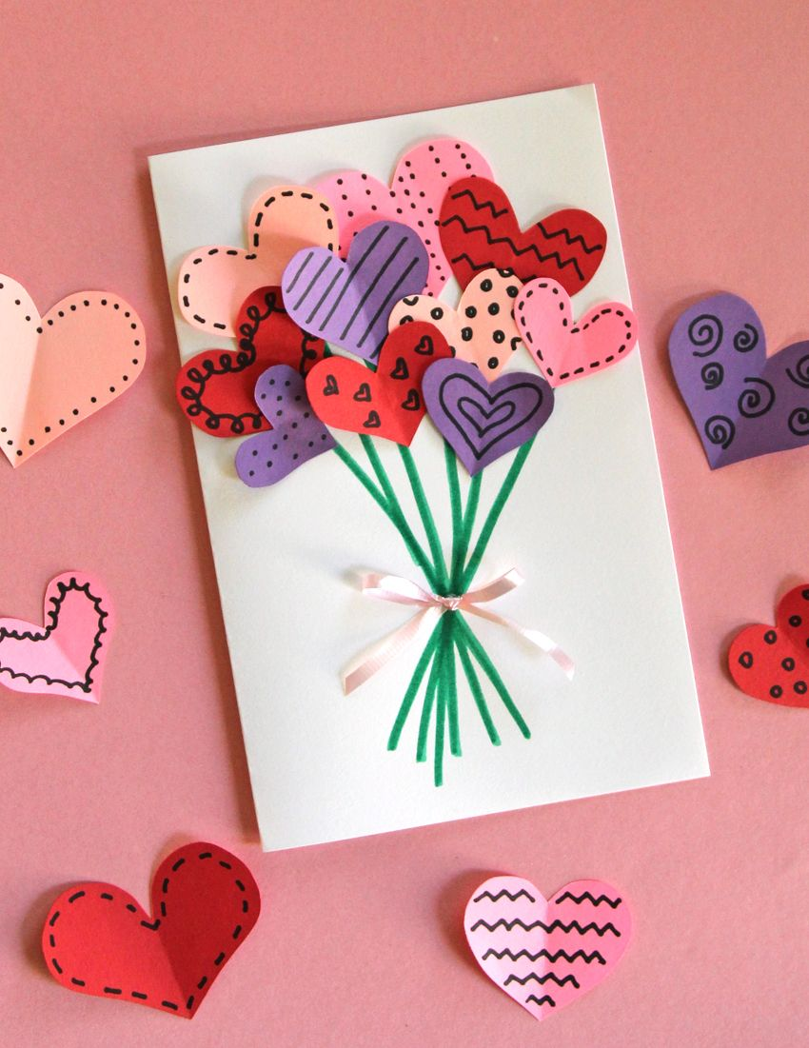
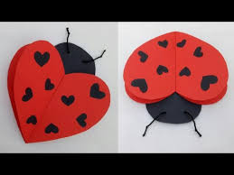
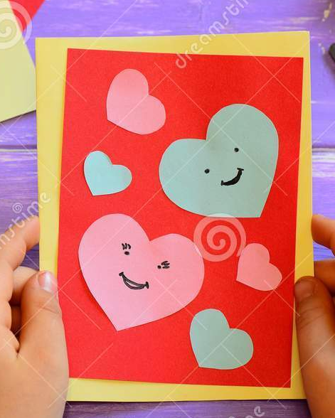
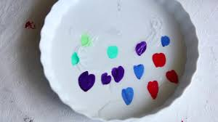
Optional Friday Craft!
Pop Up Valentines day cards!!
(
OR…
Floating Heart Fun!!
Click here to watch me! )
Click here to watch me!
I know you have already made a card in RE this week so please don’t feel pressure to make another one!! I just don’t want you to forget your DT pop up skills we have already practised at school!!

Slide 9

Have a really lovely half term!!
And…

