Slide 1
Friday 5th February

Slide 2
Today I would like you to try and complete these activities but at a time that suits you.
The details you need for today are all on this powerpoint or in the Friday file on the Remote Learning tab (week 4).
Some exercise to wake us up with Joe Wickes or 5 a day - click this link
Registration from 9.30am
Handwriting practise – see slide 3
Mathemagician Challenge – see slide 4
Spelling test – Teams OR together at home (slide 5)
Mathletics activities x2 (today or any other point in the week)
Science – see slide 7
Craft/Science activity – see slide 8 (optional!)

Slide 3
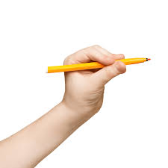
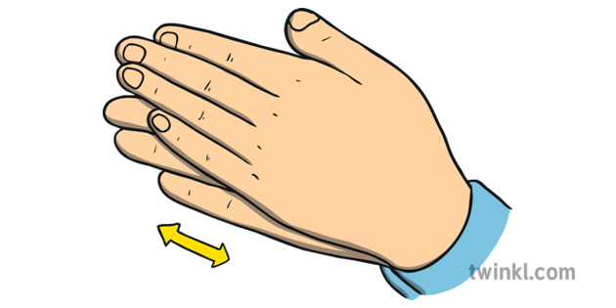
Handwriting:
Today is a 10 minute session with me – all you need is your whiteboard, pen and rubber! Please click the link below.
Handwriting with Mrs O'Brien

Slide 4

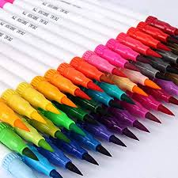
Mathemagician Challenge:
Colouring Pens!
Mathemagician Powerpoint Link - also on web page if this isn't working!!

Slide 5

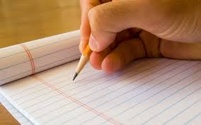
Spelling Tests
Moons – Teams Meeting 10.30am
Stars – Teams Meeting 10.50am
Rockets – Teams Meeting 11.10am
OR – feel free to complete a test at home with mum or dad at a time that suits you!! There is no pressure to attend with me! Please do send me your result though!!

Slide 6

Mathletics:
Please try to complete 1 or 2 activities that have been set for you.

Slide 7
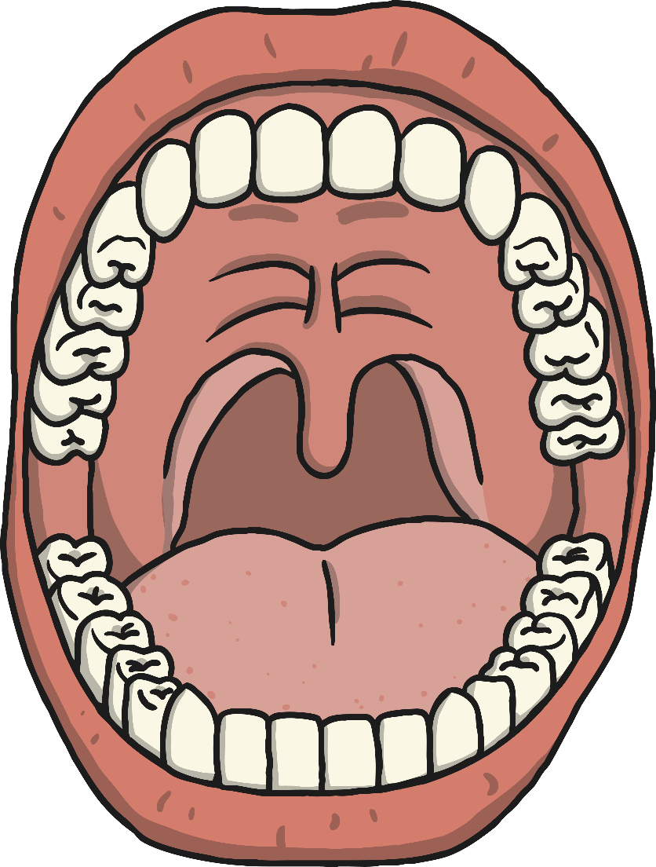
Science:
Sense of Taste!
Please watch the story of Lima and the Red Hot Chilli and follow up with either –
Re creating the story at home with the same foods and drinks
A game of Food Jeopardy
OR a general tasting session of your own (whichever you have time and resources for)
When tasting - PLEASE make sure you taste as normal and then again holding your noses – what do you notice?
Please try and record findings (as shown in the video) in your home learning books for any option made!
Apologies for the confusing video where all 3 activities are suggested – lesson learnt about making the video over a few days!!!! Please do just choose 1!!
Lima's Red Hot Chilli and Activity ideas
Sense of Taste Powerpoint

Slide 8
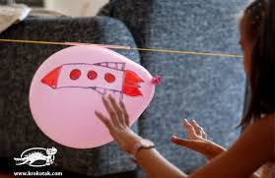
Optional Friday Craft!
Let’s make our own balloon rocket! You need your thread, your straw, cellotape and your balloon!
Click this link to watch me!

Slide 9

Have a lovely weekend!!
The AMAZING Mrs Tomes has made a trail for you to follow this weekend around Sunningdale! Here are the maps and the clues! I hope to see lots of you out and about wrapped up in scarves and hats with your clipboards and your excellent looking eyes!!
Good Luck and Have Fun!!
Trail clues
Sunningdale Trail map.jpeg

