Slide 1
Friday 15th January
Today I would like you to try and complete these activities but at a time that suits you. Please do not feel pressure to join the spelling test meeting if you will find it quicker and easier to do it at home together. But please email me the mark out of 10 if you do not join me for the test. The details you need for today are all on this powerpoint or in the Friday file on the Remote lLearning tab.
Some exercise to wake us up with Joe Wickes or 5 a day - click this link
Registration from 9.30am – Teams (see invites)
Handwriting practise – see slide 2
Mathemagician Challenge – see slide 3
Spelling test – Teams OR together at home (slide 4)
Mathletics activities x2 (today or any other point in the week)
Science – see slide 6
Craft/Science activity – see slide 8 (optional!)

Slide 2
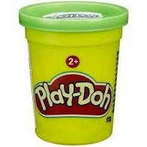
Handwriting
Handwriting Warm Up Link
please click this link to warm up your hands. You will need your play doh!
Now find your whiteboards, pens and rubbers and have a go at turning your letters into aliens!! Alien Letters - click this link

Slide 3

Mathemagician Challenge
please click this link for my input
Using all of the play doh in your pot, can you make the 8 planets, looking carefully at the SHAPE and SIZE.
Which planet is the BIGGEST and which planet is the SMALLEST?
Be Careful!!! What would happen if you used ALL of your play doh to make the first planet? How can you share it between 8 planets?

Slide 4


Spelling Tests
Moons – Teams Meeting 10.30am
Stars – Teams Meeting 10.50am
Rockets – Teams Meeting 11.10am
OR – feel free to complete a test at home with mum or dad at a time that suits you!! There is no pressure to attend with me! Please do send me your result though!!

Slide 5

Mathletics:
Please try to complete 1or 2 activities that have been set for you.

Slide 6
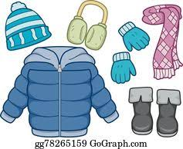
Science:
LO: I can spot the signs of Winter
LO: I know why I wear layers in the Winter
Please click this link for my starter and follow up with this link.
We are learning that heat moves from hotter things to colder things. We wear layers to TRAP the warm air and stop it from escaping. We need layers for insulation!!
Please find a teddy to wrap up warm – how many things can you put on?!

Slide 7
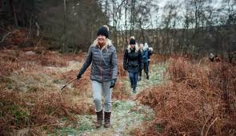
If you have time to go for a wintery walk, please use the Winter checklist sheet to tick off signs of Winter! This is on the Fridays page of the Remote Learning File on our Class Page

Slide 8
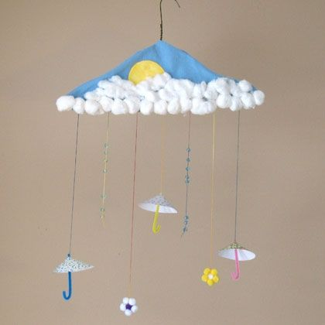
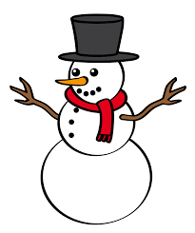



Friday Craft/Science OPTIONAL!!!
Following a wintery walk, can you remember some of the signs of Winter? Can you choose a few and make a ‘Signs of Winter’ decoration using the hanger and some of the coloured paper from your pack? If you want to cut out some winter pictures, there are some for you in the ‘Friday’ file on the class page but if you want to get creative and do your own thing, that is great!
Have fun and stay warm!!

Slide 9
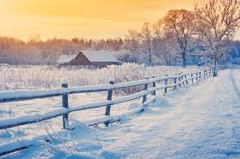
Have a great weekend and well done!

