Slide 1
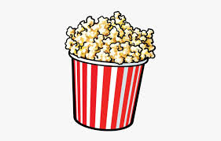
Friday 29th January

Slide 2
Today I would like you to try and complete these activities but at a time that suits you.
The details you need for today are all on this powerpoint or in the Friday file on the Remote Learning tab (week 4).
Some exercise to wake us up with Joe Wickes or 5 a day - click this link
Registration from 9.30am
Handwriting practise – see slide 3
Mathemagician Challenge – see slide 4
Spelling test – Teams OR together at home (slide 5)
Mathletics activities x2 (today or any other point in the week)
Science – see slide 7
Craft/Science activity – see slide 8 (optional!)

Slide 3
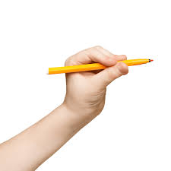
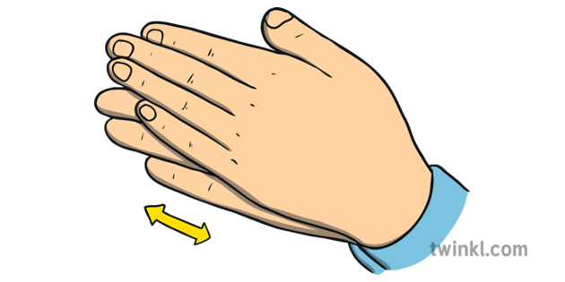
Handwriting:
Please start with a warm up – watch and copy me!!
Now use your whiteboard or the printout saved to Week 4 to practise numeral formation 3, 4 and 5.

Slide 4
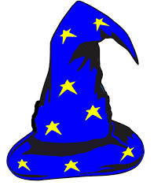
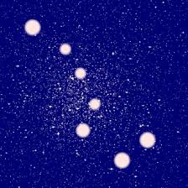
Mathemagician Challenge:
Star Constellations!!
Please start by watching the story followed by looking through the Mathemagician Powerpoint.
1. My Story
2. Mathemagician Powerpoint!

Slide 5

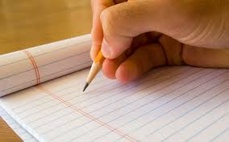
Spelling Tests
Moons – Teams Meeting 10.30am
Stars – Teams Meeting 10.50am
Rockets – Teams Meeting 11.10am
OR – feel free to complete a test at home with mum or dad at a time that suits you!! There is no pressure to attend with me! Please do send me your result though!!

Slide 6

Mathletics:
Please try to complete 1 or 2 activities that have been set for you.

Slide 7
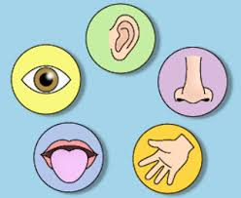
Science:
The senses!
(Today we will be using all 5 senses to make some popcorn. I’m hoping popcorn kernels were added to shopping lists! This will need adult support so please do it at a time that works for you all. The weekend is fine!!
Senses powerpoint - click here!
Click this link - let's make popcorn!!

Slide 8
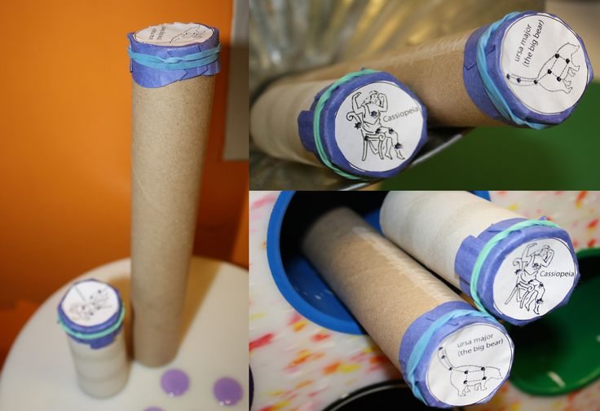
Optional Friday Craft!
Let’s make our own star constellation for the ceiling!
Click this link to watch me!

Slide 9
Have a lovely weekend and well done everyone!
In next Friday’s science lesson, we will be looking at the sense of taste – we will be reading a story where the little girl tastes chilli and then tries to get rid of the taste with water, ice cream, jelly, mango and finally milk!! I would like the children to go on a similar journey so please either prepare a few things to taste including one unusual/not very nice item or copy the items just mentioned from the story if you’re feeling brave!! Thank you for preparing for these lessons, I am very grateful!

