Slide 1

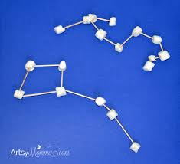
Mathemagician Challenge!
Can you find the right star constellation?

Slide 2
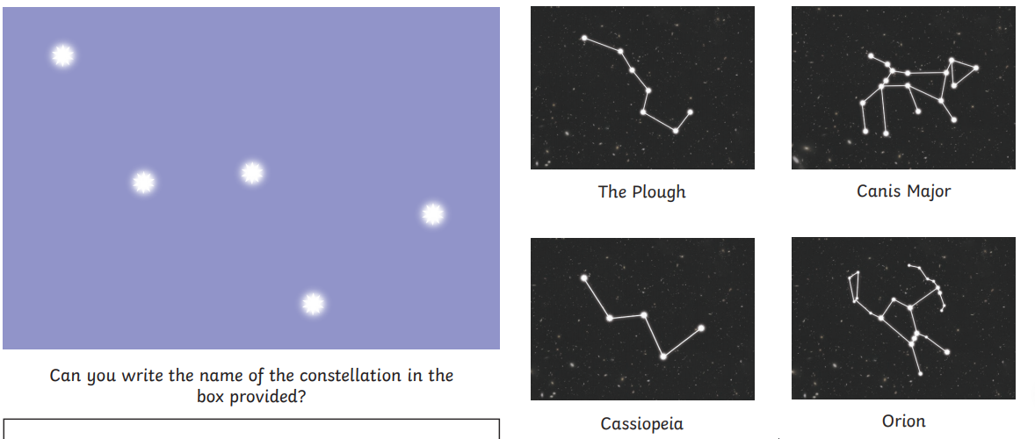
Which star constellation is this??
Can you make it now with your play doh and spaghetti or sticks?

Slide 3
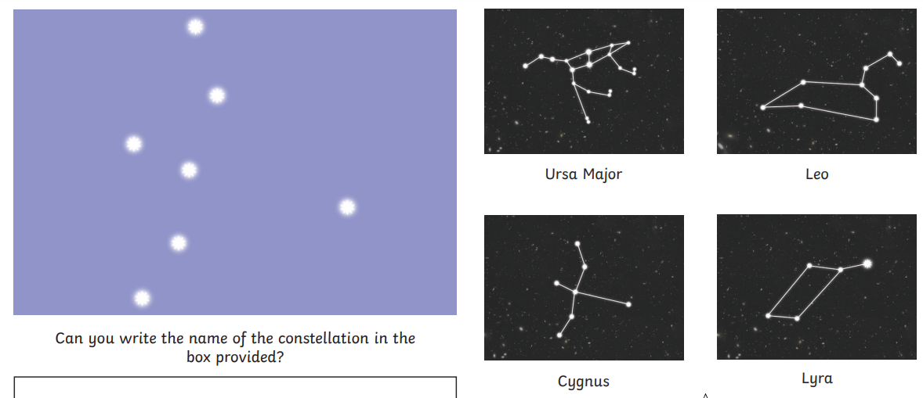
Which star constellation is this??
Can you make it now with your play doh and spaghetti or sticks?

Slide 4
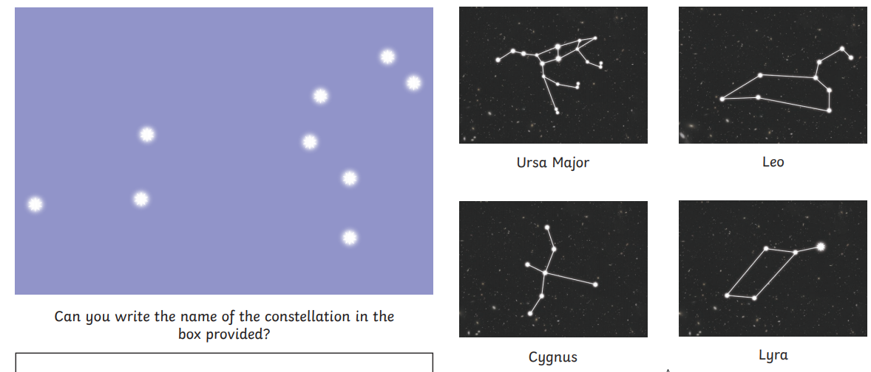
Which star constellation is this??
Can you make it now with your play doh and spaghetti or sticks?

Slide 5
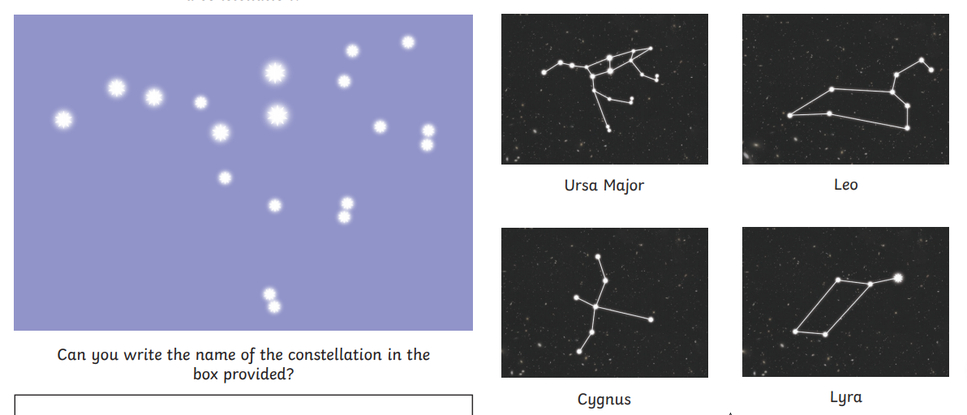
Which star constellation is this??
Can you make it now with your play doh and spaghetti or sticks?
OPTIONAL EXTRA EXTRA HARD CHALLENGE!!

