Slide 1
Friday 22nd January

Slide 2
Today I would like you to try and complete these activities but at a time that suits you.
The details you need for today are all on this powerpoint or in the Friday file on the Remote Learning tab (week3).
Some exercise to wake us up with Joe Wickes or 5 a day - click this link
Registration from 9.30am – Teams (see invites)
Handwriting practise – see slide 3
Mathemagician Challenge – see slide 4
Spelling test – Teams OR together at home (slide 5)
Mathletics activities x2 (today or any other point in the week)
Science – see slide 7
Craft/Science activity – see slide 8 (optional!)

Slide 3

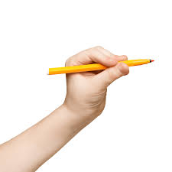
Handwriting
Please start with a warm up – can you make your body into a number 1 or a 2 or a 3??!! Then click this link.
Use your whiteboard to practise numeral formation or use the printout saved to Week 3.

Slide 4
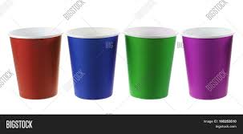
Mathemagician Challenge
Click here for my input
(you will need 7 cups, water and milk)
7 Cups!!
The 3rd and the 5th cups are empty.
The last cup is the fullest.
The middle cup is half full.
The 1st cup is the only cup with milk in.
The 2nd cup is nearly empty.
The 6th cup is almost full.

Slide 5

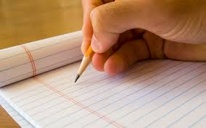
Spelling Tests
Moons – Teams Meeting 10.30am
Stars – Teams Meeting 10.50am
Rockets – Teams Meeting 11.10am
OR – feel free to complete a test at home with mum or dad at a time that suits you!! There is no pressure to attend with me! Please do send me your result though!!

Slide 6

Mathletics:
Please try to complete 1or 2 activities that have been set for you.

Slide 7
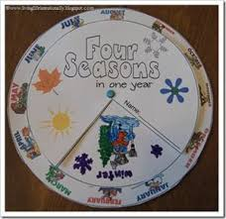
Science:
Please see separate Winter Powerpoint on Week 3 of my Fridays tab in Remote Learning.

Slide 8
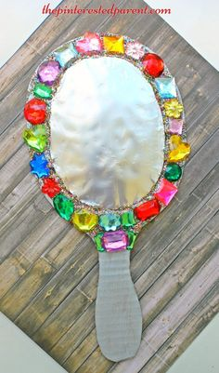
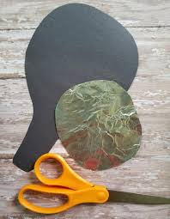
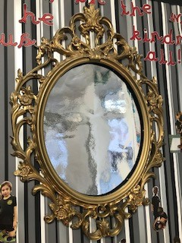
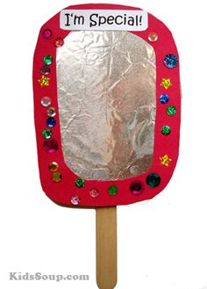
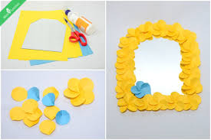
Optional Friday Craft!
Mirror Mirror on the wall, see the KINDNESS in us all!
Using the mirror paper in your Friday Fun envelope, can you design and make your own mirror to keep an eye on all the kind things you are doing for your family? Just like our mirror in the classroom!! It can be any shape and you can decorate the frame however you choose! It would be lovely to see all your designs.

Slide 9
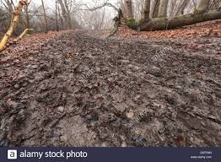
Weekend Challenge!
Who can find the MUDDIEST path?!
Don’t forget your wellies!!

