Slide 1

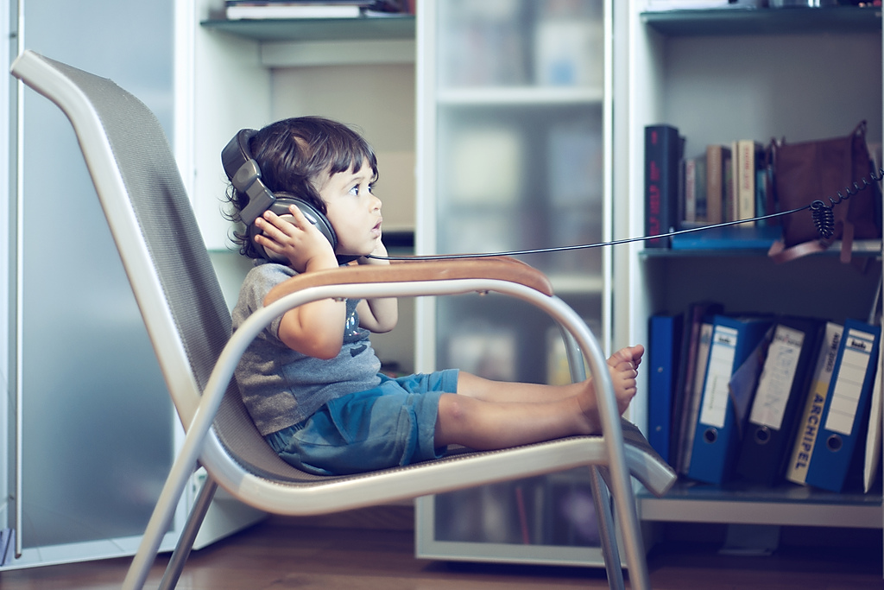

Photo courtesy of Philippe Put (@flickr.com) - granted under creative commons licence - attribution

Slide 2




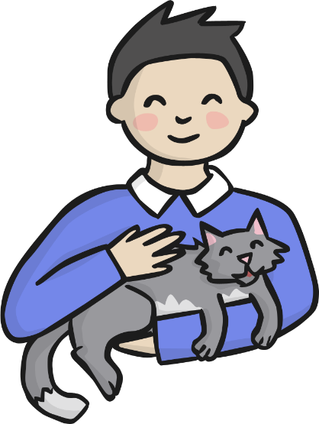


Slide 3
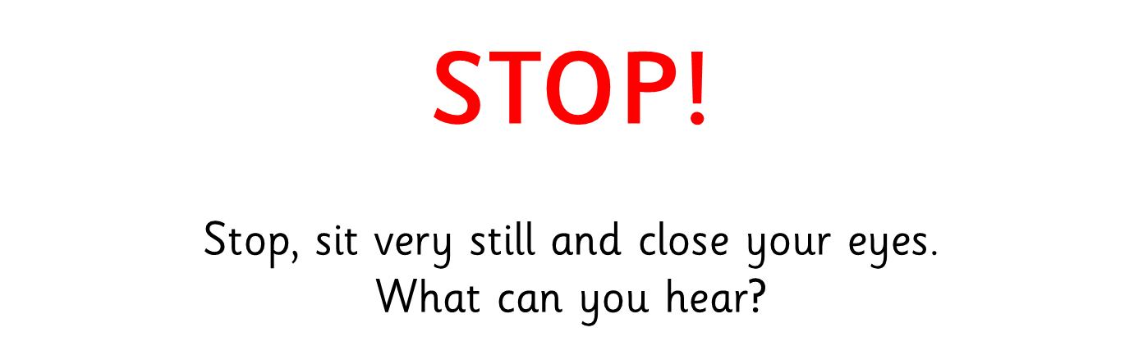

Slide 4
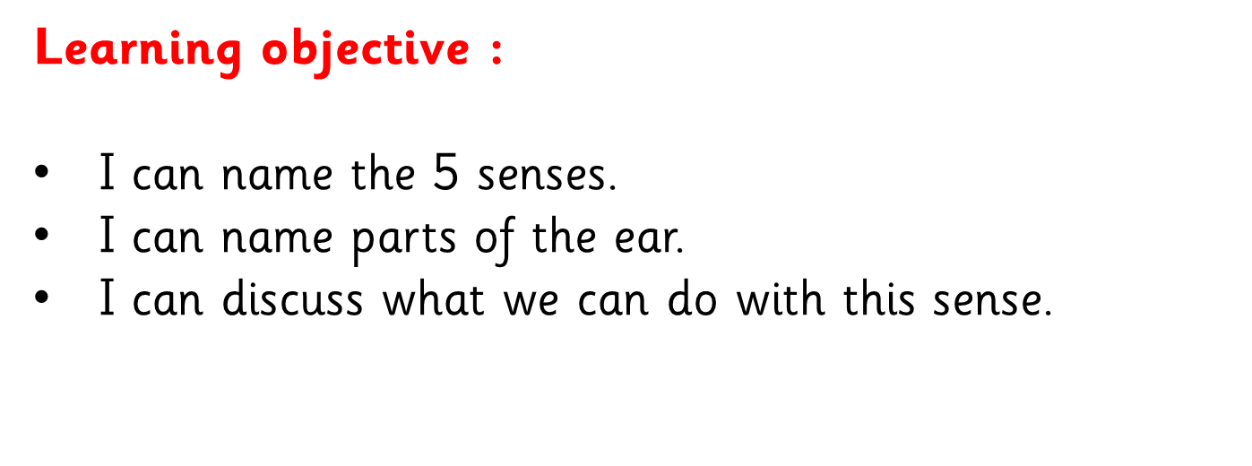

Slide 5
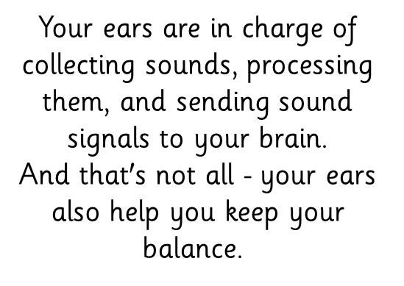
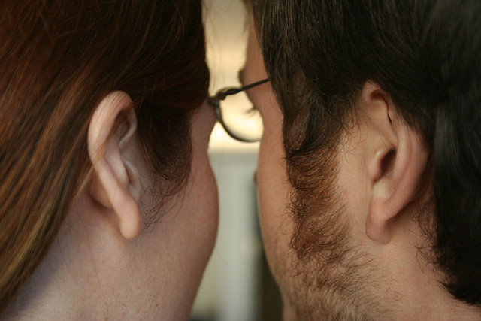
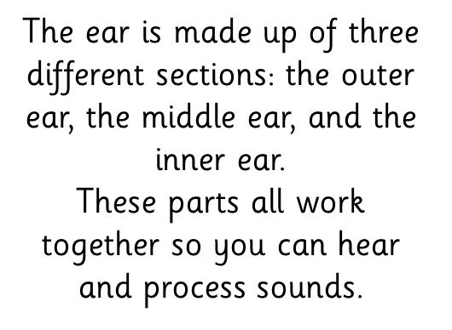
Photo courtesy of jordanfischer (@flickr.com) - granted under creative commons licence - attribution

Slide 6
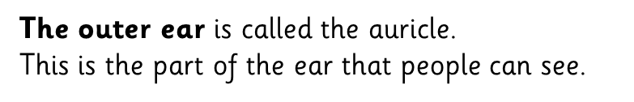
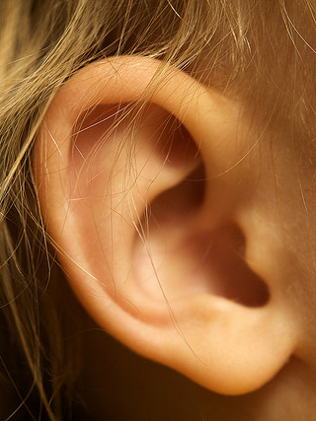
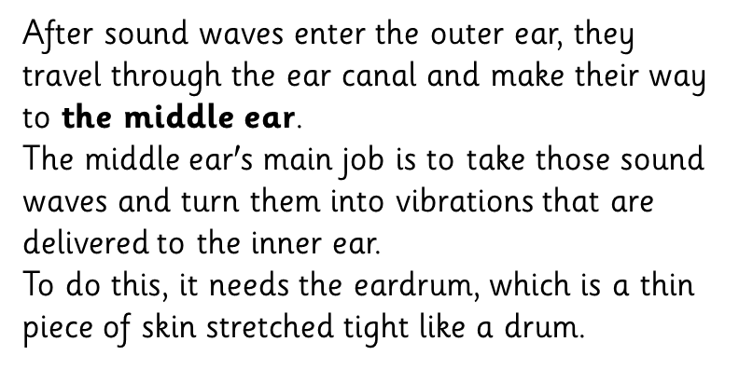
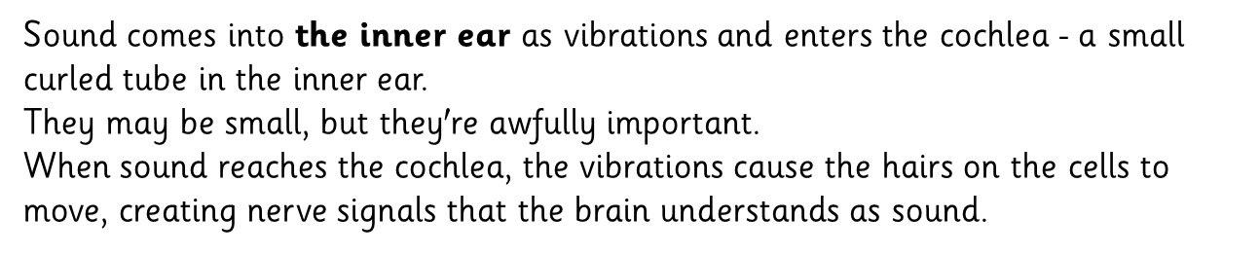
Photo courtesy of Travis Isaacs(@flickr.com) - granted under creative commons licence - attribution

Slide 7

Can you guess
the sounds?

Slide 8
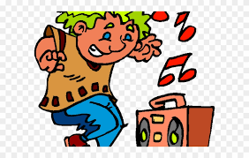
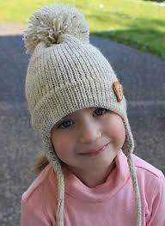
Now can you make up an experiment?
Remember to change just 1 thing each time you test.
Listen again to the sounds but perhaps change how far away you are from the laptop, or change what noise is already in the room you are in, or change what clothing you have over your ears – sun hat, woolly hat, ear muffs. Was it easier or was it harder to hear?
Before you start, try and predict what the answer might be.
At the end of the experiment write a sentence in your books about what you found out.

Slide 9
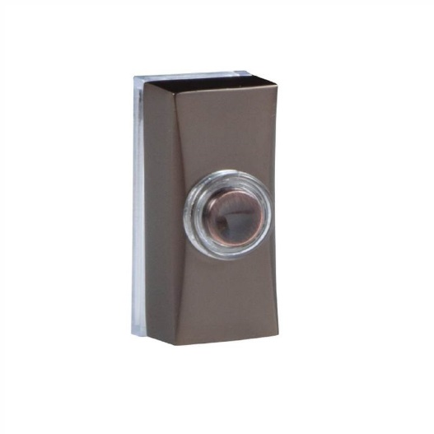
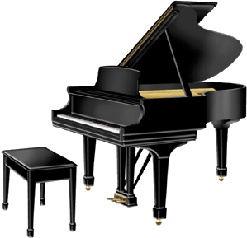
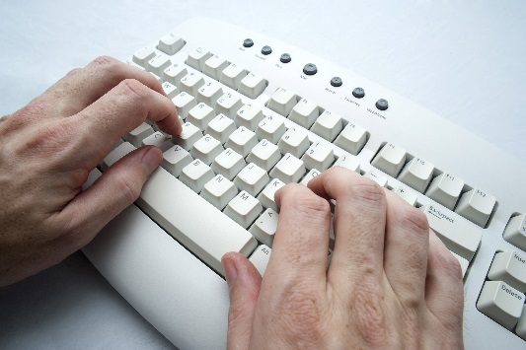
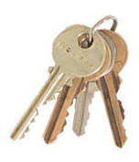
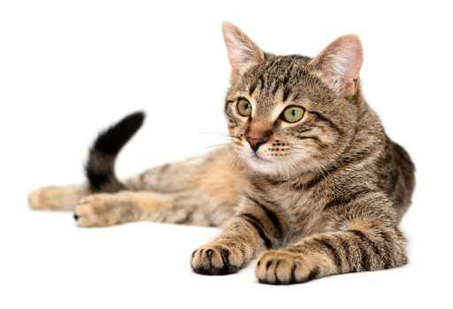
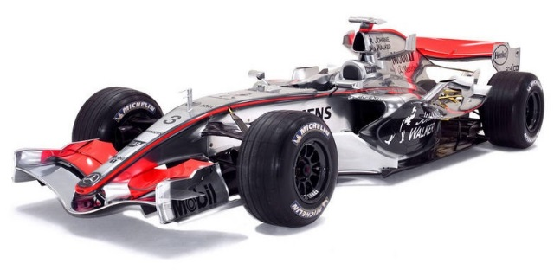

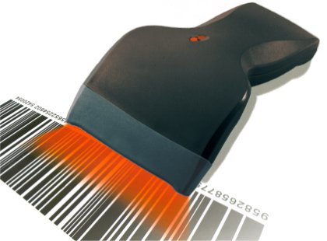
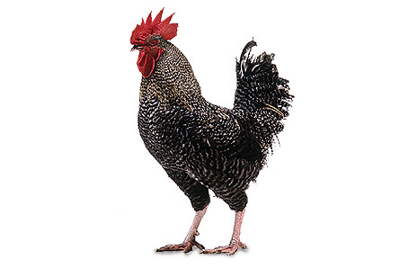
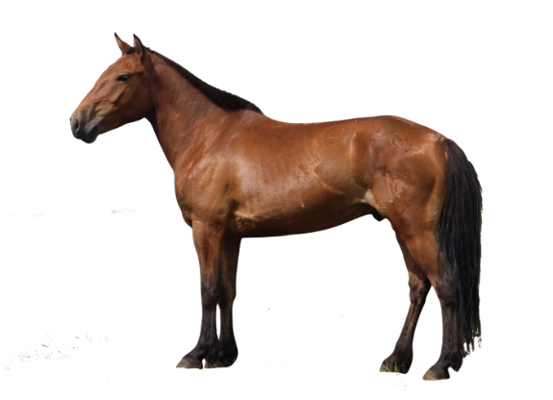
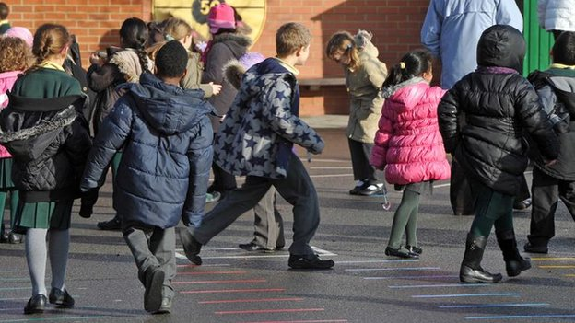
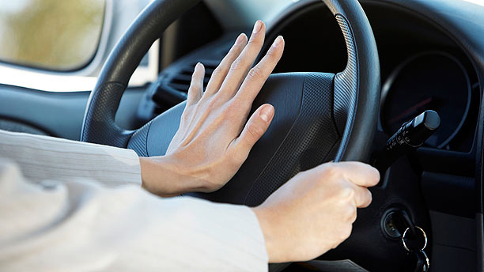
How many did
We guess right?

Slide 10
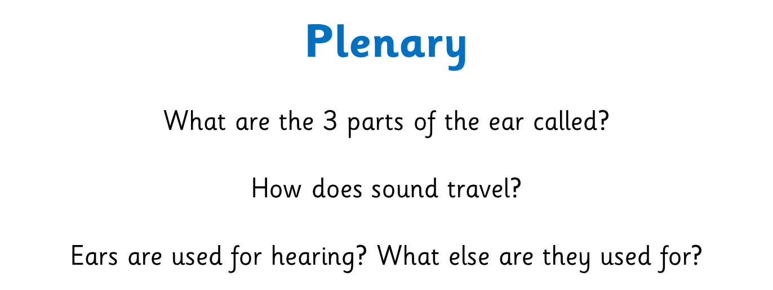

Slide 11
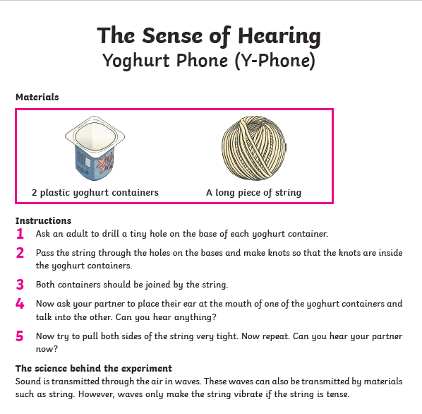
If you want to learn more – you could make a Yoghurt Pot Phone and see how sound waves are carried!
This is OPTIONAL!

