Slide 1

Friday 26th February

Slide 2
Today I would like you to try and complete these activities but at a time that suits you.
The details you need for today are all on this PowerPoint or in the Fridays Section of Remote Learning.
Some exercise to wake us up with Joe Wickes or 5 a day - click this link
Registration is now at 9.15am
Handwriting practise – see slide 3
Mathemagician Challenge – see slide 4
Spelling test – Teams OR together at home (slide 5)
Mathletics activities x2 (today or any other point in the week)
Science – see slide 7
Craft/Science activity – see slide 8 (optional!)

Slide 3
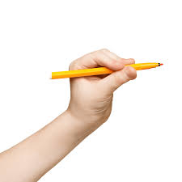
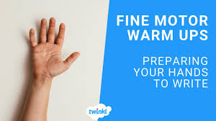
Handwriting:
Today is an 8-minute session with me. You will need your whiteboard, pen and rubber! Please click the link below.
Click here to watch me!!

Slide 4
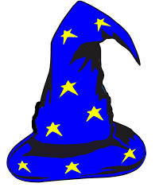
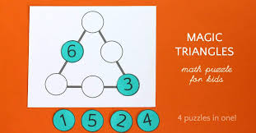
Mathemagician Challenge:
The Magic Triangle!!
Your Challenge!!

Slide 5
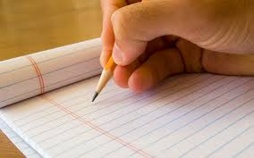
Spelling Tests – Please note the NEW times!!
Moons – Teams Meeting 9.40am
Stars – Teams Meeting 10.00am
Rockets – Teams Meeting 10.20am
OR – feel free to complete a test at home with mum or dad at a time that suits you!! There is no pressure to attend with me! Please do send me your result though!!

Slide 6

Mathletics:
Please try to complete 1 or 2 activities that have been set for you.

Slide 7
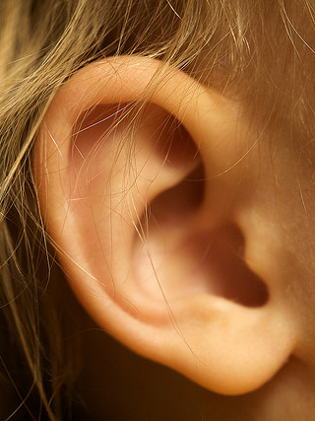
Science:
Sense of Hearing
Please start by listening to the story of Freddie and the Fairy! Story Link
And follow up with: Sound and Hearing PowerPoint (with me talking it through.)
Here is a recording sheet IF you choose to use it for the ‘listening’ task!
Science recording sheet
Sound and Hearing PowerPoint (without me!)

Slide 8
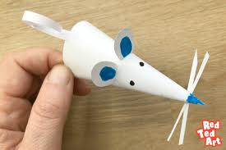
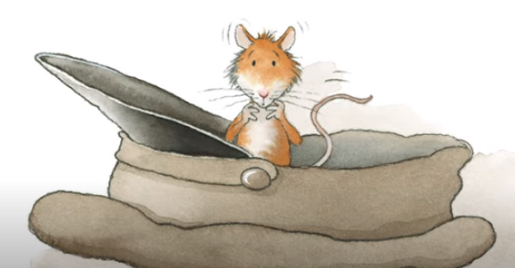
Optional Friday Craft!
Can you make Percy the Park Keeper’s Squeaky Mouse friend from the woods?!
Please Click Here!!

Slide 9
Dear parents, next week we will be looking at our sense of smell. Please can you have prepared a selection of smells ready for the lesson?!
The best thing to do is to put the smell onto cotton wool – can you do 2 of each as I would like to see if they can match the smells using their excellent sense!
Some Ideas:
lemon juice
• orange juice
• minty toothpaste
• pencil sharpenings
• perfume
• ginger
mud
• vanilla
• coffee (cold)
• chocolate
• onion
• garlic
• vinegar
About 5 would be great!! Thank you!!

Slide 10
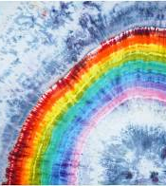
Have a lovely weekend!
One more week to go!!!

