Slide 1


Friday 5th March!
Your last day of home schooling!!!

Slide 2

Today is a Digital Detox Day so if you can please try and stay away from the computers!! I have attached my pre recorded lessons but there is no pressure to complete them today. We would be happier if you went for a walk and spotted the signs of Spring, shared a book together and worked on creating something from the remains of your Friday Fun envelope!
Signs Of Spring

Slide 3
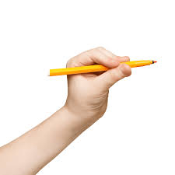

Handwriting:
Today is an 9-minute session with me. You will need your whiteboard, pen and rubber! Please click the link below.
Click Here to watch me and Nellie!!

Slide 4
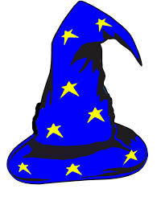
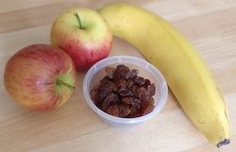
Mathemagician Challenge:
Fruity Pairs
Click Here!!

Slide 5
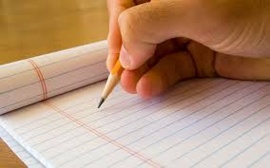
Spelling Tests
Today’s spelling tests will all need to be completed at home because it is Digital Detox Day and we are preparing classrooms for Monday!!
(Please do email me the results though and thank you!!)

Slide 6

Mathletics:
Please try to complete 1 or 2 activities that have been set for you.

Slide 7
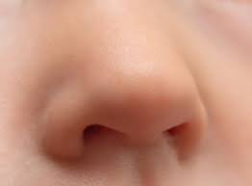

Science:
Sense of Smell
Please start by listening to the story of Smelly Bill! Click Here!!
And follow up with:
Sense of Smell PowerPoint
Here is a recording sheet IF you choose to use it for the ‘smelling’ task!
Smell recording sheet!

Slide 8

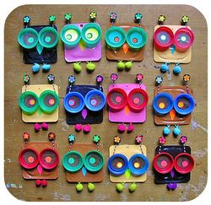
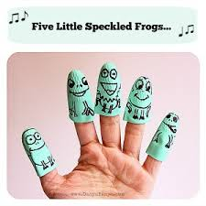
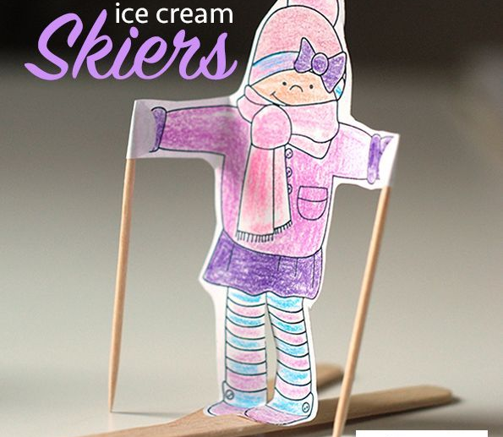
Free Friday!!
Today you are ‘screen free’ so please design, create and make using your left over items in the Friday Fun envelope and your amazing imaginations!! I can not wait to see what you come up with!! Have fun! (I have attached a couple of templates on the Friday page if you want them!)
Click Here

Slide 9

WOW!!
We DID IT!!!!!
Have an amazing weekend and I’ll see you in class next week!!!

