Slide 1


YEAR 1
Addition & Subtraction
Number bonds to 10
Compare number bonds
Add together
Add more
Finding a part
Block 2 – Week 6

Slide 2

Lesson 1
Step: Number bonds to 10

Slide 3

Fluency
How many more spots would the butterfly need to make ten?
5 more spots to make 10.

Slide 4

Fluency
How many more spots would the toadstool need to make ten?
2 more dots to make 10.

Slide 5

Fluency
How many more spots would the bow need to make ten?
5 more dots to make 10.

Slide 6
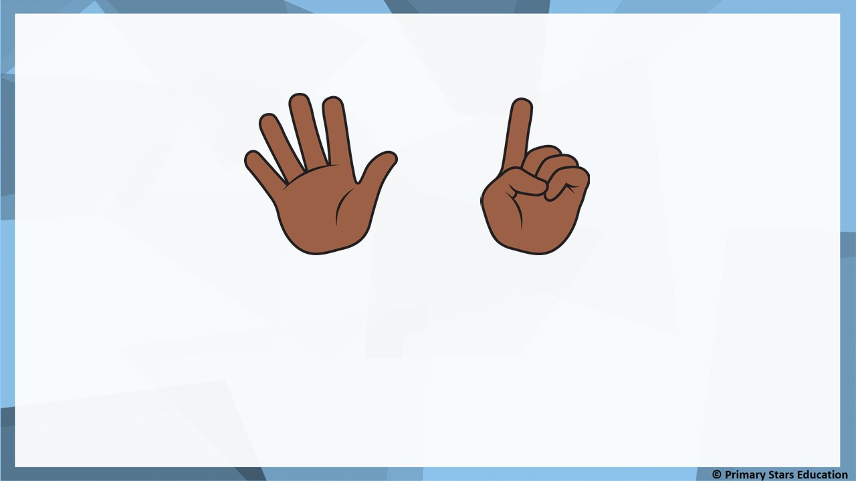
Fluency
How many more fingers need to be shown to make 10?
4 more fingers are needed.
Write a number sentence to represent this:
6 + 4 = 10

Slide 7
Fluency
Complete the number bonds to 10.
8
4
2 + _____ = 10
6 + _____ = 10

Slide 8
Fluency
Complete the number bonds to 10.
5
5
7
3
_____ + _____ = 10
_____ + _____ = 10

Slide 9

Fluency
Match the number bonds to 10.
6
7
3
9
8
4
1
2

Slide 10
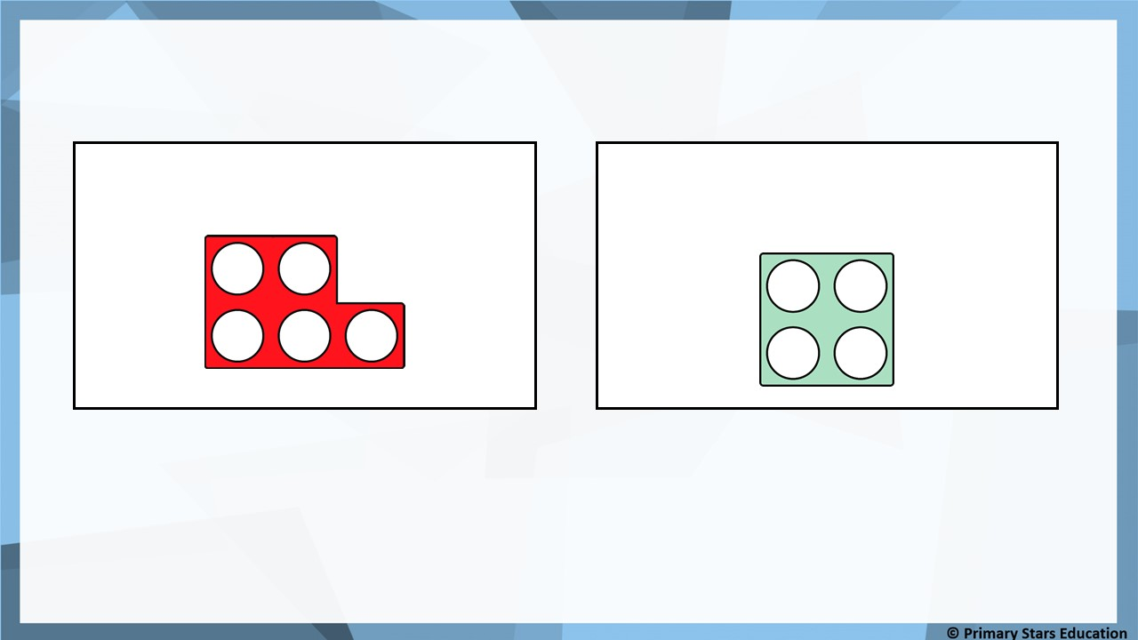
Reasoning
Two number frames need to make a total of 10.
This is the first number frame:
Kat says this is the second number frame:
Is Kat correct?
No, Kat is not correct. 5 + 4 = 9 (not 10).

Slide 11
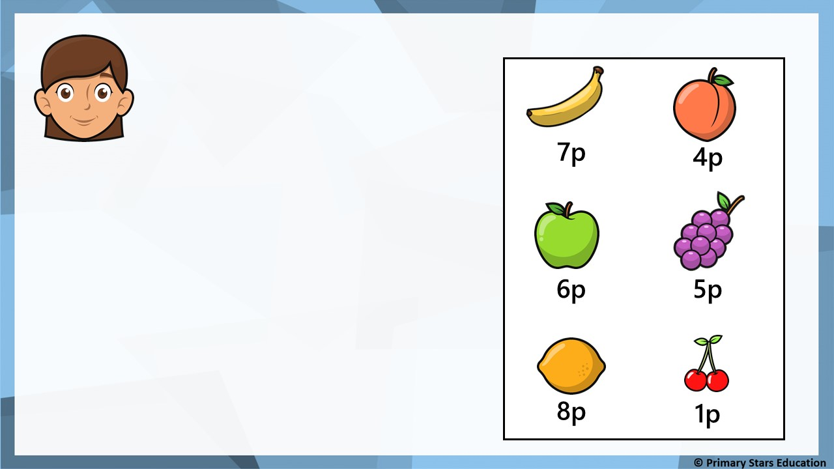
Problem solving
I have 10p to spend.
Which two items could Beth have bought if she spent the whole amount?
Beth could have bought:
Apple and peach (6p + 4p = 10p)
Two lots of grapes (5p + 5p = 10p).

Slide 12
Lesson 2
Step: Compare number bonds

Slide 13
Fluency
Match the number bonds.
5 + 4
5 + 5
2 + 5
3 + 6
3 + 7
5 + 3
2 + 6
4 + 3

Slide 14
Fluency
Match the number bonds.
+
+
+
+
+
+
+
+

Slide 15
Fluency
Tick the number sentence that show equal bonds.
6 + 2
2 + 7
5 + 2
✓
1 + 6
1 + 8
7 + 3
3 + 4
4 + 5

Slide 16
Fluency
Use <, > or = to make the comparisons correct.
2 + 7
<
7 + 3
5 + 4
>
2 + 6
8 + 1
=
9 + 0
5 + 2
=
4 + 3

Slide 17
Fluency
Use <, > or = to make the comparisons correct.
9 + 1
>
3 + 6
7 + 2
=
4 + 5
6 + 2
<
4 + 5
1 + 6
=
7 + 0

Slide 18

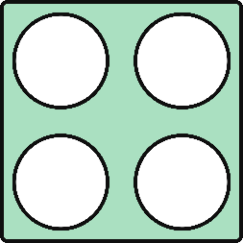


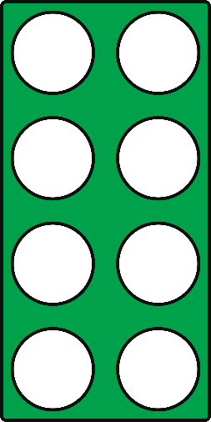
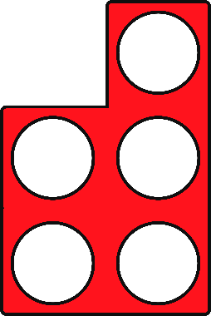

Fluency
Compare the number frames using <, > or =.
<
=
>

Slide 19
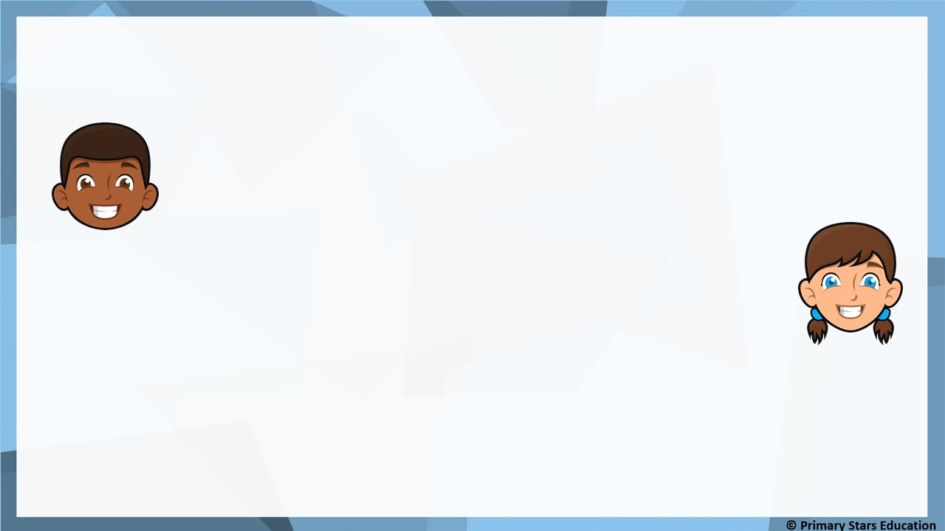
Reasoning
5 + > 2 + 6
?
The number 3 could go in the box.
Mo
The number 4 could go in the box.
Jess
Who do you agree with?
Explain why.
Jess as 5 + 4 = 9 and this is greater than 2 + 6 which equals 8.

Slide 20
Problem solving
Complete the number sentences to make them true.
+
<
+
+
>
+
+
=
+

Slide 21
Lesson 3
Step: Add together

Slide 22
Fluency
If 2 is a part and 4 is a part, what is the whole?
6
2
+
4
=
6
2
4

Slide 23
Fluency
If 3 is a part and 5 is a part, what is the whole?
8
3
+
5
=
8
3
5

Slide 24
Fluency
If 6 is a part and 4 is a part, what is the whole?
10
6
+
4
=
10
6
4

Slide 25
Fluency
There are 2 blue balloons and 3 yellow balloons.
How many altogether?
2
+
3
=
5
5
=
2
+
3

Slide 26
Fluency
There are 5 blue buses and 4 yellow buses.
How many altogether?
5
+
4
=
9
9
=
5
+
4

Slide 27
Fluency
There are 5 blue pencils and 5 yellow pencils.
How many altogether?
5
+
5
=
10
10
=
5
+
5

Slide 28

Reasoning
I have 4 yellow balls and 6 red balls. This means I have 9 balls altogether.
Is Ben correct?
Explain how you know.
No. Ben has 10 balls altogether as 4 + 6 = 10.

Slide 29
Problem solving
Use the bar model to create four number sentences.
5
+
3
=
8
8
5 | ?
3
+
5
=
8
8
=
5
+
3
8
=
3
+
5

Slide 30
Lesson 4
Step: Add more

Slide 31
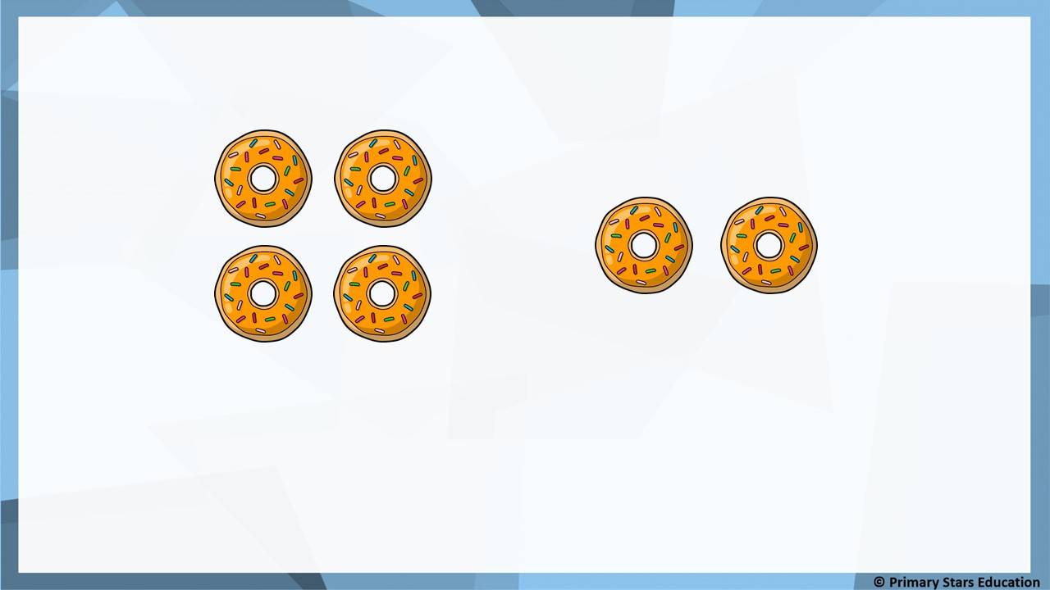
Fluency
How many doughnuts are there in total?
2
6
4 + _____ = _____
6
There are ______ doughnuts.

Slide 32
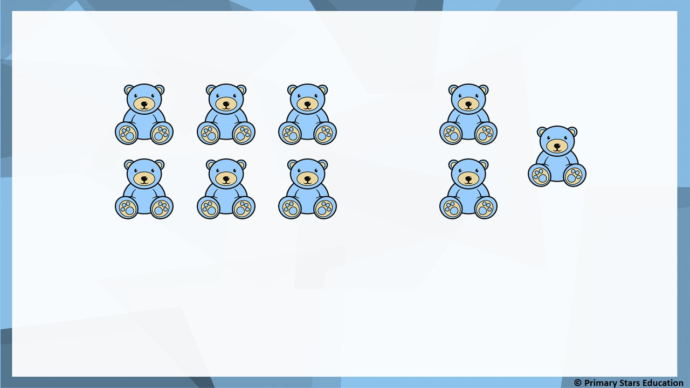
Fluency
How many bears are there in total?
3
9
6 + _____ = _____
9
There are ______ bears.

Slide 33
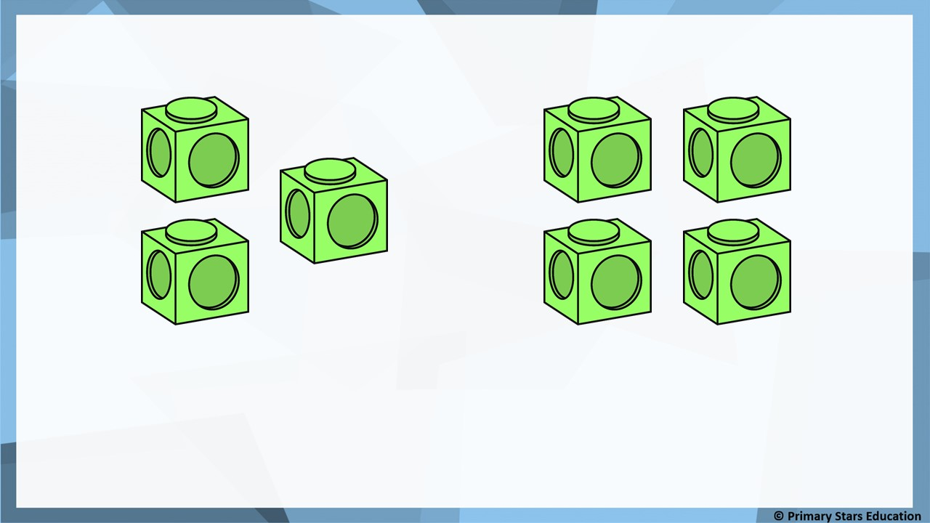
Fluency
How many cubes are there in total?
4
7
3 + _____ = _____
7
There are ______ cubes.

Slide 34


Fluency
Complete:
First | Then | Now | Number sentence
4
+
3
=
7
5
+
4
=
9

Slide 35


Fluency
Complete:
First | Then | Now | Number sentence
6
+
2
=
8
3
+
2
=
5

Slide 36

Reasoning
If a 0 is added to a number, the number stays the same.
True or false?
Explain how you know.
True.
When adding 0 the number will always stay the same as nothing is being added.

Slide 37

Problem solving
Points are scored when the ball lands in the hole.
Kat plays 2 balls.
Kat’s first ball scored 3 points.
What is the highest and lowest score Kat could get from both balls?
2
3
4
5
Highest score: 8 (3 + 5 = 8).
Lowest score: 5 (3 + 2 = 5).

Slide 38
Lesson 5
Step: Finding a part

Slide 39
Fluency
Complete the part-whole model and number sentences.
3
+
2
=
5
5
5
=
3
+
2
2
2
3 is a part, _____ is a part.
5 is the whole.

Slide 40
Fluency
Complete the part-whole model and number sentences.
5
+
3
=
8
8
8
=
5
+
3
3
3
5 is a part, _____ is a part.
8 is the whole.

Slide 41
Fluency
Complete the part-whole model and number sentences.
4
+
6
=
10
10
10
=
4
+
6
6
6
4 is a part, _____ is a part.
10 is the whole.

Slide 42
Fluency
There are six pencils. Four of them are red.
How many are green?
4
+
2
=
6
6
6
=
4
+
2
4
2
2
4 is a part, _____ is a part.
6 is the whole.

Slide 43
Fluency
There are nine pencils. Six of them are blue.
How many are white?
6
+
3
=
9
9
9
=
6
+
3
6
3
3
6 is a part, _____ is a part.
9 is the whole.

Slide 44
Fluency
There are seven bows. Four of them are purple.
How many are pink?
4
+
3
=
7
7
7
=
4
+
3
4
3
3
4 is a part, _____ is a part.
7 is the whole.

Slide 45

Reasoning
The missing number is 5.
9
Jess
4
?
The missing number is 6.
Dom
Who is correct?
Explain how you know.
Jess is correct as 4 + 5 = 9.

Slide 46


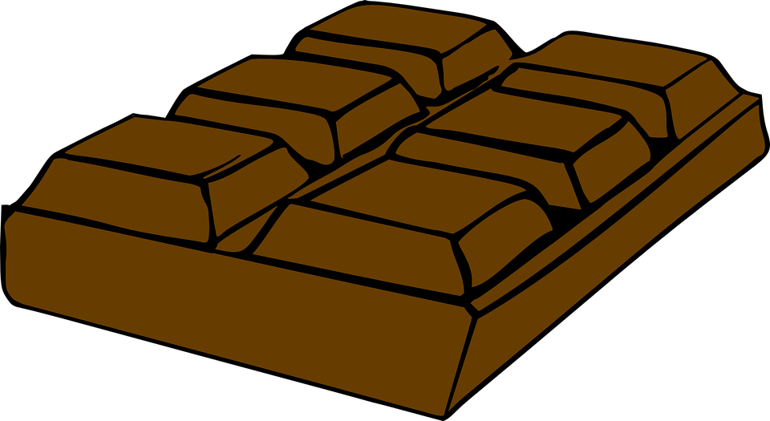


Problem solving
Matt spends 8p on a sweet and another item.
Doughnut
9p
Sweet
5p
Chocolate
4p
Muffin
7p
Lolly
3p
What was the other item? Explain how you know.
Lolly as it costs 3p. 5p + 3p = 8p.
Can you think of two other items can you buy for 10p?

