Slide 1
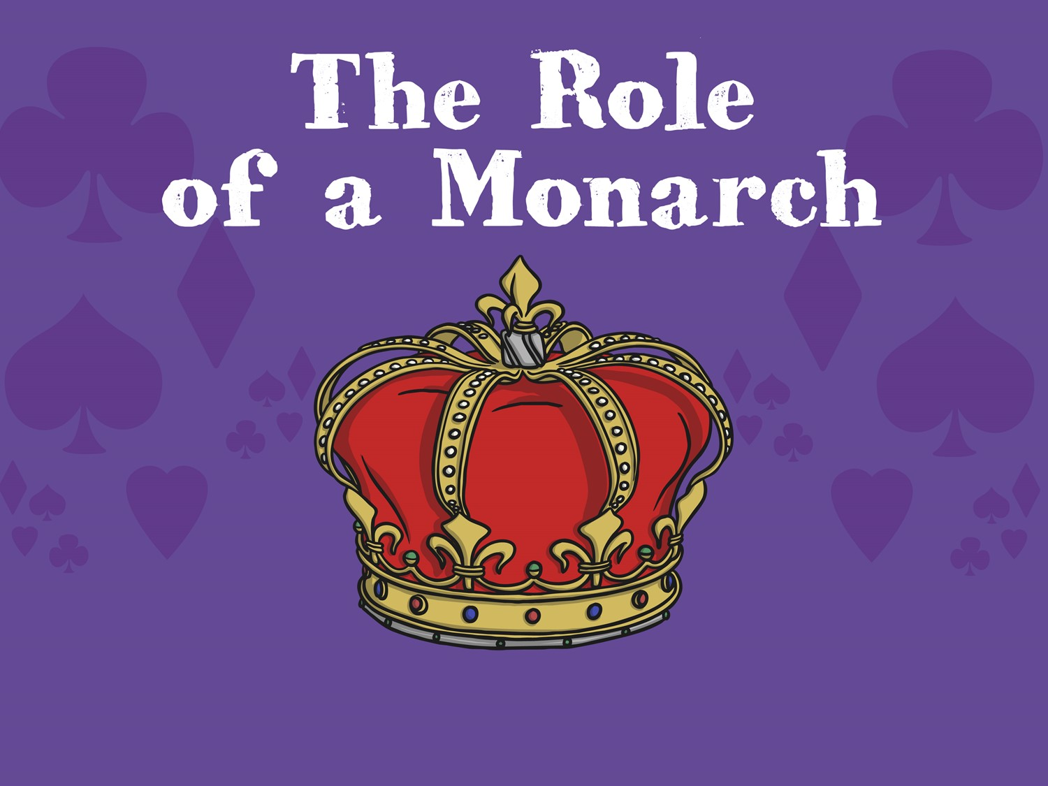

Slide 2
Aim
I can understand what a monarch is and the qualities needed to be a good monarch.
Success Criteria
I can talk about what a good monarch would do in different situations.
I can think of some rules and laws that I might create if I were a monarch.

Slide 3
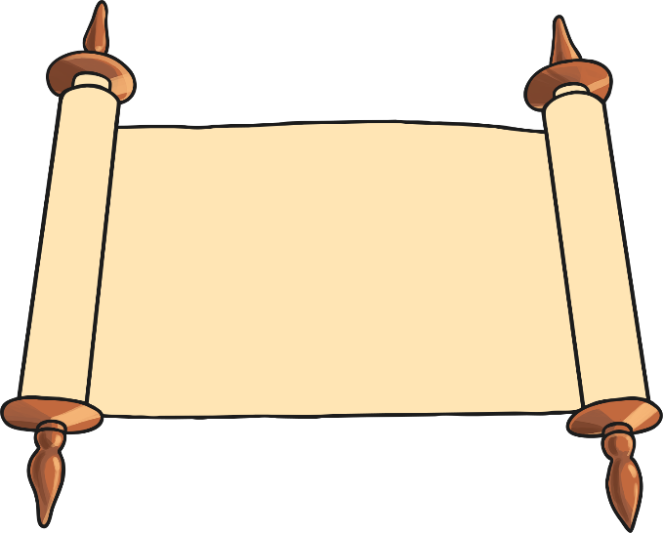
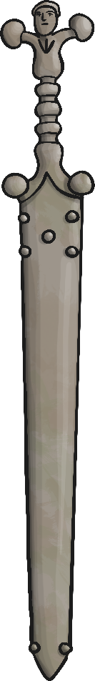

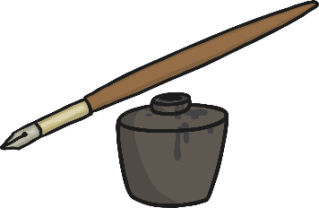
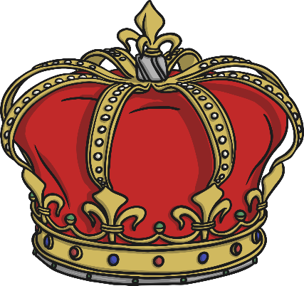
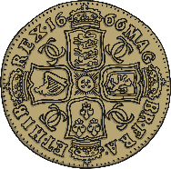
Royal Objects
Who would use these objects?

Slide 4
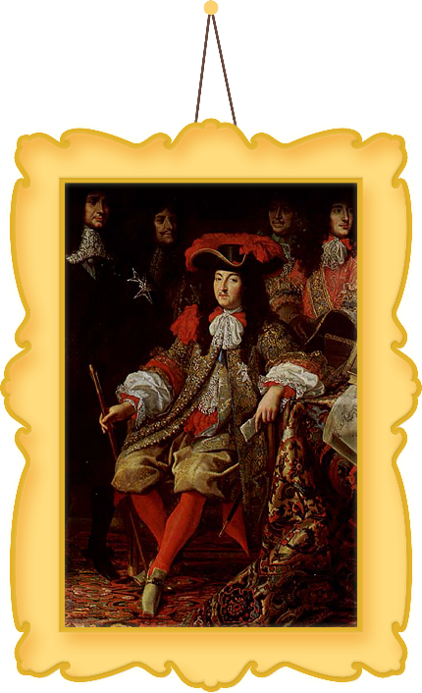
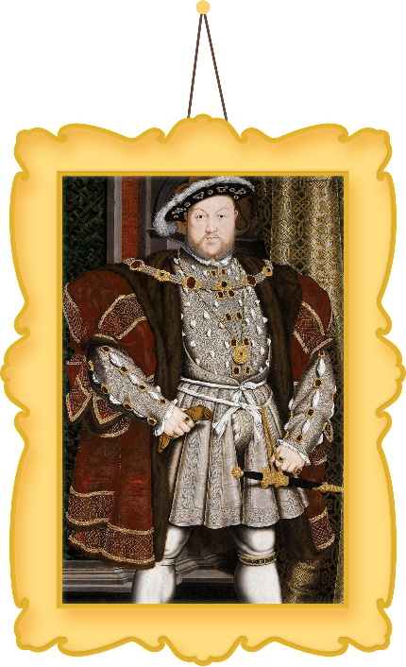
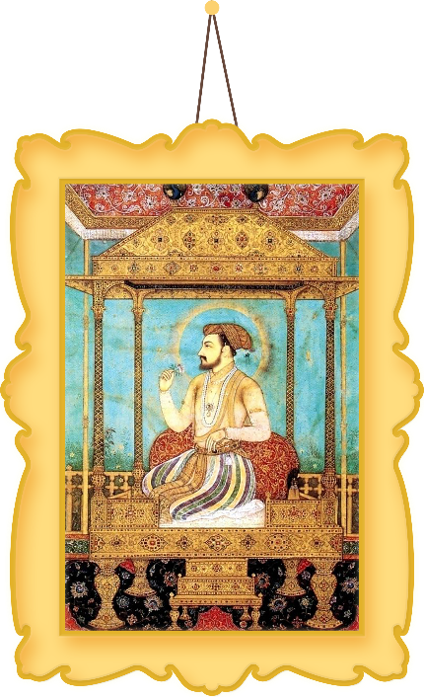
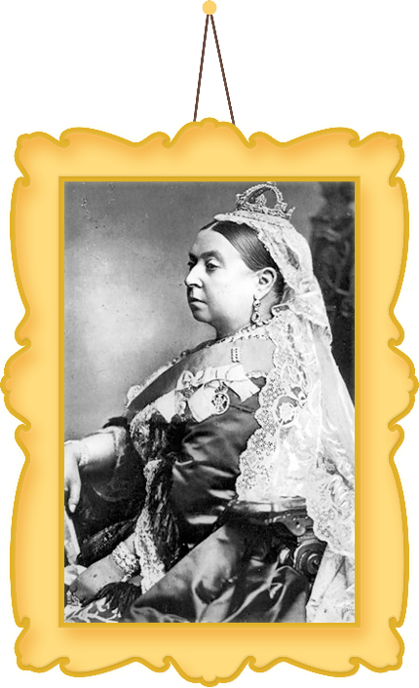
What is a Monarch?
A monarch is a king or queen, an emperor or a sultan. They are usually part of a royal family and rule as monarch until their death, or if they decide to abdicate.
Louis XIV
Henry VIII
Shah Jahan
Queen Victoria

Slide 5



Royal Objects
What does a monarch do?
The scroll and pen is for the king or queen to write rules and laws for the country.
The sword represents the king or queen’s role to defend the country from enemies who may want to take over.
The book helps the king or queen to make good choices and decisions.
The crown represents how powerful the king or queen is in the country.
The money represents the king or queen paying for things for the people in the country.

Slide 6
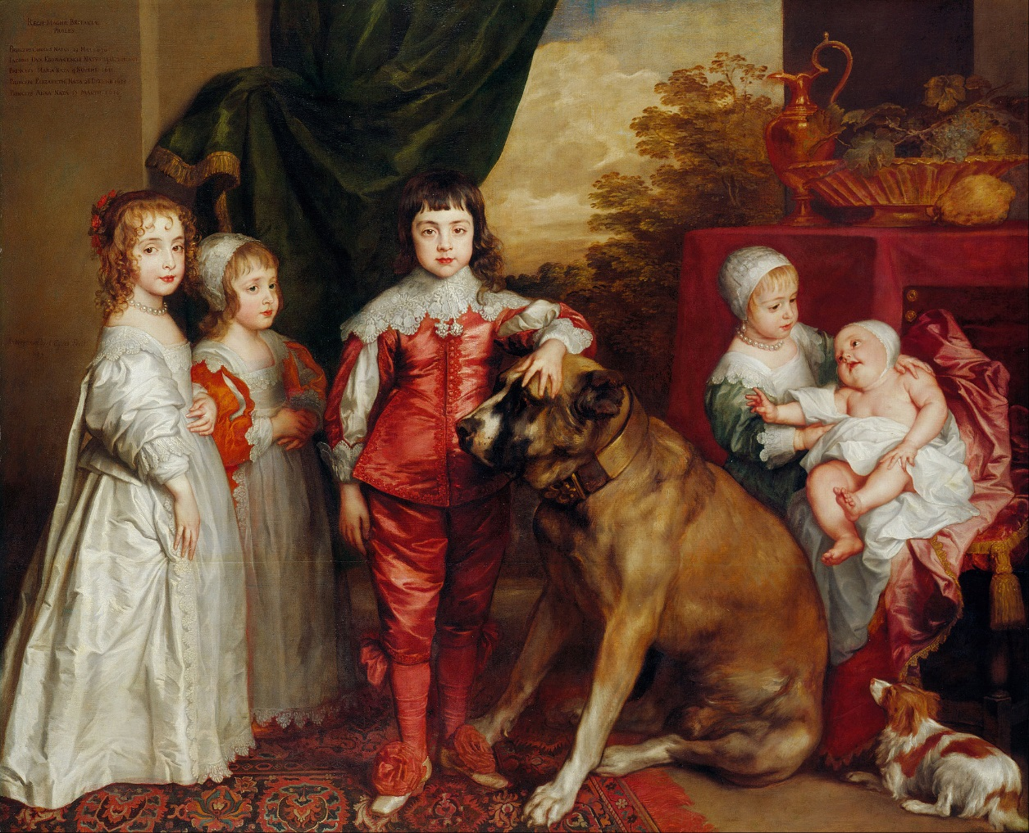
Next in Line who becomes the next king or queen?
Can you tell which child in the painting is to become the next monarch?
Nowadays. It is the eldest child who becomes the next king or queen (whether they are male or female).
In the United Kingdom, the tradition is that the eldest son of the king and queen becomes the next king (unless there are no sons and then the eldest daughter becomes queen).

Slide 7
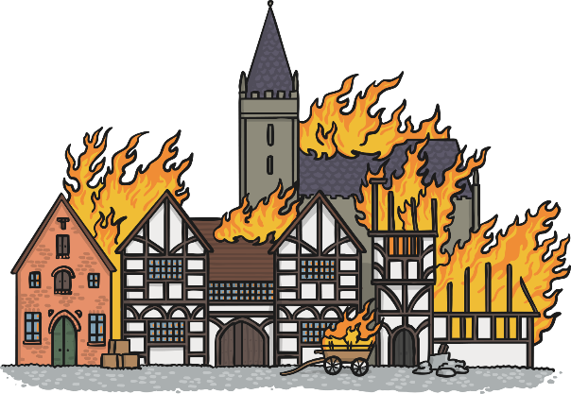

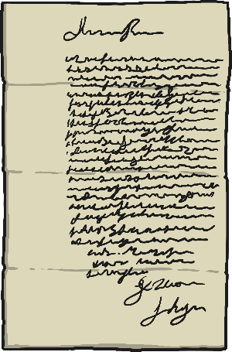
Monarchs
What would a good monarch do in these situations?
There has been a terrible fire in London. Lots of homes and buildings have been destroyed.
The king of Spain sends you a gift of twenty jewels.
You receive a letter asking you to attend the opening of a new school that is 200 miles away.
What qualities does a good monarch need to have?
Kind or selfish?
Helpful or mean?
Weak or brave?

Slide 8

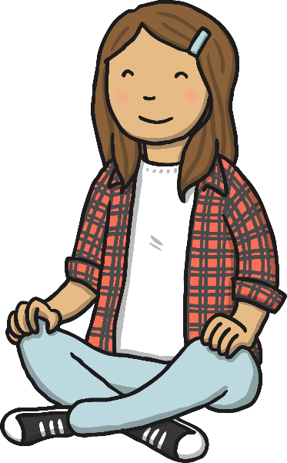
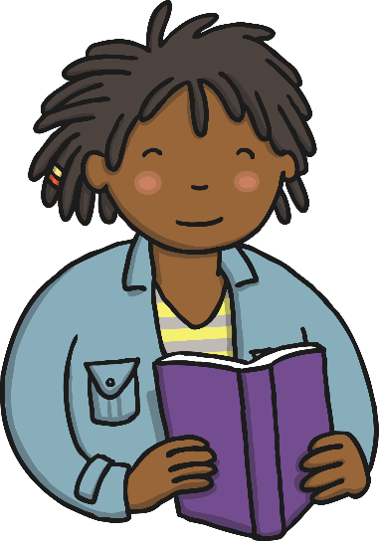
My Rules and Laws
What rules would you create if you were king or queen?
I would like you to design a poster and let me know how you would rule England.
What is important to you to rule ALL your people?
How are you going to be a good monarch?
Why should the country have that rule?

Slide 9
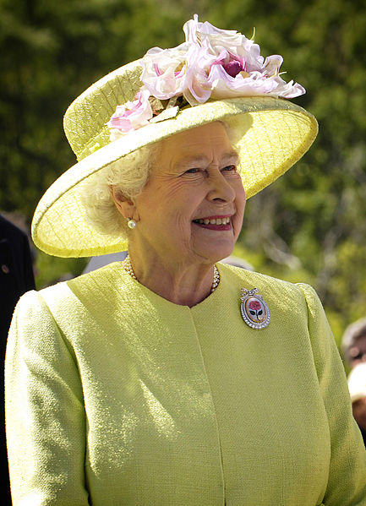
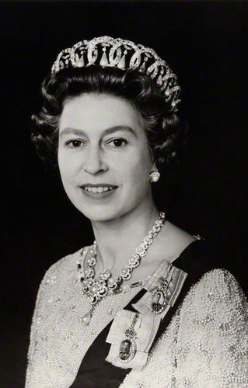
The Queen and Parliament
Elizabeth II became Queen of Great Britain and Northern Ireland in 1952.
Nowadays, the British monarch does not have as much power as they used to. Mainly the decisions about the country are decided by the people in the government, such as the Prime Minister.

Slide 10
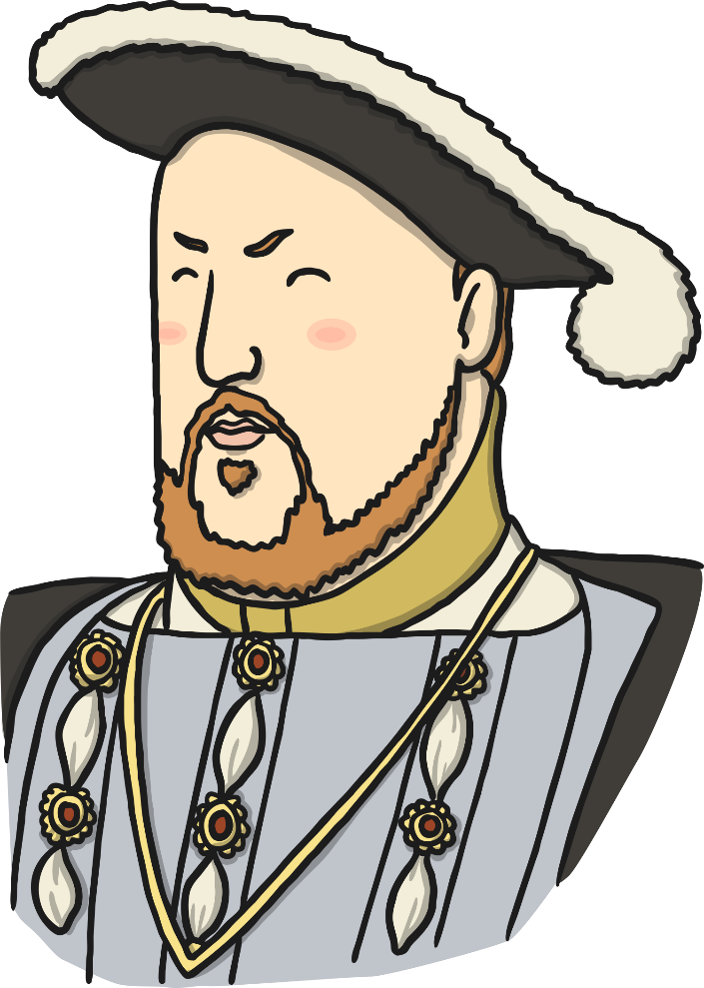
The Queen and Parliament
We have had kings and queens for hundreds of years, and the history of Britain is closely connected to them. Some of them were good people who tried to rule wisely and do their best for people. However, some were not very good! Some kings were cruel and mistreated people who disagreed with them.
People started to feel that the king should have some wise people to advise him, and that some of the great nobles, who owned a lot of land, should play a part in deciding how to run the country.

Slide 11
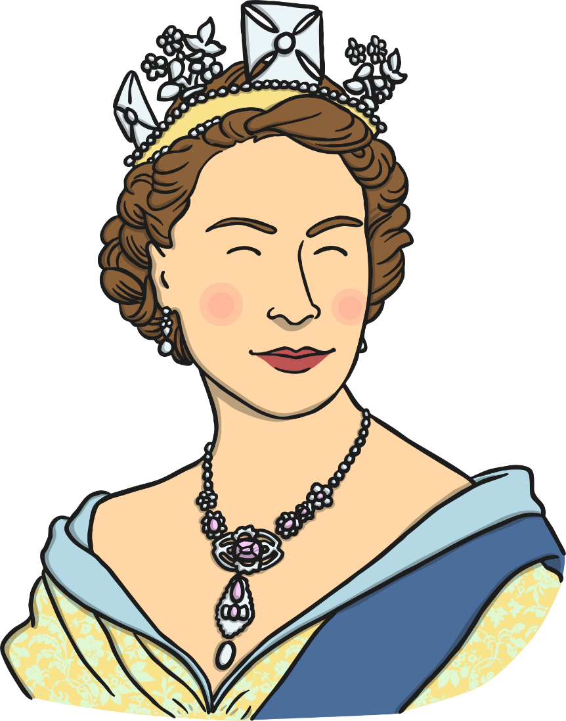
The Queen and Parliament
Sometimes the king found it helpful to call together these groups of nobles and church leaders to advise him on what to do, although he didn’t always agree with them or do what they wanted him to do! These gatherings came to be known as ‘parliaments’. The word comes from the French word ‘parler’ meaning ‘to talk’.
The Prime Minister became the person who was in charge of the parliament meetings.
Things have changed over time, but to this day the Prime Minister still meets with the queen every week to tell her what the government is doing. The Queen listens and offers advice to her Prime Minister.

Slide 12
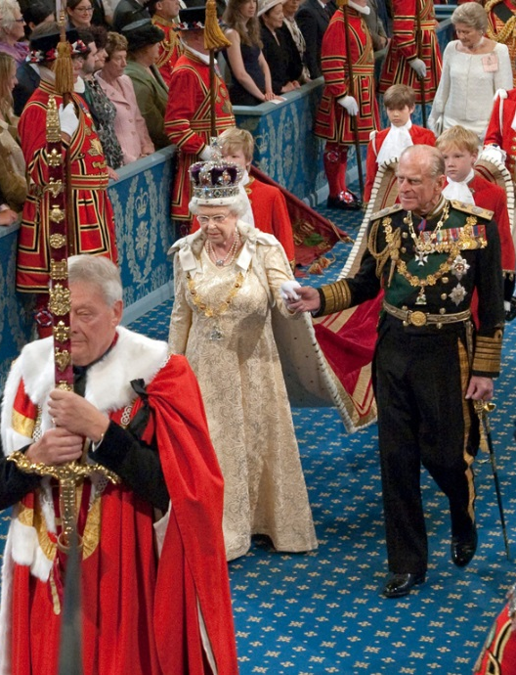
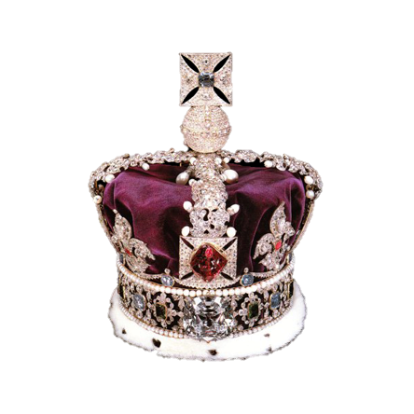
The Queen and Parliament
Elizabeth II wears the Imperial State Crown at the opening of Parliament.
St Edward’s Sapphire sits at the top of the crown. It is thought that this stone is over 1,000 years old!
According to various stories, when King Edward was on his way to a church ceremony, he met a beggar and when the King realised his pockets were empty, he gave his sapphire ring to the beggar. A few years later, two pilgrims from the Holy Land returned the ring to the King saying they had met Saint John who had given it to them.
The saint had been disguised as the beggar and congratulated the King on his kindness.
What quality of the monarch does this stone represent?

