Slide 1


Lesson 4
Step: Add more

Slide 2
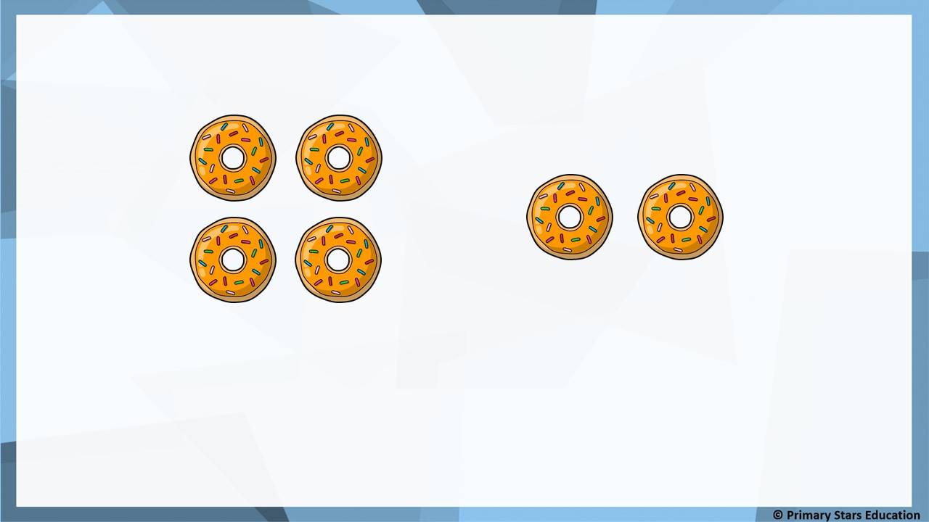
Fluency
How many doughnuts are there in total?
2
6
4 + _____ = _____
6
There are ______ doughnuts.

Slide 3
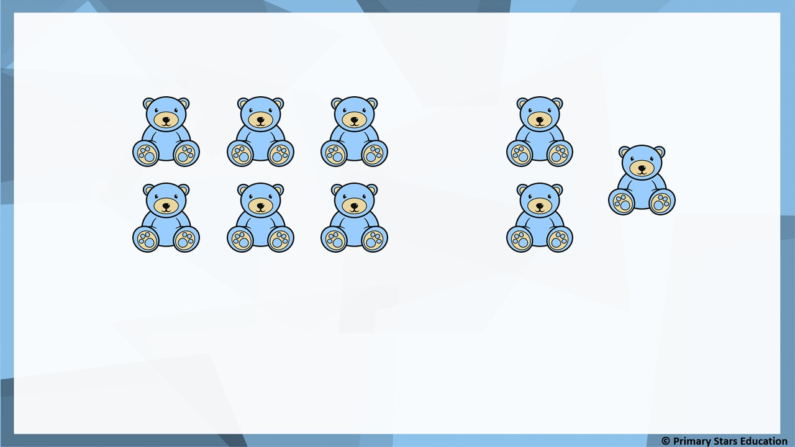
Fluency
How many bears are there in total?
3
9
6 + _____ = _____
9
There are ______ bears.

Slide 4
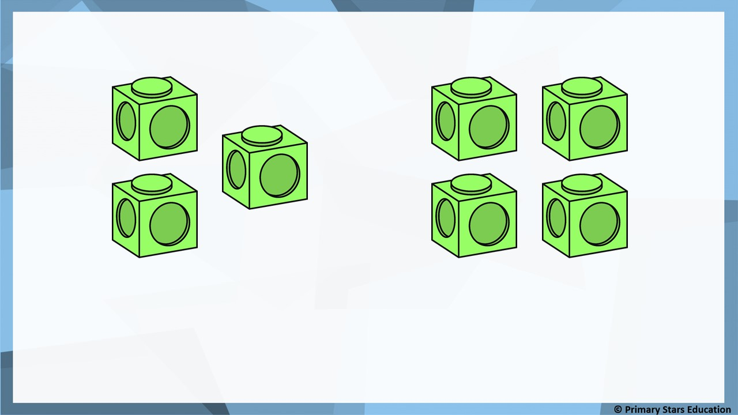
Fluency
How many cubes are there in total?
4
7
3 + _____ = _____
7
There are ______ cubes.

Slide 5


Fluency
Complete:
First | Then | Now | Number sentence
4
+
3
=
7
5
+
4
=
9

Slide 6


Fluency
Complete:
First | Then | Now | Number sentence
6
+
2
=
8
3
+
2
=
5

Slide 7

Reasoning
If a 0 is added to a number, the number stays the same.
True or false?
Explain how you know.
True.
When adding 0 the number will always stay the same as nothing is being added.

Slide 8

Problem solving
Points are scored when the ball lands in the hole.
Kat plays 2 balls.
Kat’s first ball scored 3 points.
What is the highest and lowest score Kat could get from both balls?
2
3
4
5
Highest score: 8 (3 + 5 = 8).
Lowest score: 5 (3 + 2 = 5).

Slide 9
Lesson 5
Step: Finding a part

Slide 10
Fluency
Complete the part-whole model and number sentences.
3
+
2
=
5
5
5
=
3
+
2
2
2
3 is a part, _____ is a part.
5 is the whole.

Slide 11
Fluency
Complete the part-whole model and number sentences.
5
+
3
=
8
8
8
=
5
+
3
3
3
5 is a part, _____ is a part.
8 is the whole.

Slide 12
Fluency
Complete the part-whole model and number sentences.
4
+
6
=
10
10
10
=
4
+
6
6
6
4 is a part, _____ is a part.
10 is the whole.

Slide 13
Fluency
There are six pencils. Four of them are red.
How many are green?
4
+
2
=
6
6
6
=
4
+
2
4
2
2
4 is a part, _____ is a part.
6 is the whole.

Slide 14
Fluency
There are nine pencils. Six of them are blue.
How many are white?
6
+
3
=
9
9
9
=
6
+
3
6
3
3
6 is a part, _____ is a part.
9 is the whole.

Slide 15
Fluency
There are seven bows. Four of them are purple.
How many are pink?
4
+
3
=
7
7
7
=
4
+
3
4
3
3
4 is a part, _____ is a part.
7 is the whole.

Slide 16

Reasoning
The missing number is 5.
9
Jess
4
?
The missing number is 6.
Dom
Who is correct?
Explain how you know.
Jess is correct as 4 + 5 = 9.

Slide 17


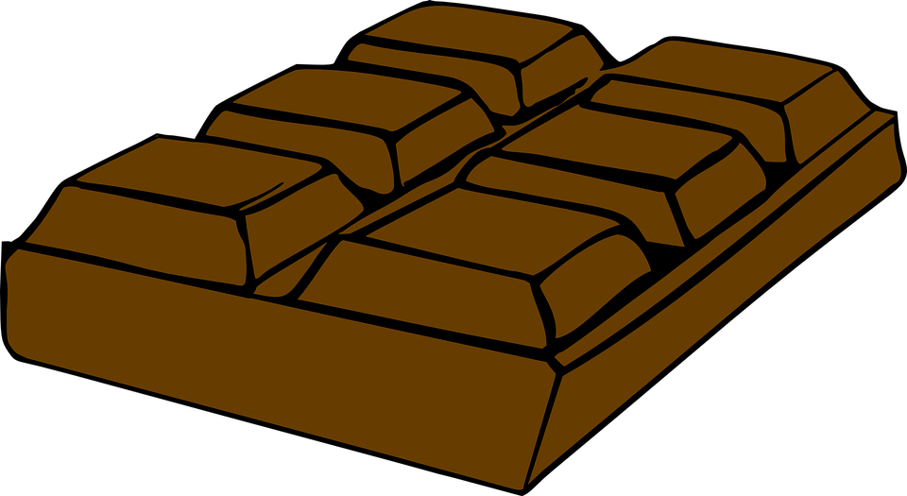


Problem solving
Matt spends 8p on a sweet and another item.
Doughnut
9p
Sweet
5p
Chocolate
4p
Muffin
7p
Lolly
3p
What was the other item? Explain how you know.
Lolly as it costs 3p. 5p + 3p = 8p.
Can you think of two other items can you buy for 10p?

