Slide 1


Lesson 5
Step: How many left (1)

Slide 2
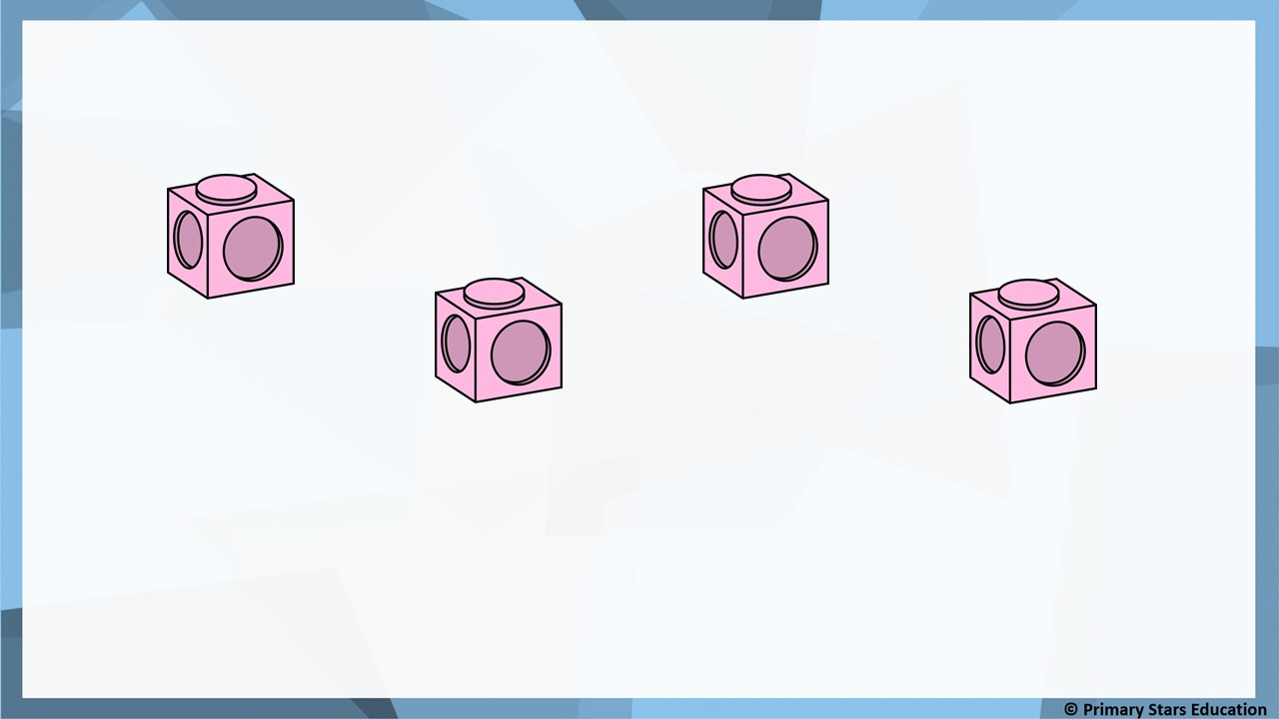
Fluency
There are 4 cubes. Take 3 away.
4
3
At first there were _______ cubes. Then _______ got taken away.
Now there is _______ cube.
1

Slide 3
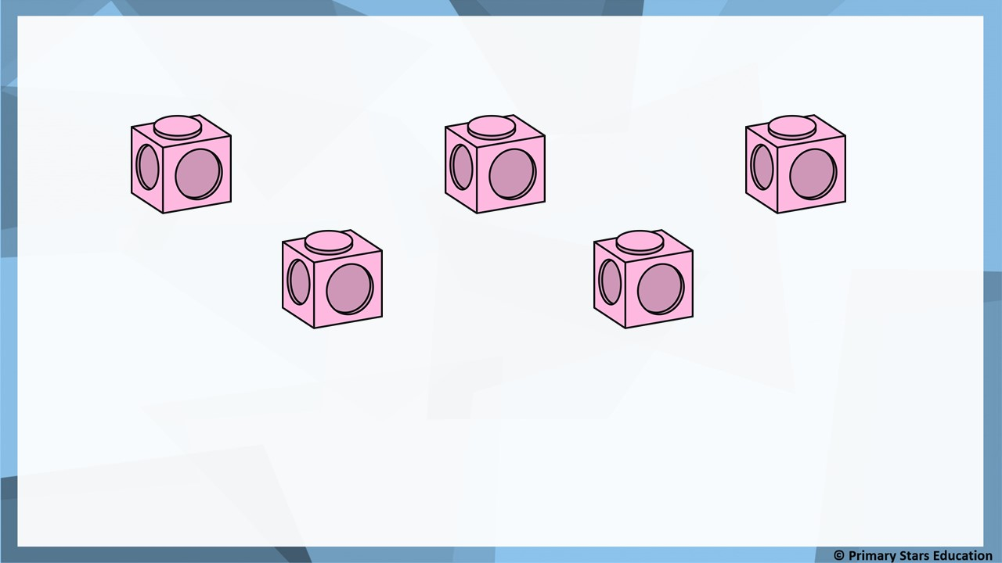
Fluency
There are 5 cubes. Take 2 away.
5
2
At first there were _______ cubes. Then _______ got taken away.
Now there are _______ cubes.
3

Slide 4
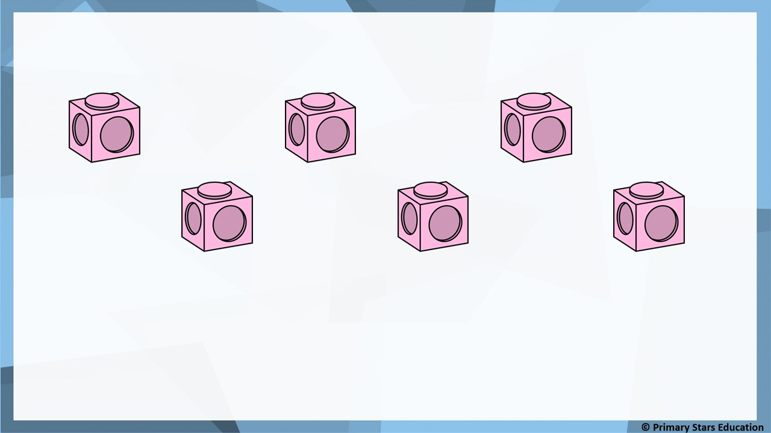
Fluency
There are 6 cubes. Take 4 away.
6
4
At first there were _______ cubes. Then _______ got taken away.
Now there are _______ cubes.
2

Slide 5
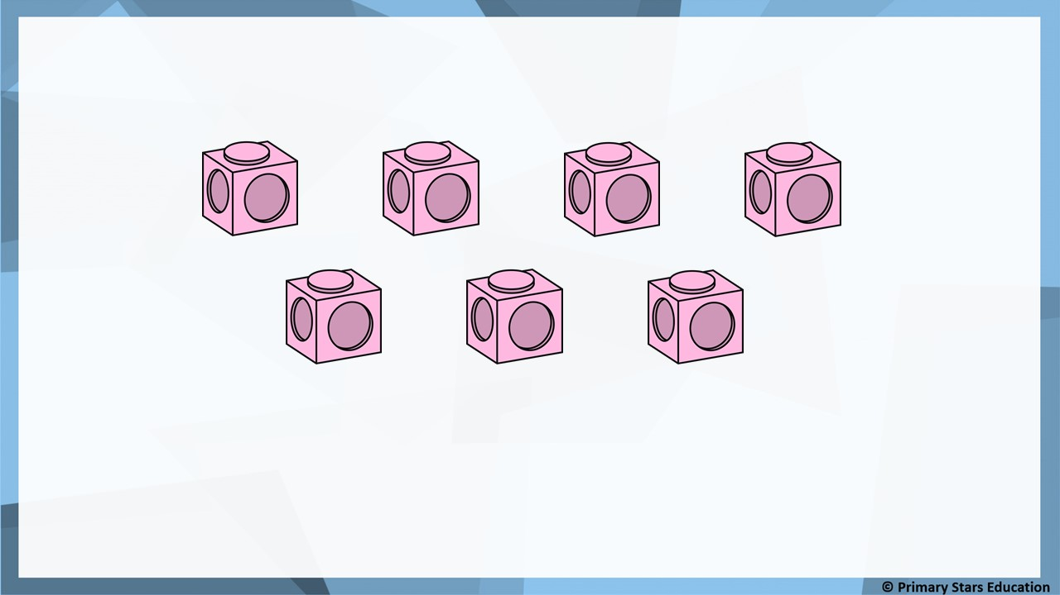
Fluency
There are 7 cubes. Take 3 away.
7
3
At first there were _______ cubes. Then _______ got taken away.
Now there are _______ cubes.
4

Slide 6
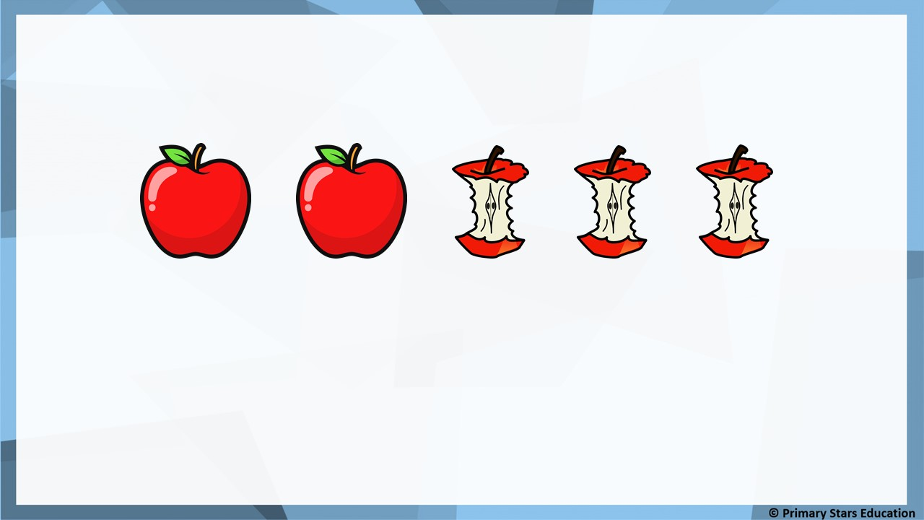
Fluency
Complete the sentences.
5
3
At first there were _______ apples. Then _______ were eaten.
Now there are _______ apples.
2

Slide 7
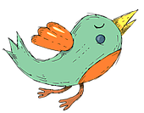
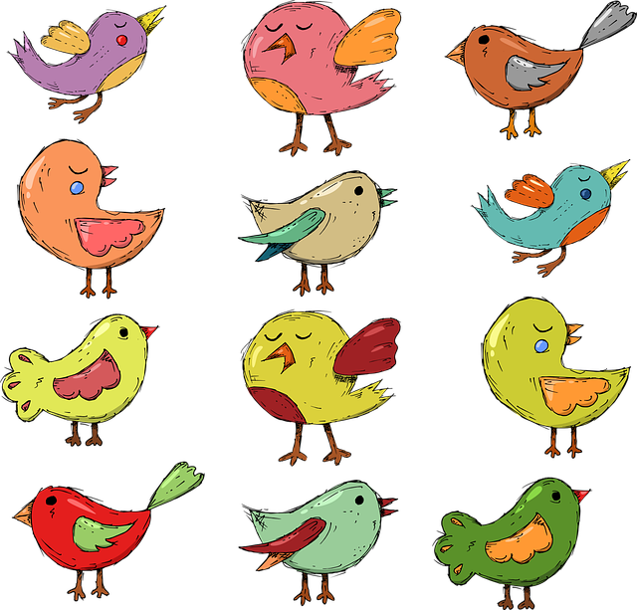
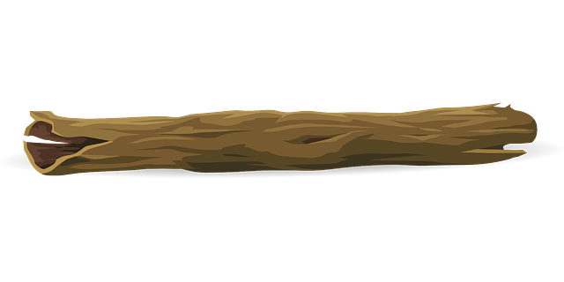
Fluency
Complete the sentences.
6
4
At first there were _______ birds. Then _______ flew away.
Now there are _______ birds.
2

Slide 8
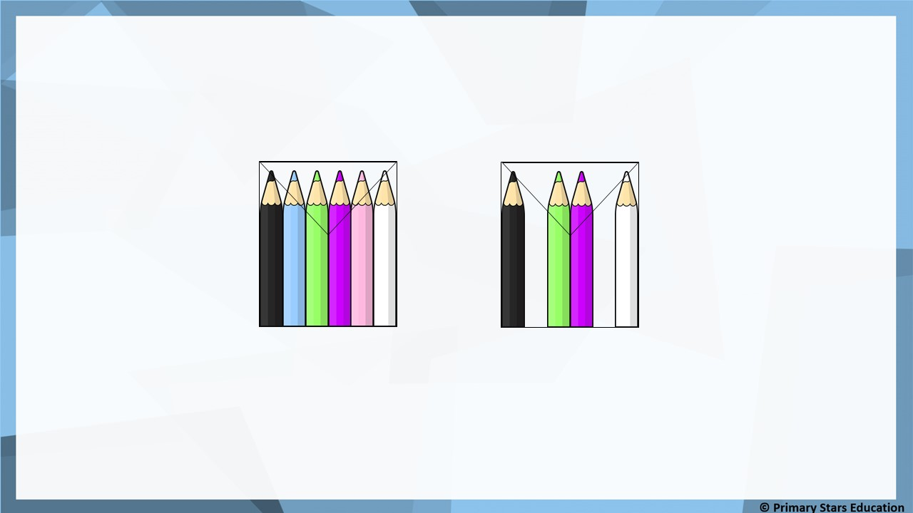
Reasoning
At first there 6 were pencils.
Then 4 pencils were removed.
Now there are 2 pencils.
Spot and explain the mistake in the story.
2 pencils were removed not 4.

Slide 9
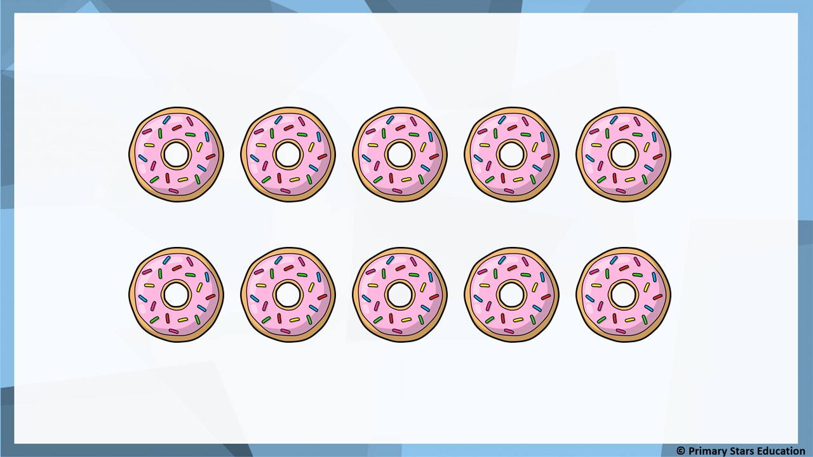
Problem solving
Write a story to match the pictures.

