Slide 1
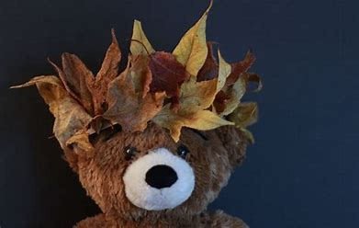
Friday 26th November
Remote Learning
Year 1

Slide 2
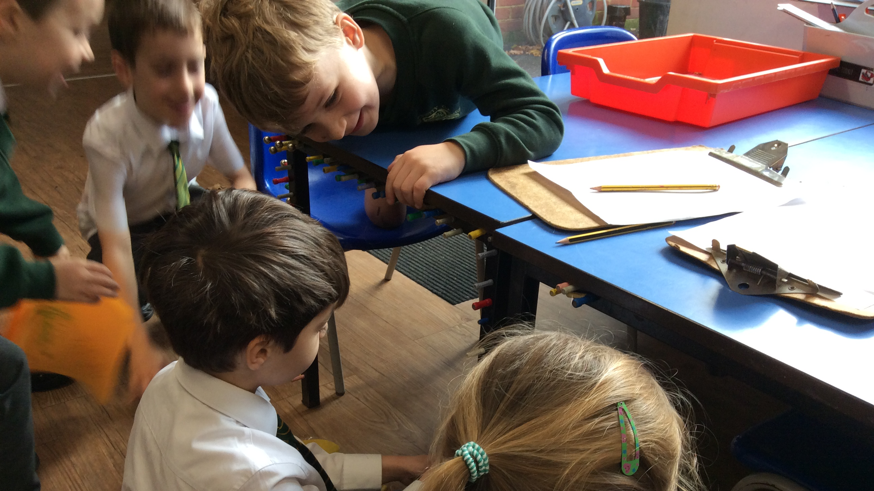
You made it to Friday!!!!
The following slides have the plan for the day but do as much or as little as works for you.
And thank you for all you have done this week!

Slide 3
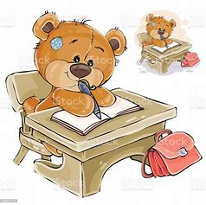
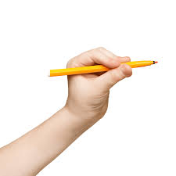
1. Handwriting
Can you copy me?!
Please click on this link!
You will need a whiteboard and pen or paper and a pencil.

Slide 4
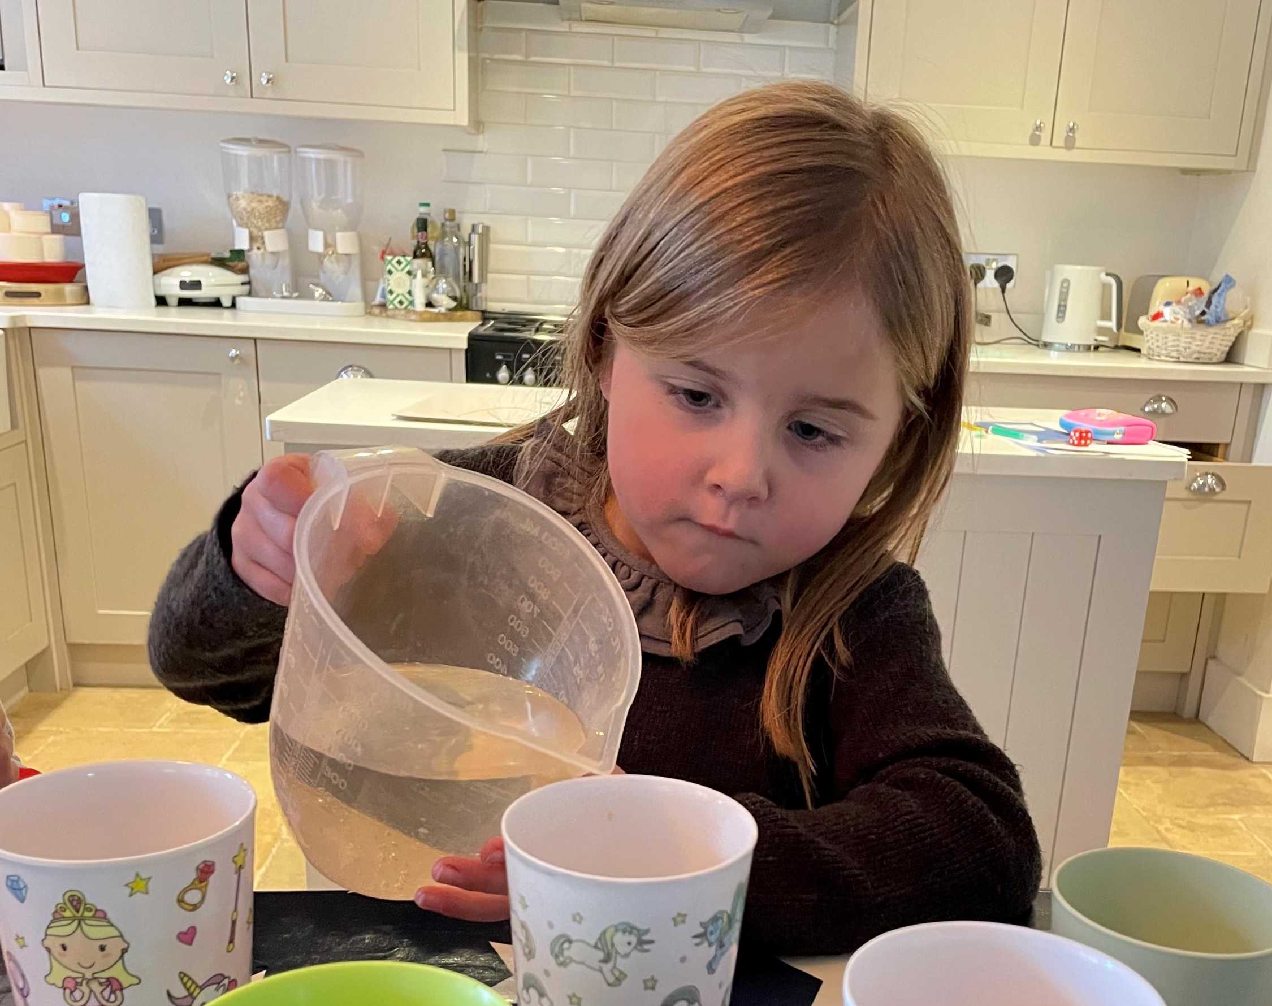
2. Mathemagician Challenge
Click here for my input
(you will need 7 cups, water and milk)
(Practising ordinal numbers and capacity concepts)
The 3rd and the 5th cups are empty.
The last cup is the fullest.
The middle cup is half full.
The 1st cup is the only cup with milk in.
The 2nd cup is nearly empty.
The 6th cup is almost full.

Slide 5
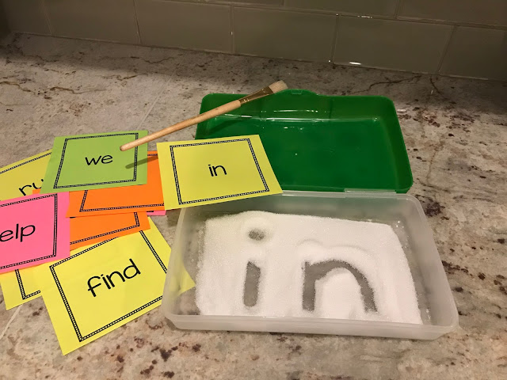
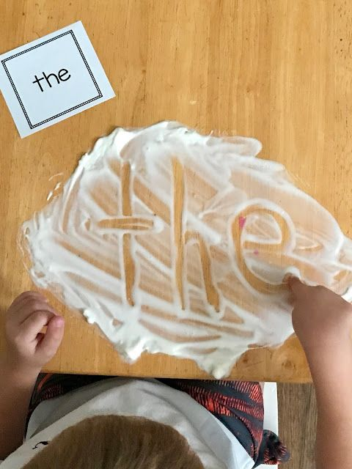
4. Phonics:
Today we need to practise our tricky words and learn one more!
How are you doing with reading and writing these words?
CLICK HERE: TRICKY WORD POWERPOINT PHASE 4
how many can you write correctly in sugar, salt, flour or shaving foam in a baking tray in 10 minutes?
(or on paper with a pencil!!!)
Set your timer!
Can you add a new word today? Try to write when? Which part of the word is the tricky part? I will give a sticker to anyone who can write it correctly next Friday!!! (Or anyone who is trying super hard!!

Slide 6

Science - Seasons
Please watch my story and listen to my chat to Posie and try to have a similar (probably better!!) one!!
Story and Science chat! Please click here!
The learning content should roughly be that leaves make food for trees. In the Autumn and Winter the leaves can’t do that anymore because there isn’t enough sunshine. When they stop working they change colour to yellow, orange, red. When they are brown that means they are dead and they fall off the trees. They fall off to make space for new leaves to grow in Spring. The new leaves will make food for the tree. That’s how the trees survive!!

Slide 7
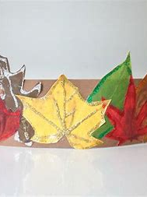
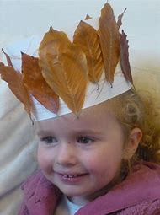
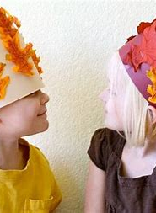

Science - Seasons:
Please continue the Kings and Queens work by using Autumn leaves to make a crown!! We can’t wait to see photos of you wearing them!! Can you write a sentence to go with it?
Eg My crown has 8 red leevs!
The brown wuns are ded.

Slide 8
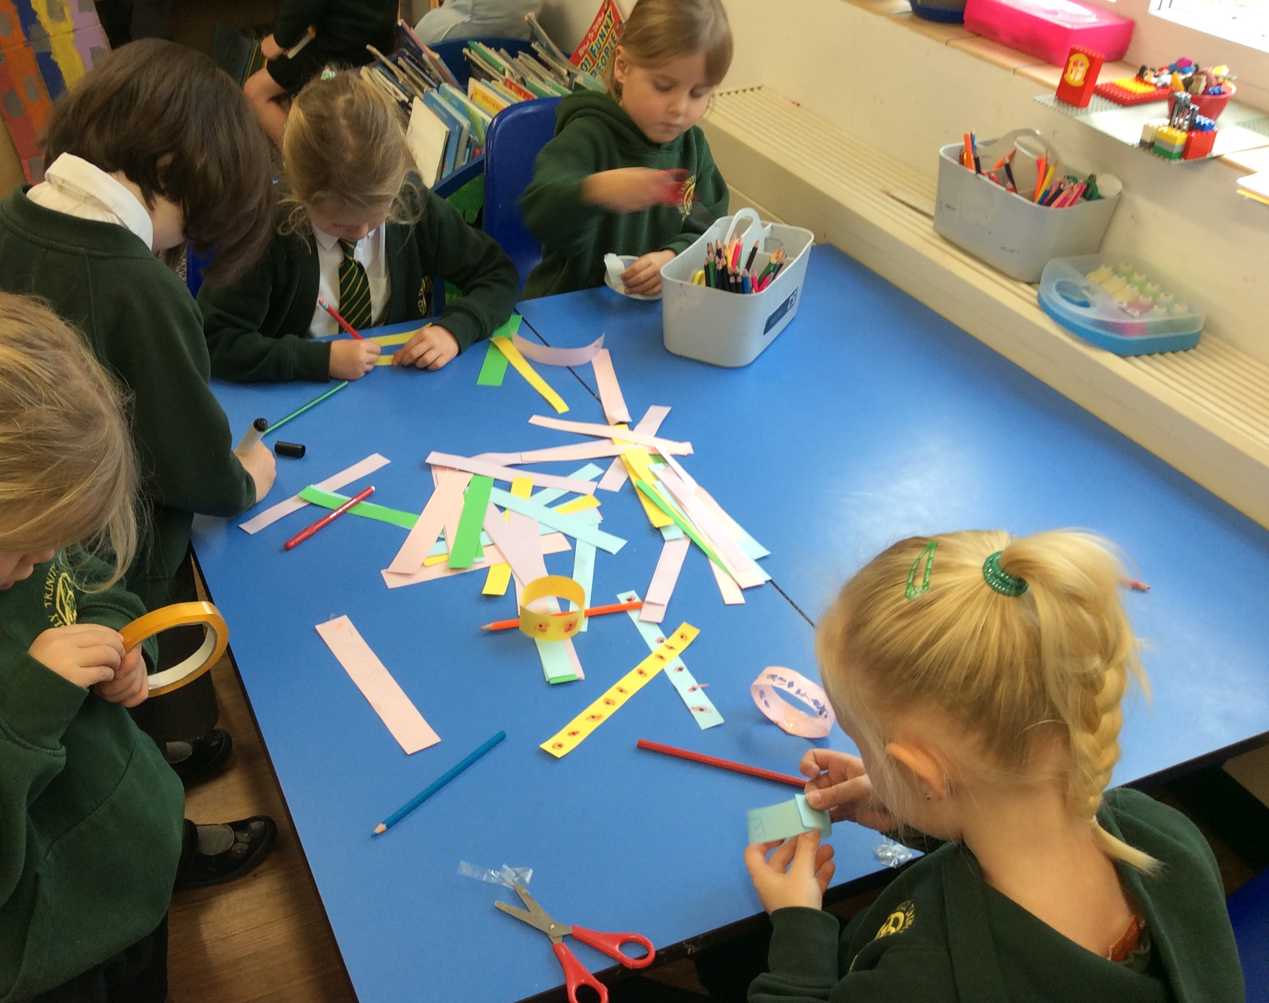
Again, there is no homework this week because of the unusually difficult circumstances but feel free to finish off anything that you think would benefit your child.
Thank you SO much for your support this week.
We can not wait to see the children back in school on Monday!!

