Slide 1


Lesson 1
Step: How many left (1)

Slide 2
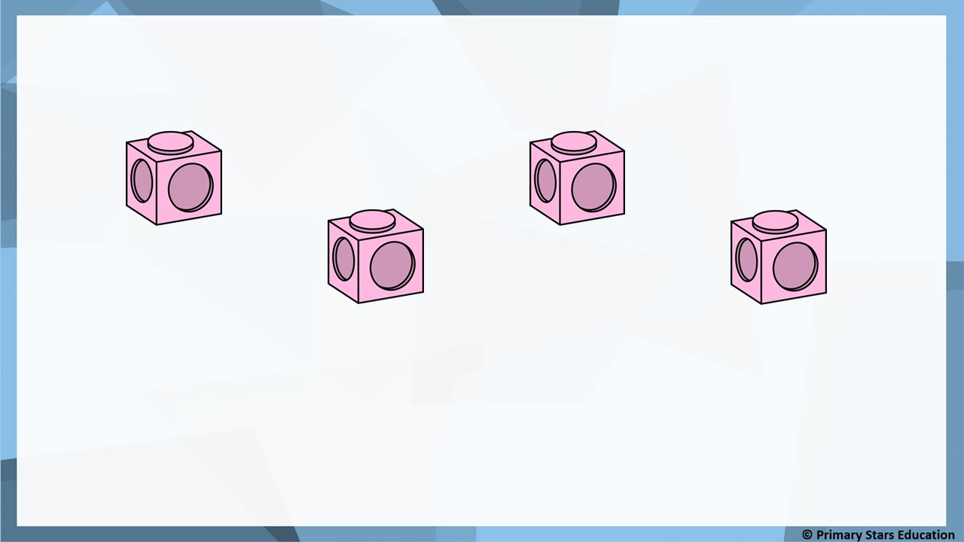
Fluency
There are 4 cubes. Take 3 away.
4
3
At first there were _______ cubes. Then _______ got taken away.
Now there is _______ cube.
1

Slide 3
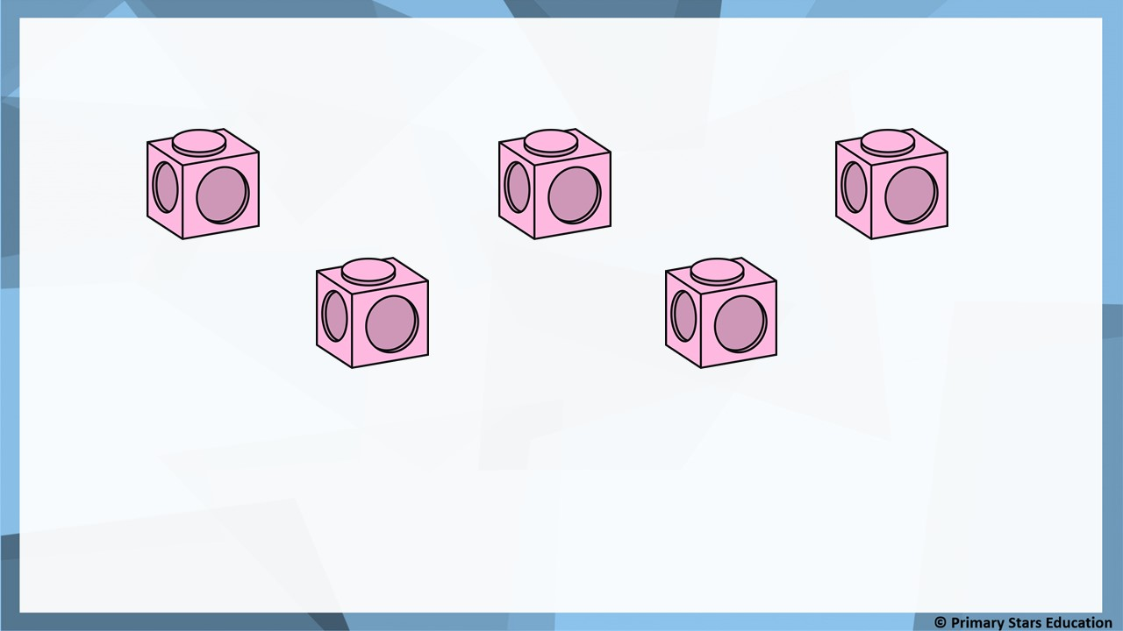
Fluency
There are 5 cubes. Take 2 away.
5
2
At first there were _______ cubes. Then _______ got taken away.
Now there are _______ cubes.
3

Slide 4
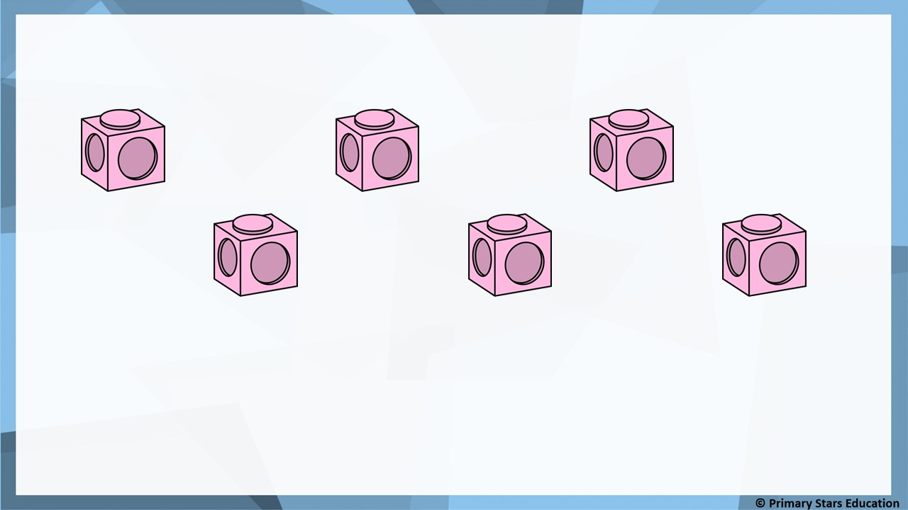
Fluency
There are 6 cubes. Take 4 away.
6
4
At first there were _______ cubes. Then _______ got taken away.
Now there are _______ cubes.
2

Slide 5
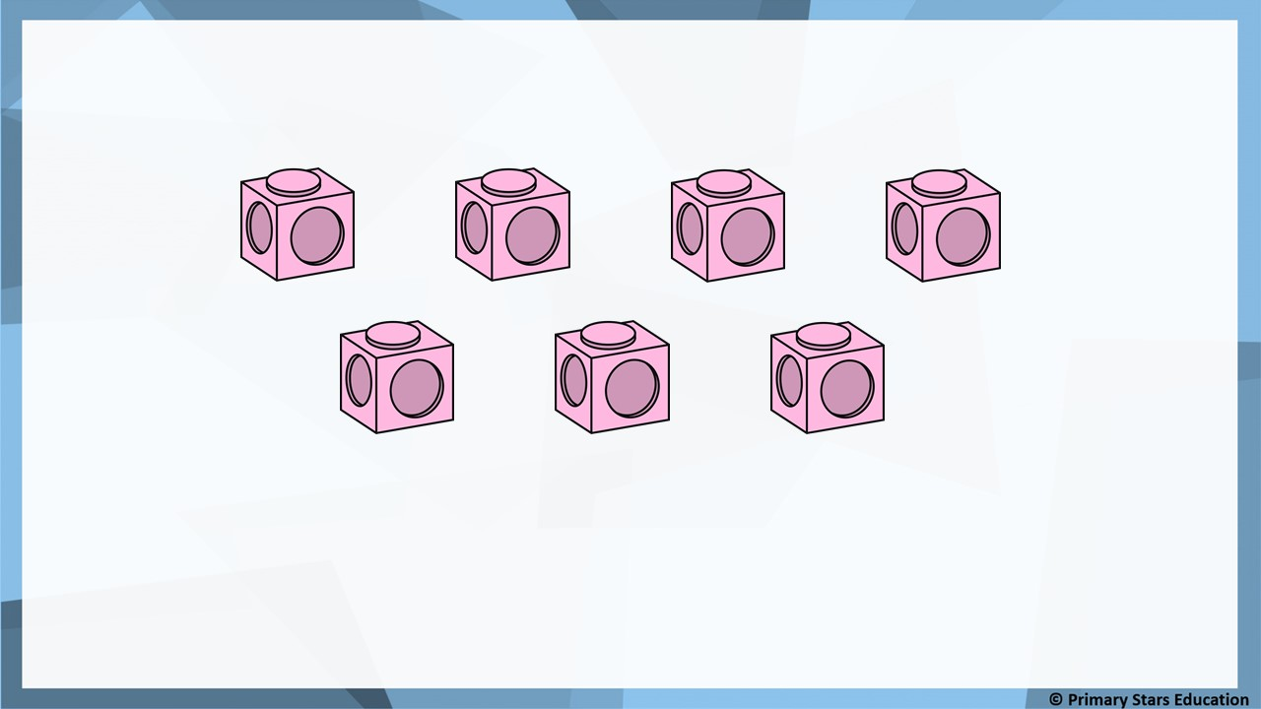
Fluency
There are 7 cubes. Take 3 away.
7
3
At first there were _______ cubes. Then _______ got taken away.
Now there are _______ cubes.
4

Slide 6
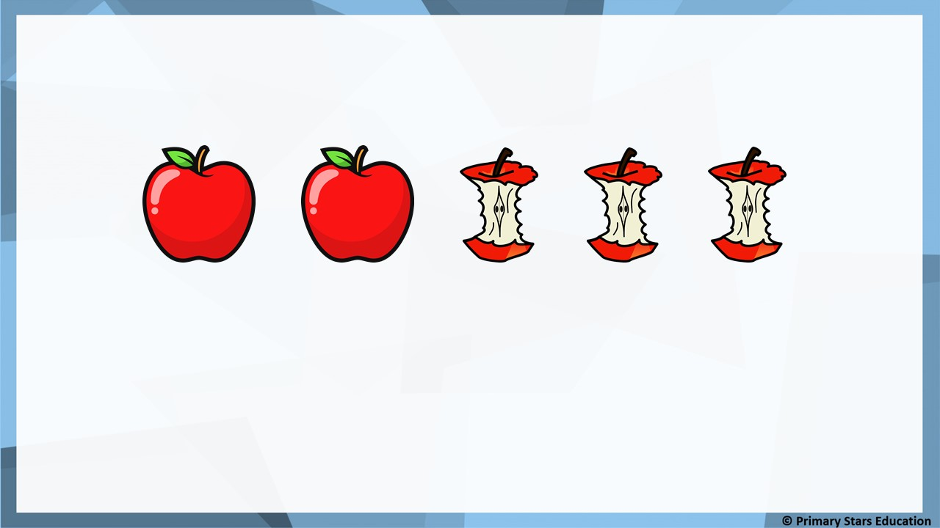
Fluency
Complete the sentences.
5
3
At first there were _______ apples. Then _______ were eaten.
Now there are _______ apples.
2

Slide 7
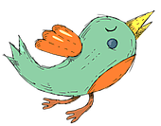
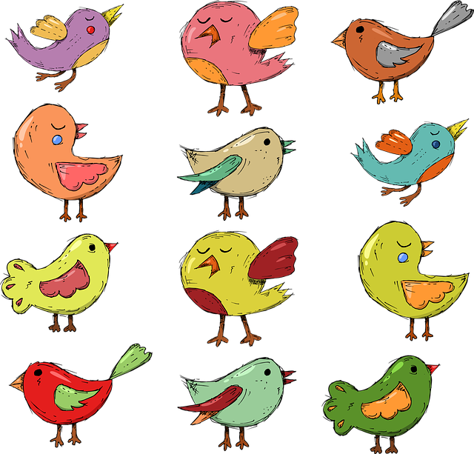

Fluency
Complete the sentences.
6
4
At first there were _______ birds. Then _______ flew away.
Now there are _______ birds.
2

Slide 8
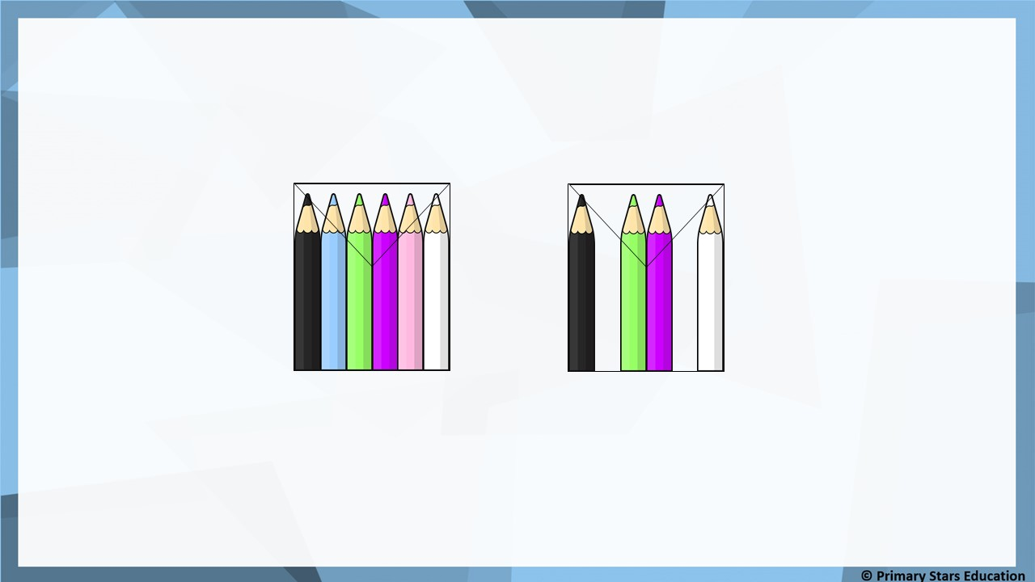
Reasoning
At first there 6 were pencils.
Then 4 pencils were removed.
Now there are 2 pencils.
Spot and explain the mistake in the story.
2 pencils were removed not 4.

Slide 9
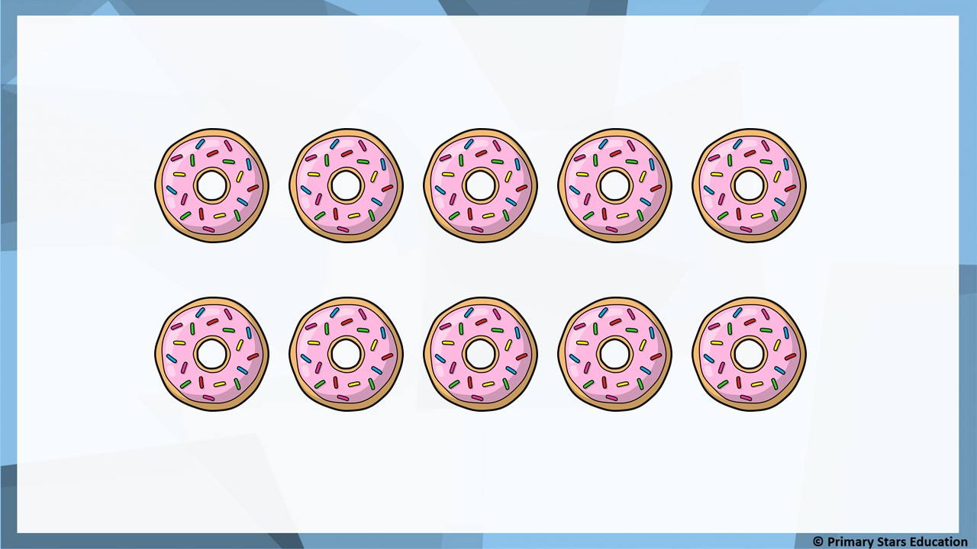
Problem solving
Write a story to match the pictures.

Slide 10
Lesson 2
Step: Subtraction – Break apart

Slide 11
Fluency
Complete the number sentence.
5
-
1
=
4

Slide 12
Fluency
Complete the number sentence.
6
-
2
=
4

Slide 13
Fluency
Complete the number sentence.
7
-
5
=
2

Slide 14
Fluency
At first there were 7 apples.
3 of them were eaten.
How many apples are left?
3
7
3
4
7
-
=
4

Slide 15
Fluency
At first there were 9 pears.
4 of them were eaten.
How many pears are left?
4
9
4
5
9
-
=
5

Slide 16
Fluency
At first there were 10 oranges.
7 of them were eaten.
How many oranges are left?
7
10
7
3
10
-
=
3

Slide 17

Reasoning
The matching number sentence is 8 – 5 = 3.
8
Matt
The matching number sentence is 8 – 3 = 5.
5
3
Kat
Who do you agree with?
Both Matt and Kat are correct.

Slide 18
Problem solving
Each missing number is 10 or less.
How many different ways can the calculation be completed?
There are 9 ways:
10 – 8 = 2
9 – 7 = 2
8 – 6 = 2
7 – 5 = 2
6 – 4 = 2
5 – 3 = 2
4 – 2 = 2
3 – 1 = 2
2 – 0 = 2
?
-
?
=
2

Slide 19
Lesson 3
Step: Fact families – 8 facts

Slide 20
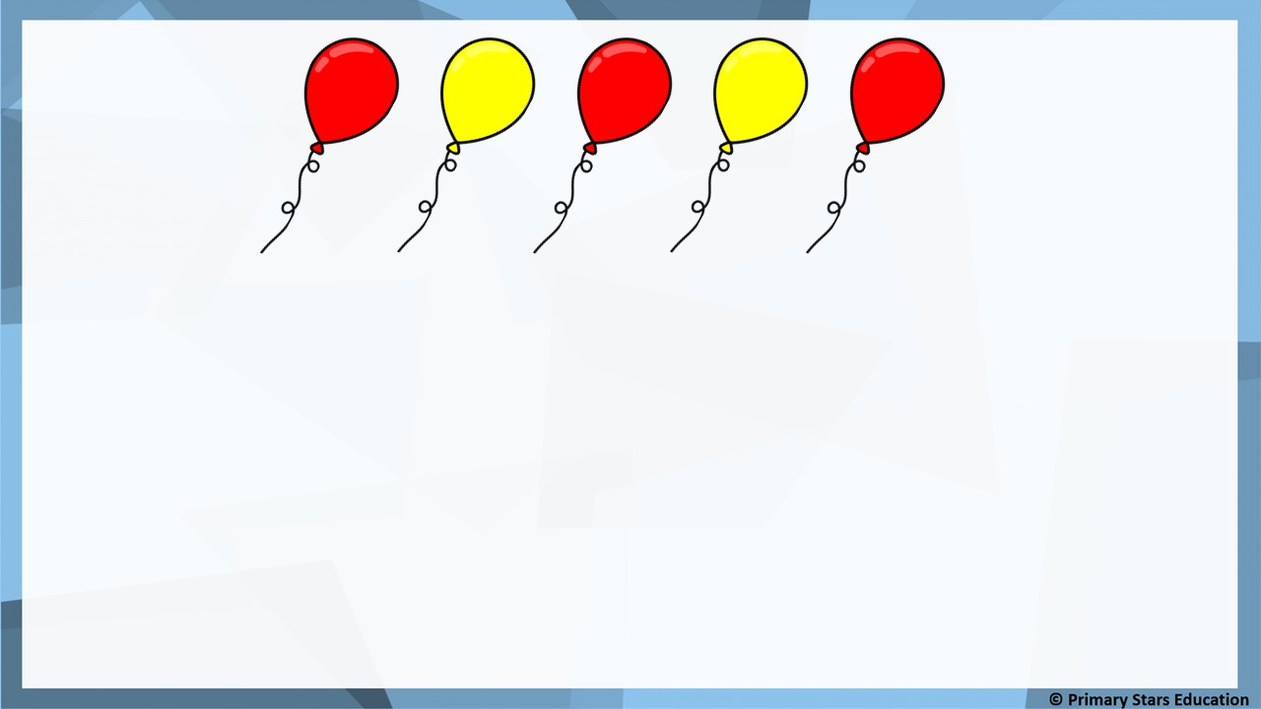
Fluency
3
+
2
=
5
5
=
3
+
2
2
+
3
=
5
5
=
2
+
3
5
-
3
=
2
3
=
5
-
2
5
-
2
=
3
2
=
5
-
3

Slide 21
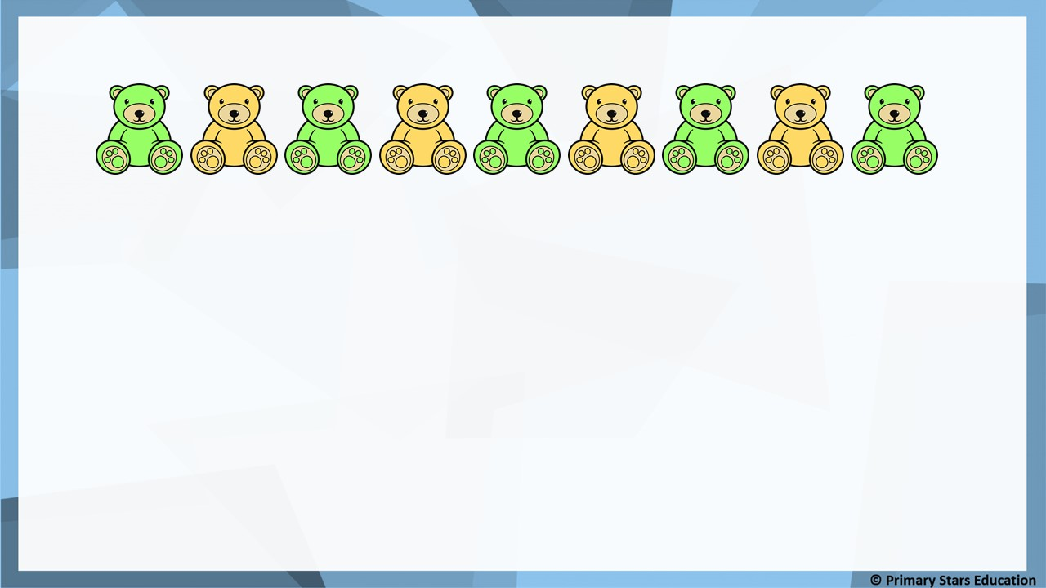
Fluency
5
+
4
=
9
9
=
5
+
4
4
+
5
=
9
9
=
4
+
5
9
-
5
=
4
5
=
9
-
4
9
-
4
=
5
4
=
9
-
5

Slide 22
Fluency
Write a fact family for the part-whole model.
5
+
3
=
8
8
=
5
+
3
5
3
+
5
=
8
8
=
3
+
5
8
8
-
5
=
3
5
=
8
-
3
3
8
-
3
=
5
3
=
8
-
5

Slide 23
Fluency
Write a fact family for the part-whole model.
6
+
4
=
10
10
=
6
+
4
6
4
+
6
=
10
10
=
4
+
6
10
10
-
6
=
4
6
=
10
-
4
4
10
-
4
=
6
4
=
10
-
6

Slide 24

Reasoning
Reasoning
3
+
5
=
8
8
=
3
+
5
5
+
3
=
8
8
=
5
+
3
8
-
3
=
5
3
=
8
-
5
8
-
5
=
3
5
=
8
-
3
The missing number sentence is 8 – 3 = 5.
Do you agree?
No, the number sentence is 8 – 5 = 3.

Slide 25
Problem solving
Use the story to create 8 related facts.
There are 5 ties on a tie rack. 4 are blue, the rest are red.
4
+
1
=
5
5
=
4
+
1
1
+
4
=
5
5
=
1
+
4
5
-
4
=
1
1
=
5
-
4
5
-
1
=
4
4
=
5
-
1

