Slide 1
Mog the forgetful cat
Tuesday 30th November 2021
I can strive for a sentence

Slide 2
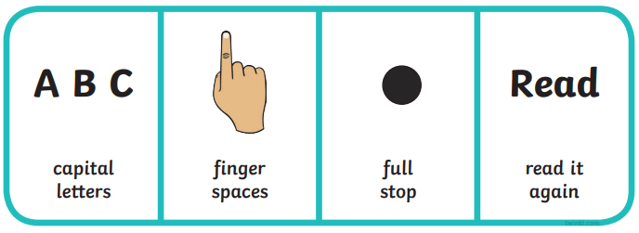
My perfect pet is my cat Thea. She is playful, soft and friendly.

Slide 3
Wednesday 1st December 2021
I can sequence events of Mog the forgetful cat.
Partner work:
Cut out the strips and sequence the events in order
What is the first…?
Here is the story.
https://www.youtube.com/watch?v=Nxi2V2402jI

