Slide 1
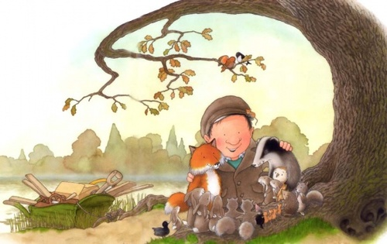
What do you think they are saying to each other?

Slide 2
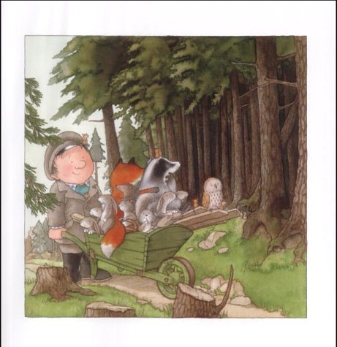
What do you think they are saying to each other?

Slide 3
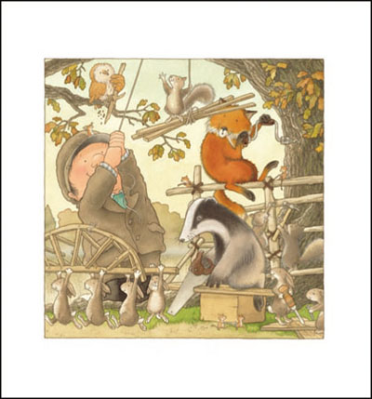
What do you think they are saying to each other?

