Slide 1
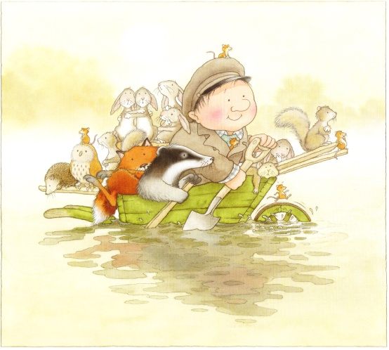
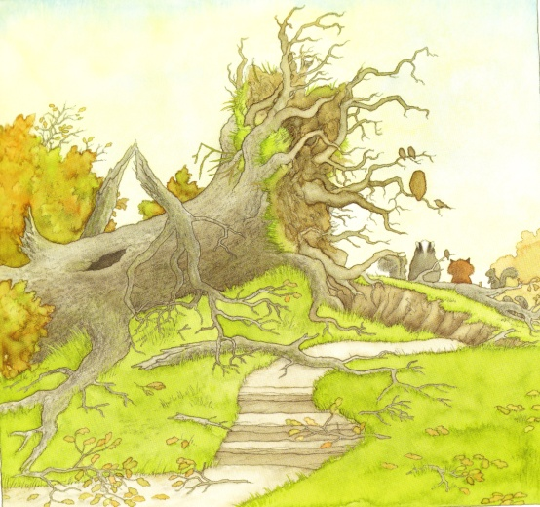
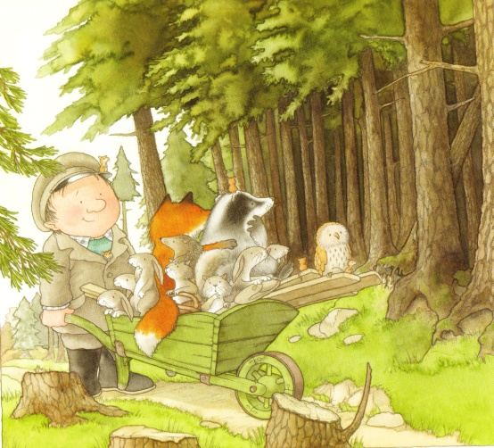
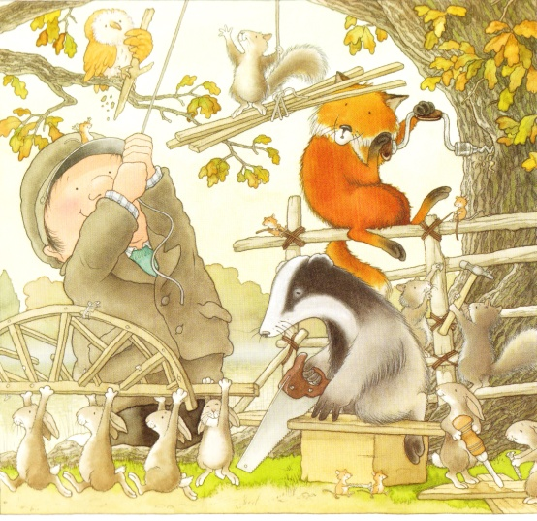
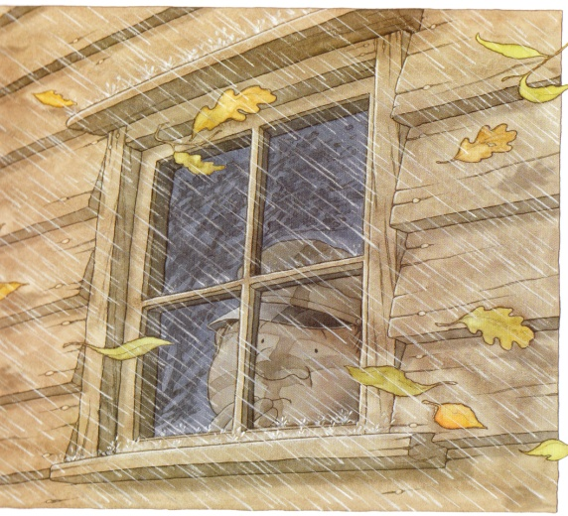
After the Storm

Slide 2
After the Storm
____________________________________________________________
____________________________________________________________
____________________________________________________________

Slide 3
____________________________________________________________
____________________________________________________________
“Well done everybody!” said Percy. “This is the best tree house I’ve ever seen.”

Slide 4
After the Storm
Percy watched the storm outside. He did not like the wind.
A big oak tree had been blown over by the storm and the animal’s homes were wrecked.
Percy said he would help the animals find somewhere new to live.

Slide 5
They slowly paddled the wheelbarrow across the lake.
The animals worked together and did what Percy told them.
“Well done everybody!” said Percy. “This is the best tree house I’ve ever seen.”

Slide 6
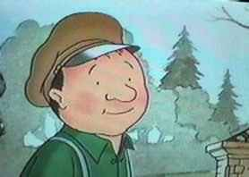
What does Percy do next?
______________________________________________________________________________________________________________________________

