Slide 1
Friday 18th February

Slide 2

Good Morning Year 1! Today there is a red warning because of the storm so stay safe and warm at home. Here are a few ideas to keep you busy today but please only do what is manageable for you as a family!

Slide 3

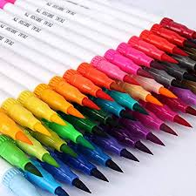
Mathemagician Challenge:
Colouring Pens!
Mathemagician Powerpoint Link

Slide 4

Mathletics:
Please try to complete the activities that have been set for you at some point before we return.

Slide 5
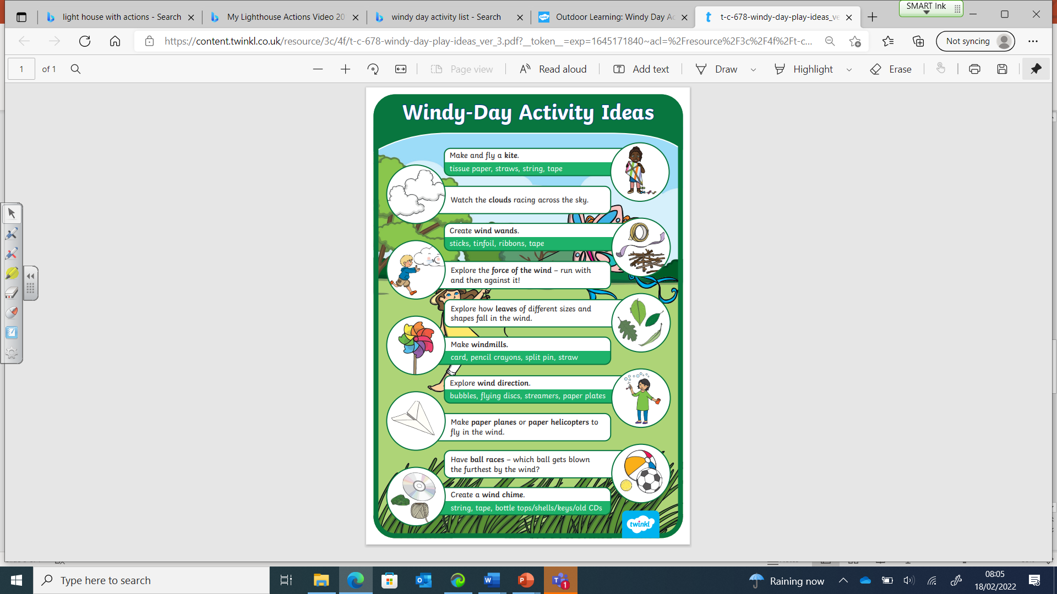
Science/English:
The Wind
Please listen to this story: After The Storm - A Percy The Park Keeper story read by Nick Butterworth – YouTube
Then, please pick ONE option that suits you today!!!!
Once you have heard this story, please talk about the wind – what is it? What can we do in the wind? Together write a list of ideas for a windy day. And choose one to do!!
Make a new home for an animal after the storm using recycled resources from around your house!
Use the attached sheets on the class page to put the story back together – have a go at writing a sentence to match each picture or try adding speech for the animals.

Slide 6

Optional Friday Craft!
Let’s make a kite
Look around the house for a bit of cardboard, some cellotape and some ribbons or strips of paper. Can you add a handle.
Use it in the house today and keep it safe for a slightly calmer day!!!

Slide 7

Have an amazing half term!

