Slide 1
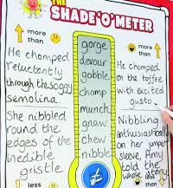
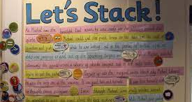
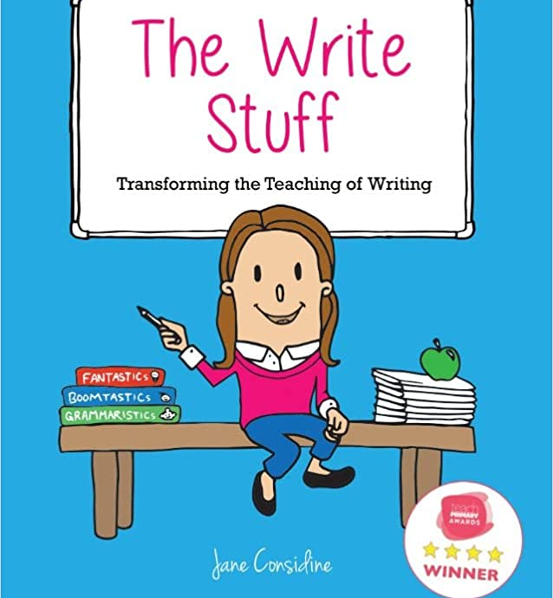
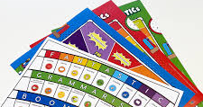
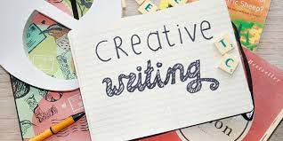
Y2 Writing Workshop
Tuesday 22nd November 2022

Slide 2
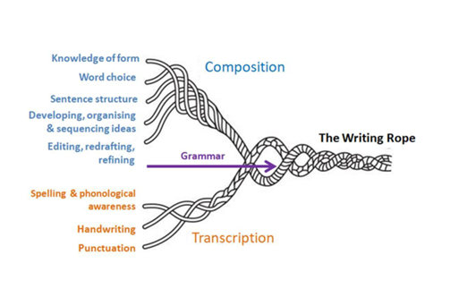

Slide 3
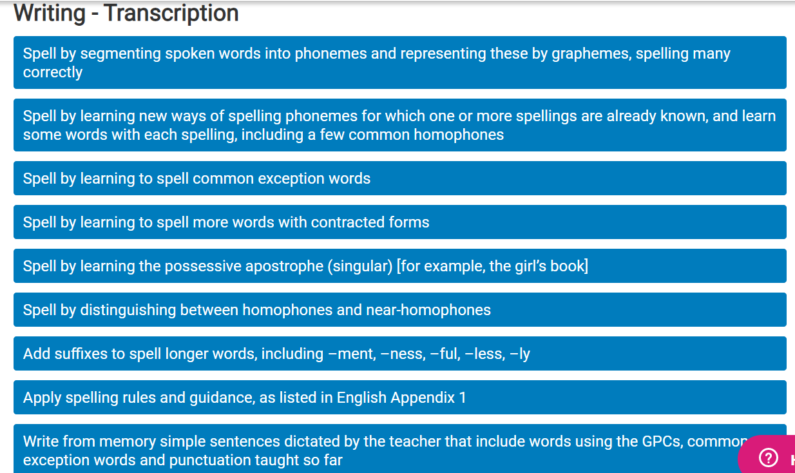

Slide 4
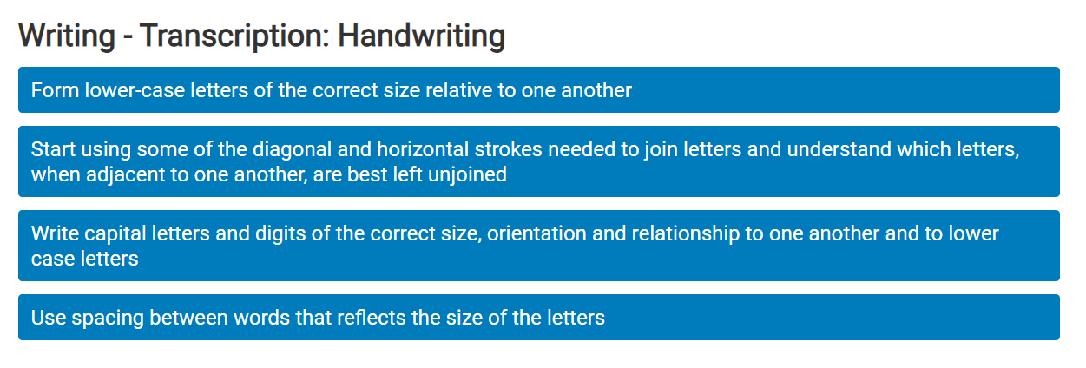

Slide 5
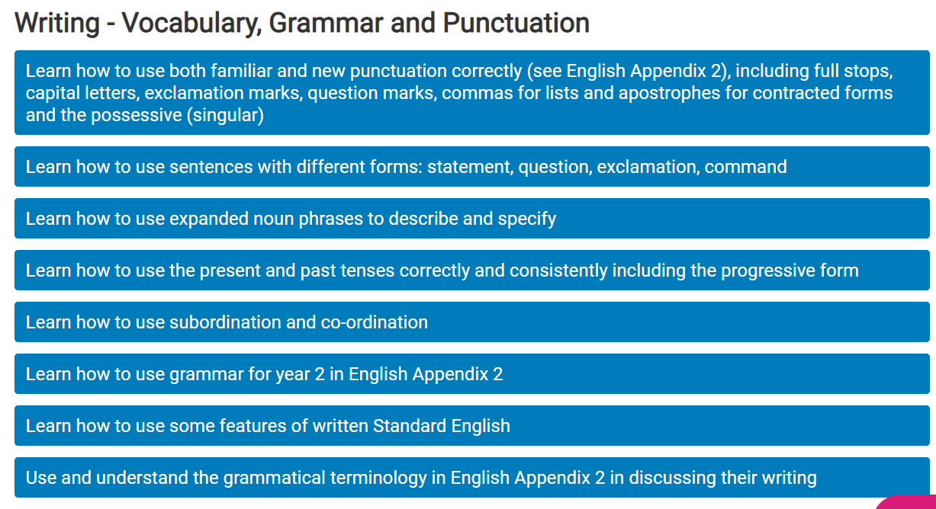

Slide 6
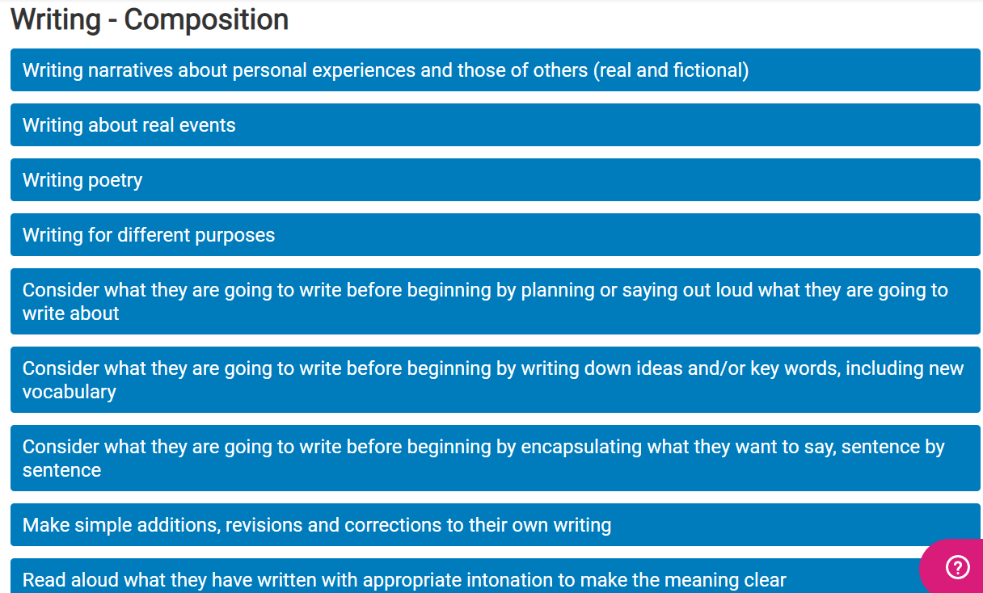

Slide 7
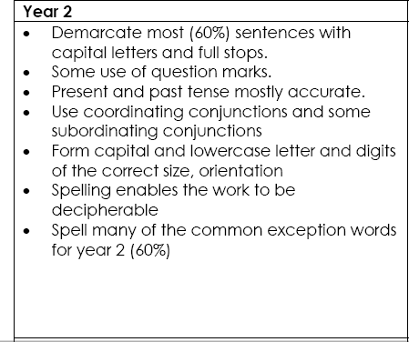

Slide 8
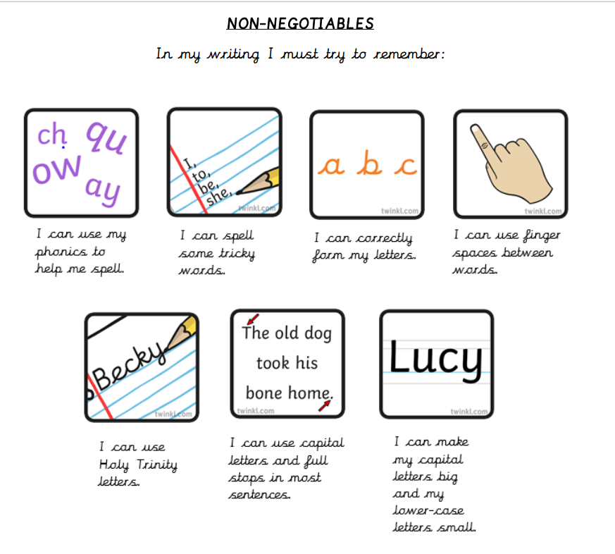

Slide 9
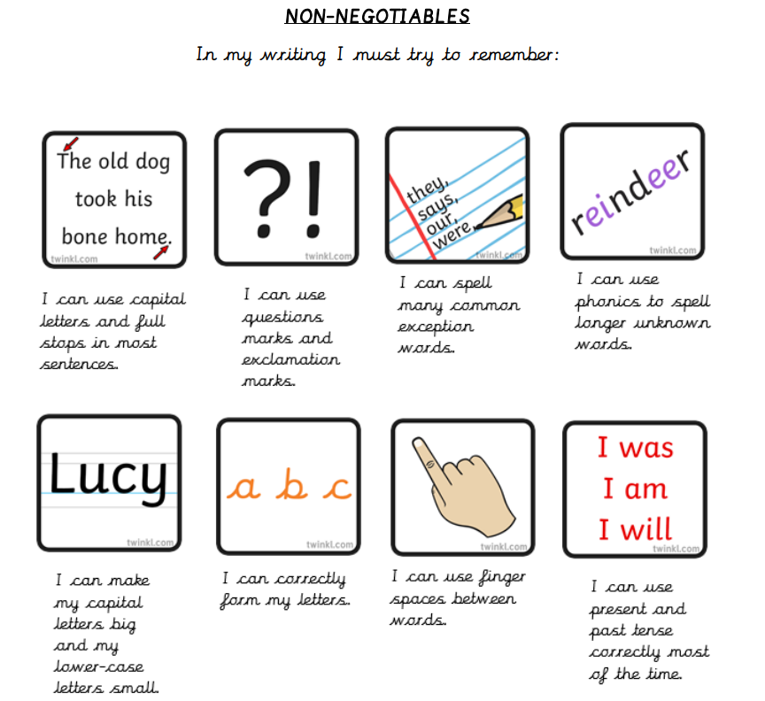

Slide 10
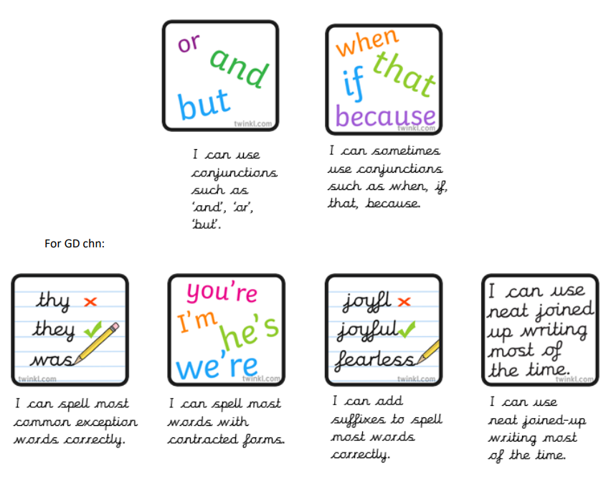

Slide 11
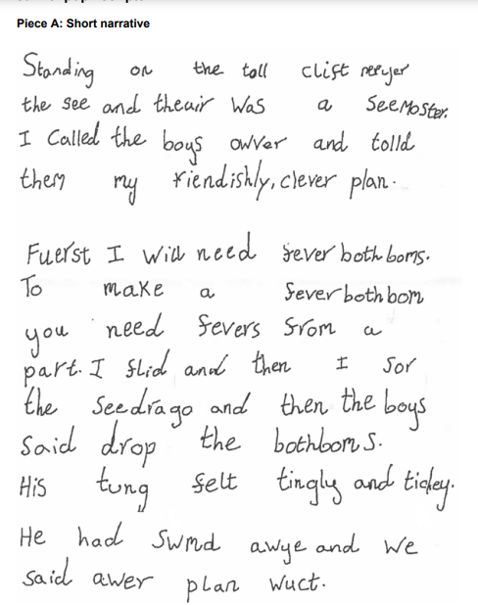
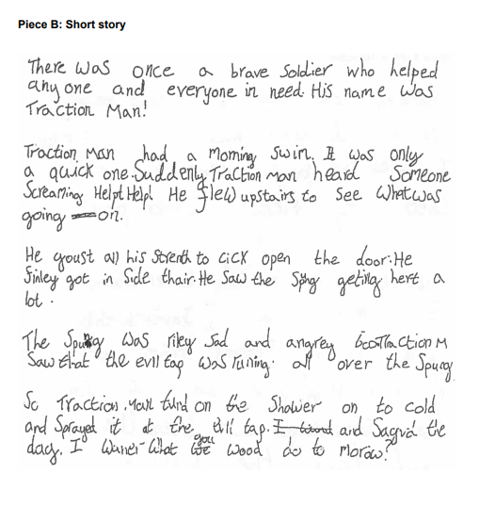

Slide 12
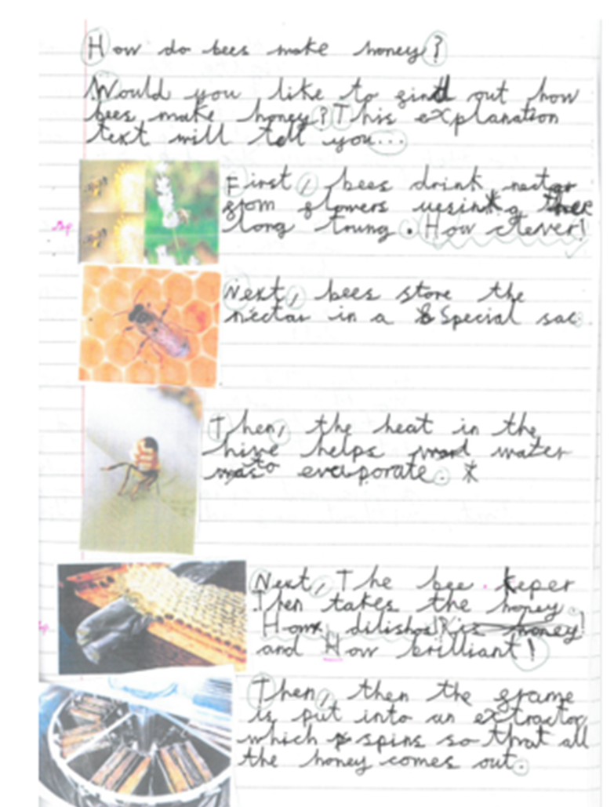
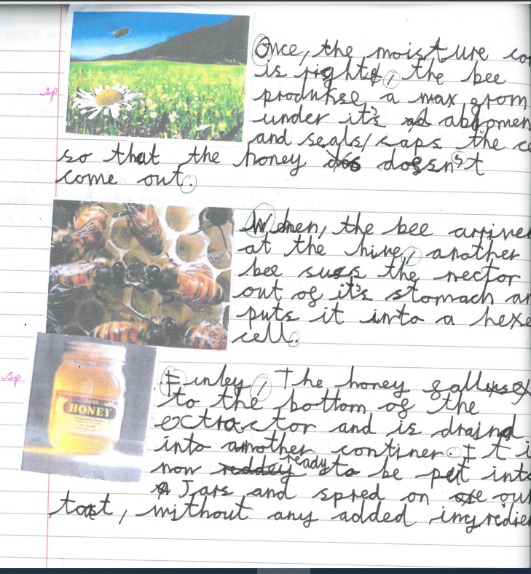

Slide 13
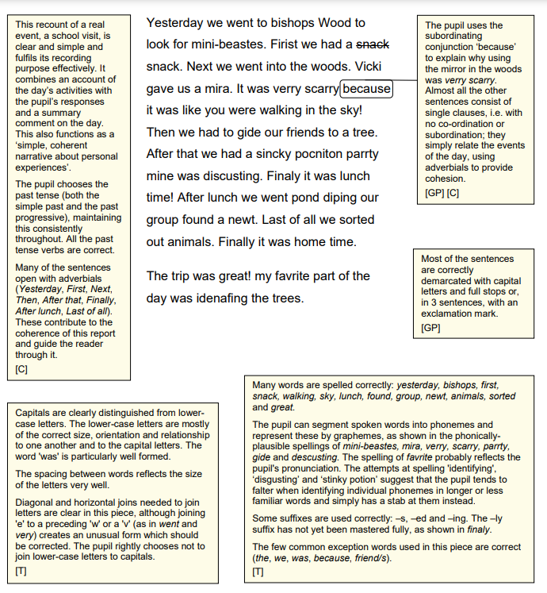
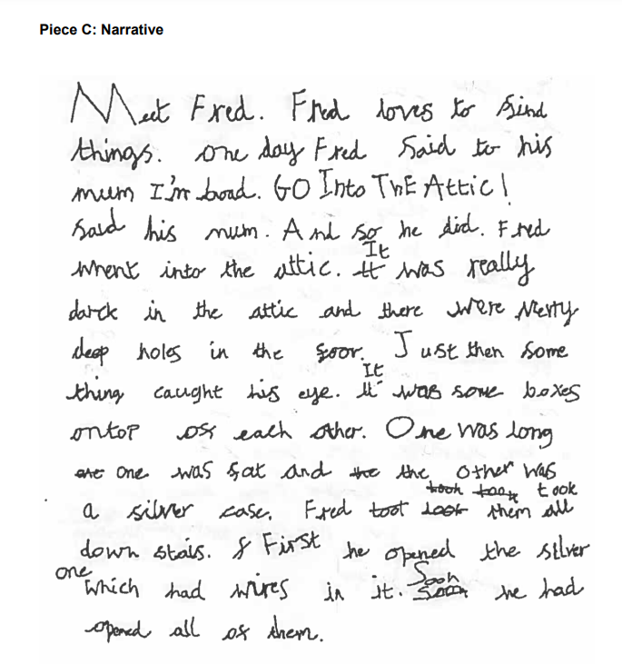

Slide 14
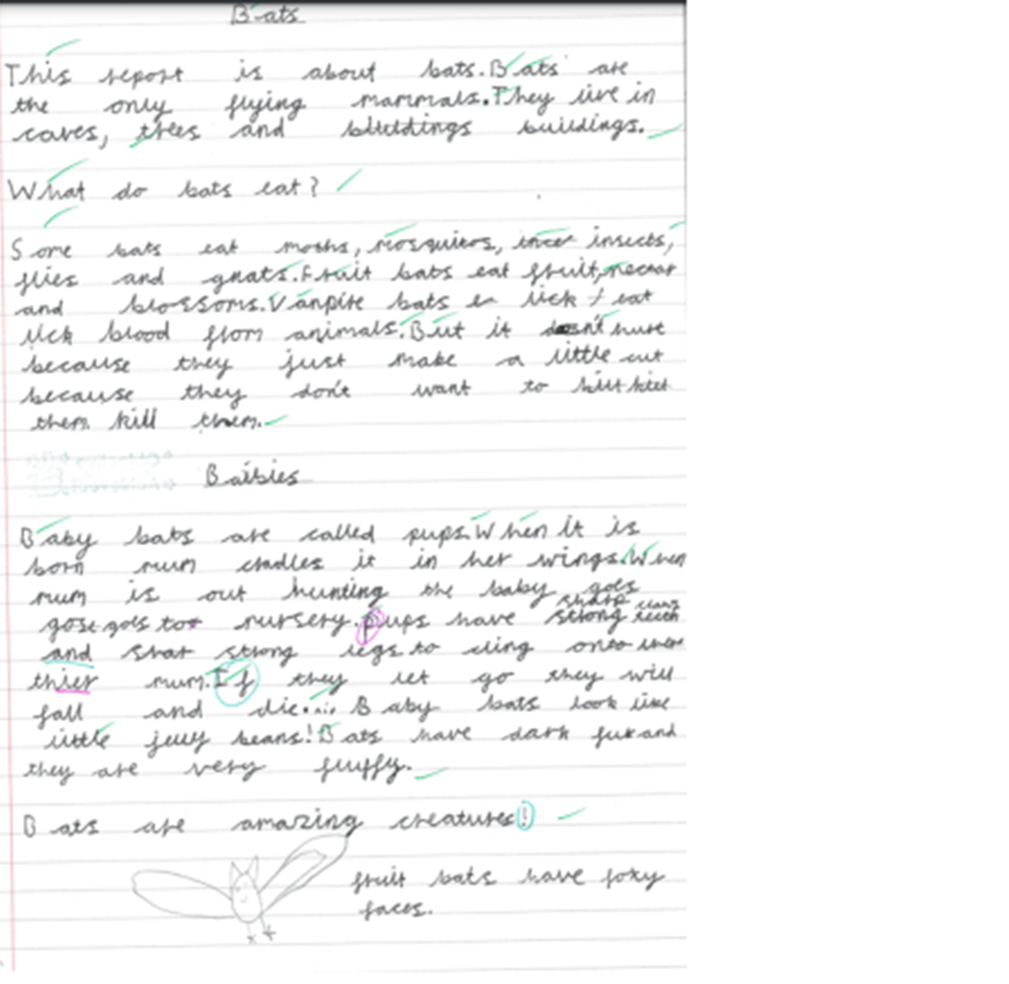
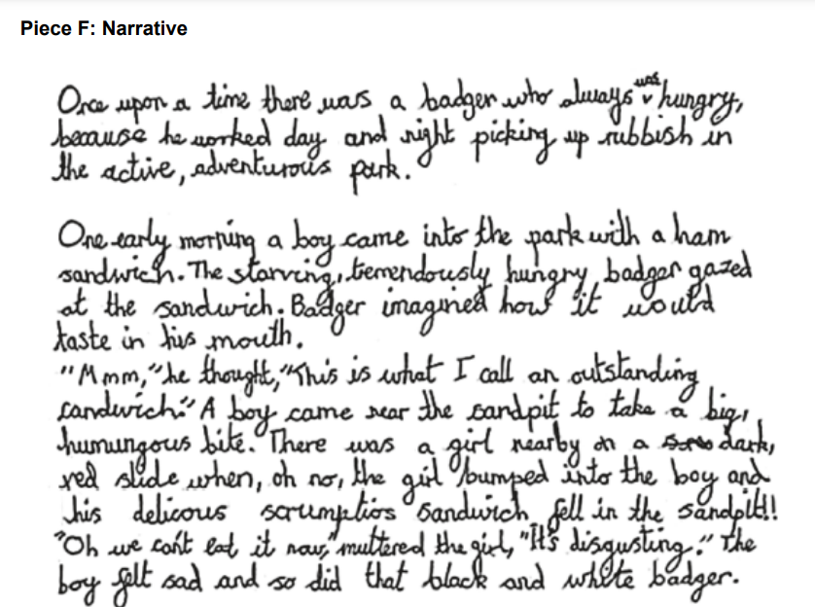

Slide 15
How we teach writing in Y2?

Slide 16
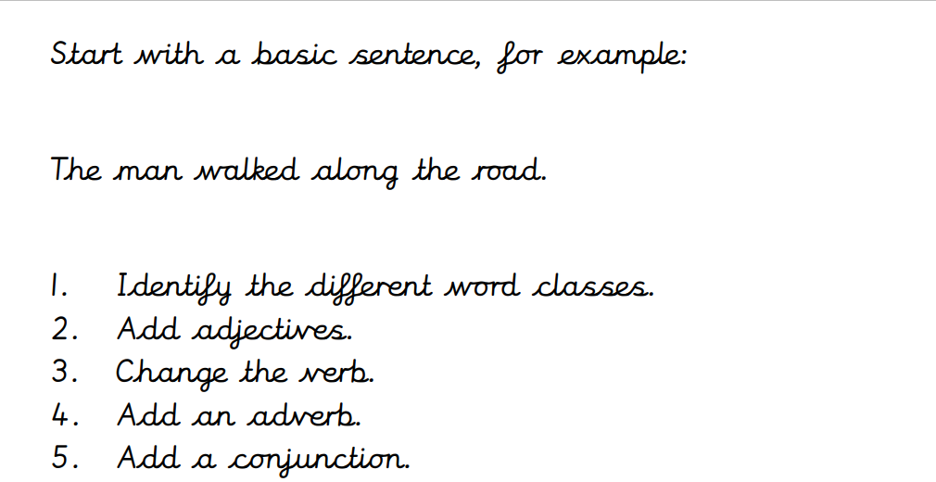

Slide 17
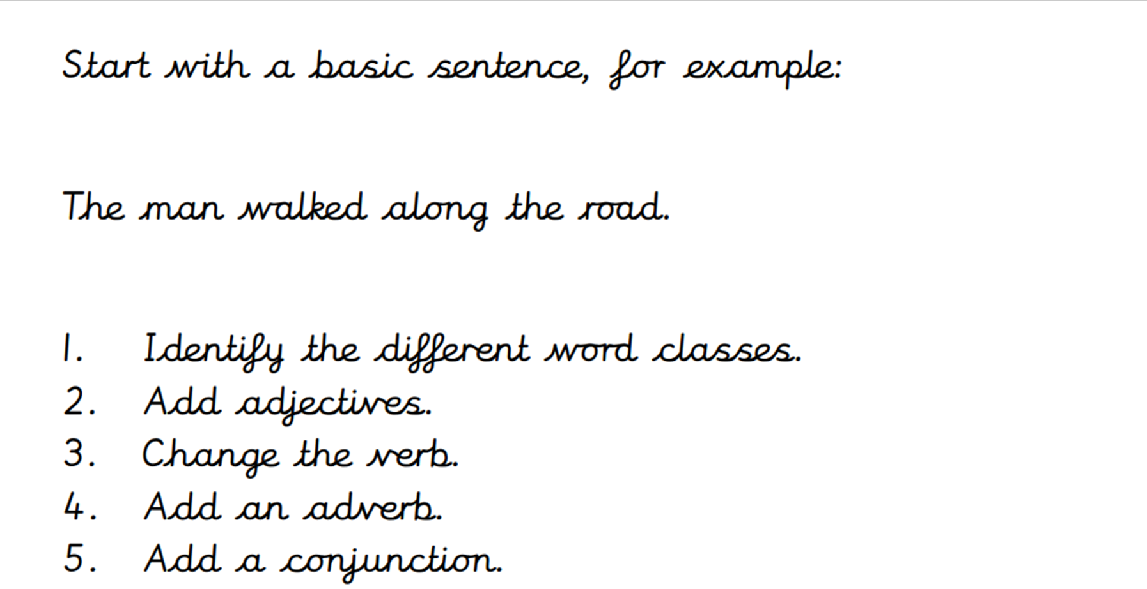
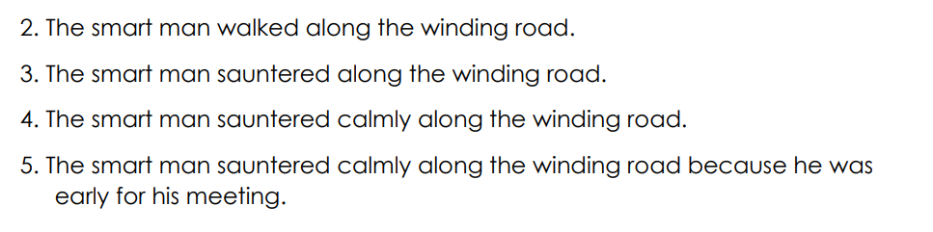

Slide 18
General Tips and Ideas
The basis of all good writing is good talk. Writing depends on knowing lots of words
and being able to join them together in interesting ways. Encourage your child to: -
explain a game or activity
describe a person, place, picture or thing
retell stories talk about things they have done e.g. visits, day at school
encourage detail
predict what might happen next in a story, TV programme or sequel to a film play word games
Be a reading model and read to your child (e.g. stories, poems, factual information such as timetables, magazines, newspaper reports, letters, emails, adverts, instructions) – discuss the ways authors use words to shape their ideas.
Be a writing model and encourage your child to write alongside you for real purposes e.g. shopping lists, birthday/Christmas lists, labels, invitations, thank you letters, emails to friends, postcards, cards for relatives, scrap books of holidays/hobbies/special events, diaries, posters for real events, short stories or poems for family members, menus, texting, bedroom or house rules.

Slide 19
Have an exciting selection of writing materials available e.g. a range of pencils, pens, coloured crayons, writing icing, writing soaps for bath time.
Praise your child for trying and don’t dwell on mistakes.
Focus on content and enjoyment of writing for fun and for purpose.
Encourage young children to look at print on road signs, food packets, in books, magazines and catalogues. Go to the library and read favourite books over and over again. Enjoy them.
Try fun activities that strengthen your child’s hand e.g. cutting, painting, squeezing playdough, picking up small things with tweezers and pegs.
Use magnetic letters and make small words together. Leave a message on the fridge door and encourage your child to reply.
Let your child write their own Christmas cards, thank you letters, cards or emails to friends or relatives, invitations to a party, or a list of things they need to take on holiday.
Cut up letters from magazines for children to make their names and short sentences.

Slide 20
As their confidence grows…
Continue talking about experiences. This remains the key to good writing. Talk about what has been seen, heard, smelt, tasted and touched with as many details as possible.
Play word-building games to develop descriptive vocabulary such as Boggle, Scrabble, Guess Who,
Create silly sentences or tongue twisters using alliteration (a group of words that all begin with the same sound) e.g. Sad Sid slipped on Sam’s salad sandwich.
Encourage your child to rehearse their sentence out loud before they write it down. Also encourage children to punctuate their sentences with a full-stop and capital letter. Celebrate what the writing says first of all rather than focusing on errors. If a tricky word has been used in an interesting way, this should be praised even if it is spelt wrongly. Remember, it is difficult to get everything right when you are learning!
Let children write part of shopping lists and then let them be responsible for carrying the list and finding certain items.
Make up fun ways to remember how to spell difficult words e.g. Big Elephants Can Always Understand Small Elephants = because, what has a hat, when has a hen.
Play ‘I Spy’ and ‘Hangman’ which encourage use of sounds and spellings
Encourage your child to learn weekly spellings. Write the spelling in sentences with accurate punctuation and practise high frequency words and handwriting.

Slide 21
Encouraging Reluctant Writers
If your child has barriers towards writing, or low self-esteem as a writer, praising and valuing your child’s writing is very important. Your child may need support when they write and may need you to talk through their ideas first and help with composing and structure. Young children often need help with ideas to write successfully.
Help your child go over problem spellings. It is extremely frustrating for children to have to battle with spelling and handwriting when they want to get their ideas down on paper. Knowing high frequency spellings will aid the flow of writing and enable the use of a vocabulary rich language. (Consider being trapped into writing ‘big’ when you really wanted to write ‘enormous’). Encourage children to sound out and have a go at more tricky words or give them the spellings.
Remember that writing does not have to be lengthy or boring!
Writing for real purposes is more meaningful and rewarding for children and creates a fun and interesting way for children to develop their writing skills.
Have fun learning together!

Slide 22
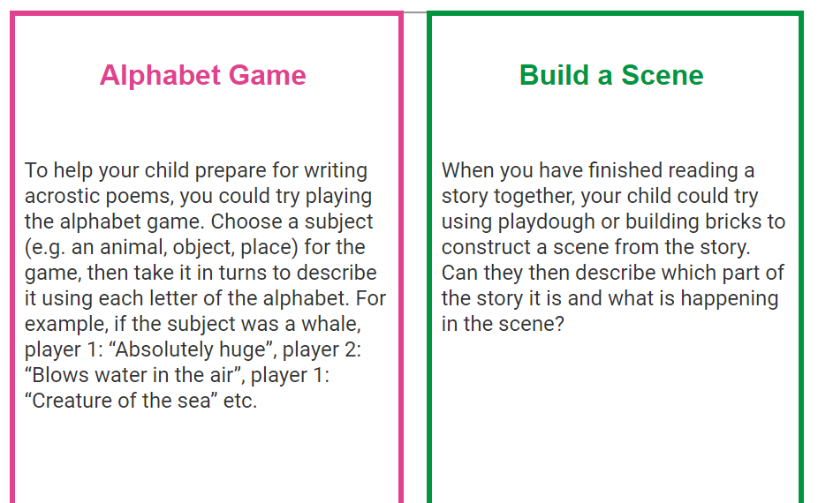
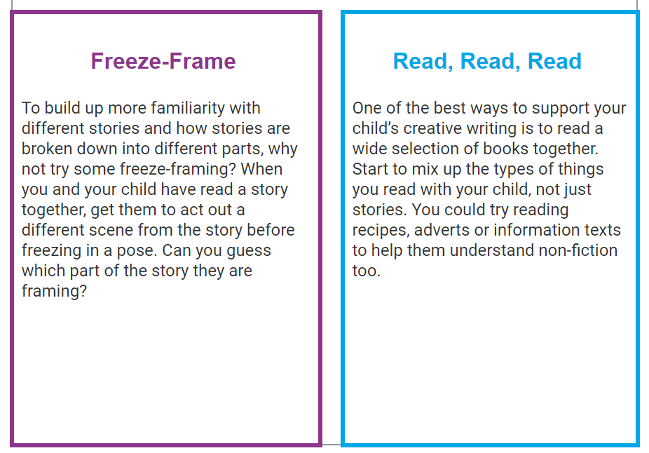

Slide 23


Any questions?

