Slide 1
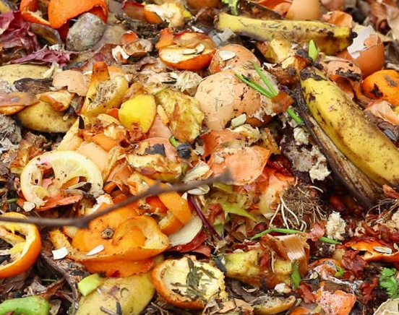
Food Waste
By eco warriors ; Saffie and Ariana

Slide 2

School
Food
Waste
This Photo by Unknown Author is licensed under CC BY-ND

Slide 3
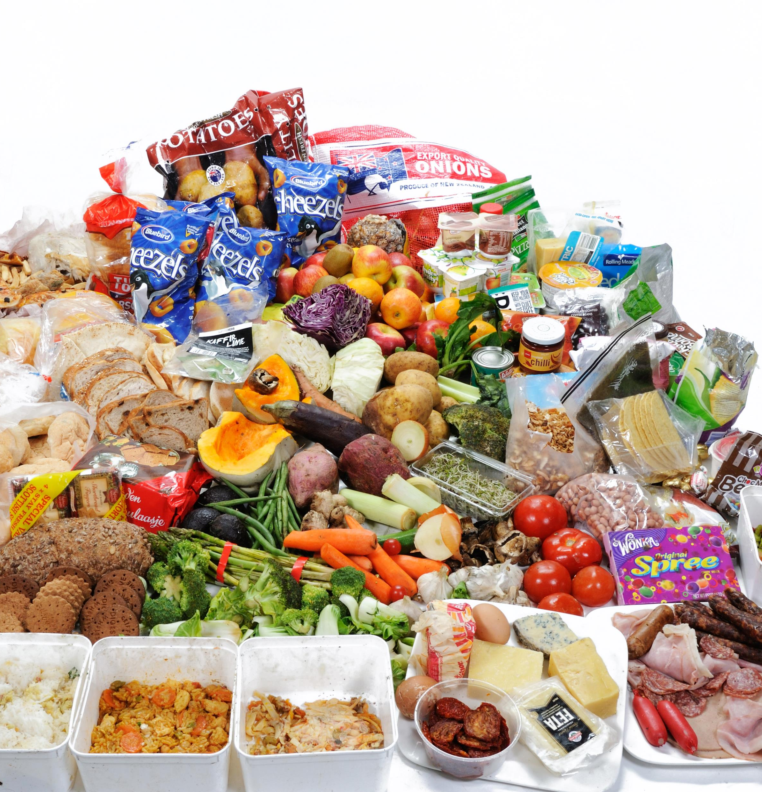
Facts
If global food waste were a country, it would be the 3rd largest emitter of greenhouse gasses after China & US.
800 million people go to bed hungry every night, that is 1 in 9 people on the planet who are starving or malnourished.
25% of all fresh water used in the world is used to grow food that is never eaten.
The average family throws £720 of edible food away each year.
The average family of 4, can save just over £60 per month by reducing their food waste.
This Photo by Unknown Author is licensed under CC BY-SA

Slide 4

Video
Eco committee Teams video
This Photo by Unknown Author is licensed under CC BY-SA

Slide 5
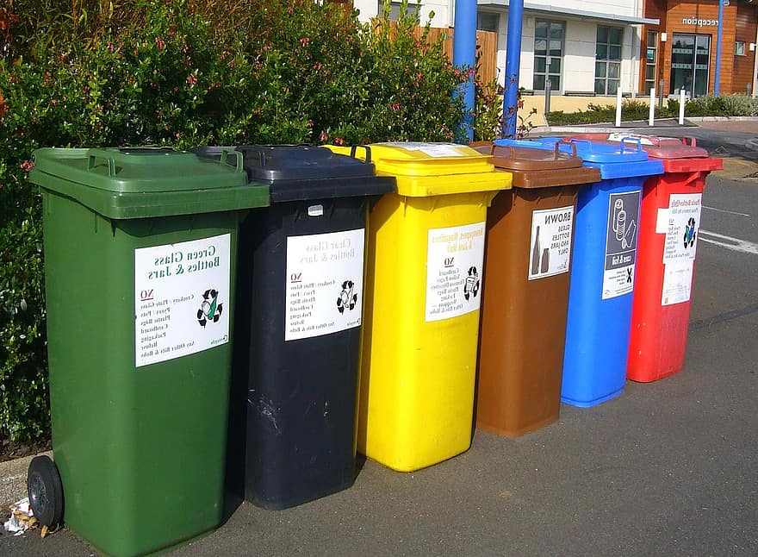

Which bin does it go in?
This Photo by Unknown Author is licensed under CC BY-SA

Slide 6
Short Quiz

Slide 7
1. How much could a family of four save per month by reducing food waste?
Just over £60

Slide 8
2. Which bin should a banana peel go in?
Compost Bin

Slide 9
3. How many tons of food waste is produced by schools in the UK per year?
A staggering 80,382 tons

Slide 10

This Photo by Unknown Author is licensed under CC BY

Slide 11

Prayer
Dear God
Help us to take care of the world.
To not waste food.
And to share food with those who do not have enough.
Amen
This Photo by Unknown Author is licensed under CC BY-SA-NC

