Slide 1
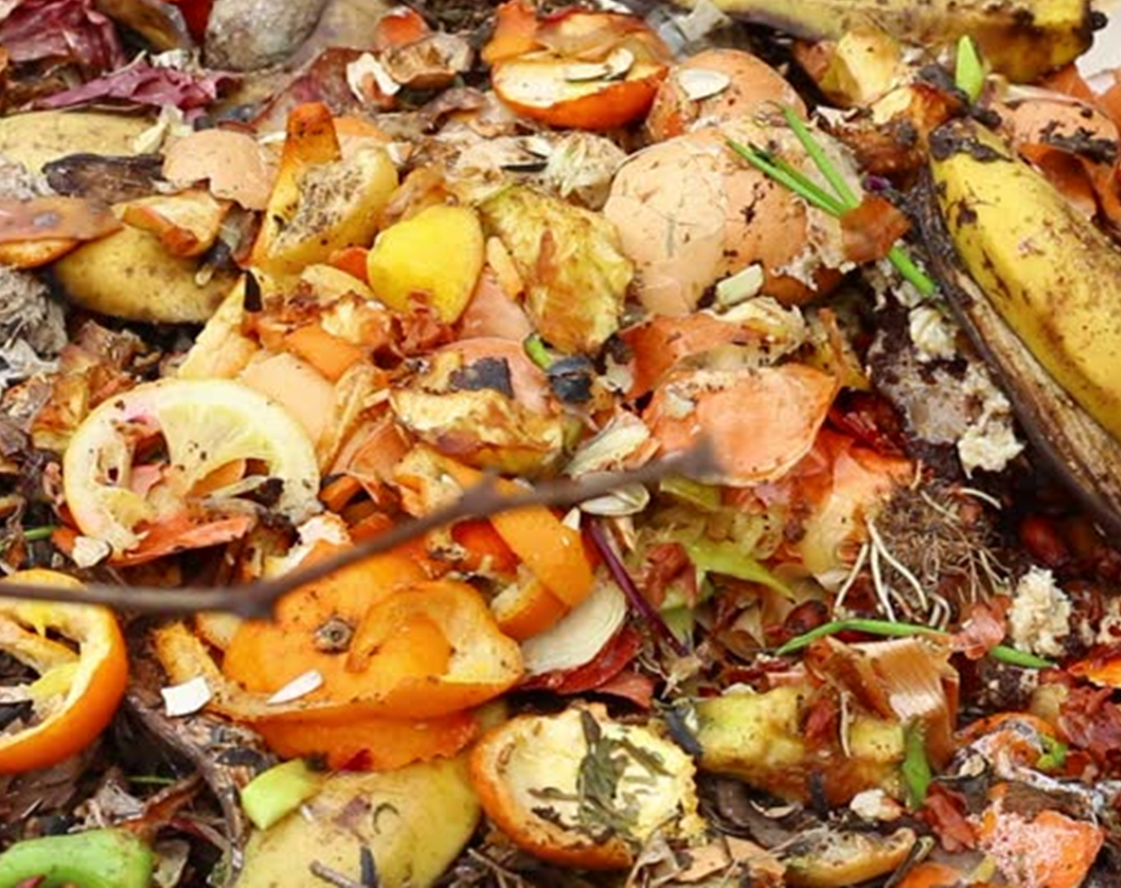
Food Waste
By Junior, Eco Warrior

Slide 2
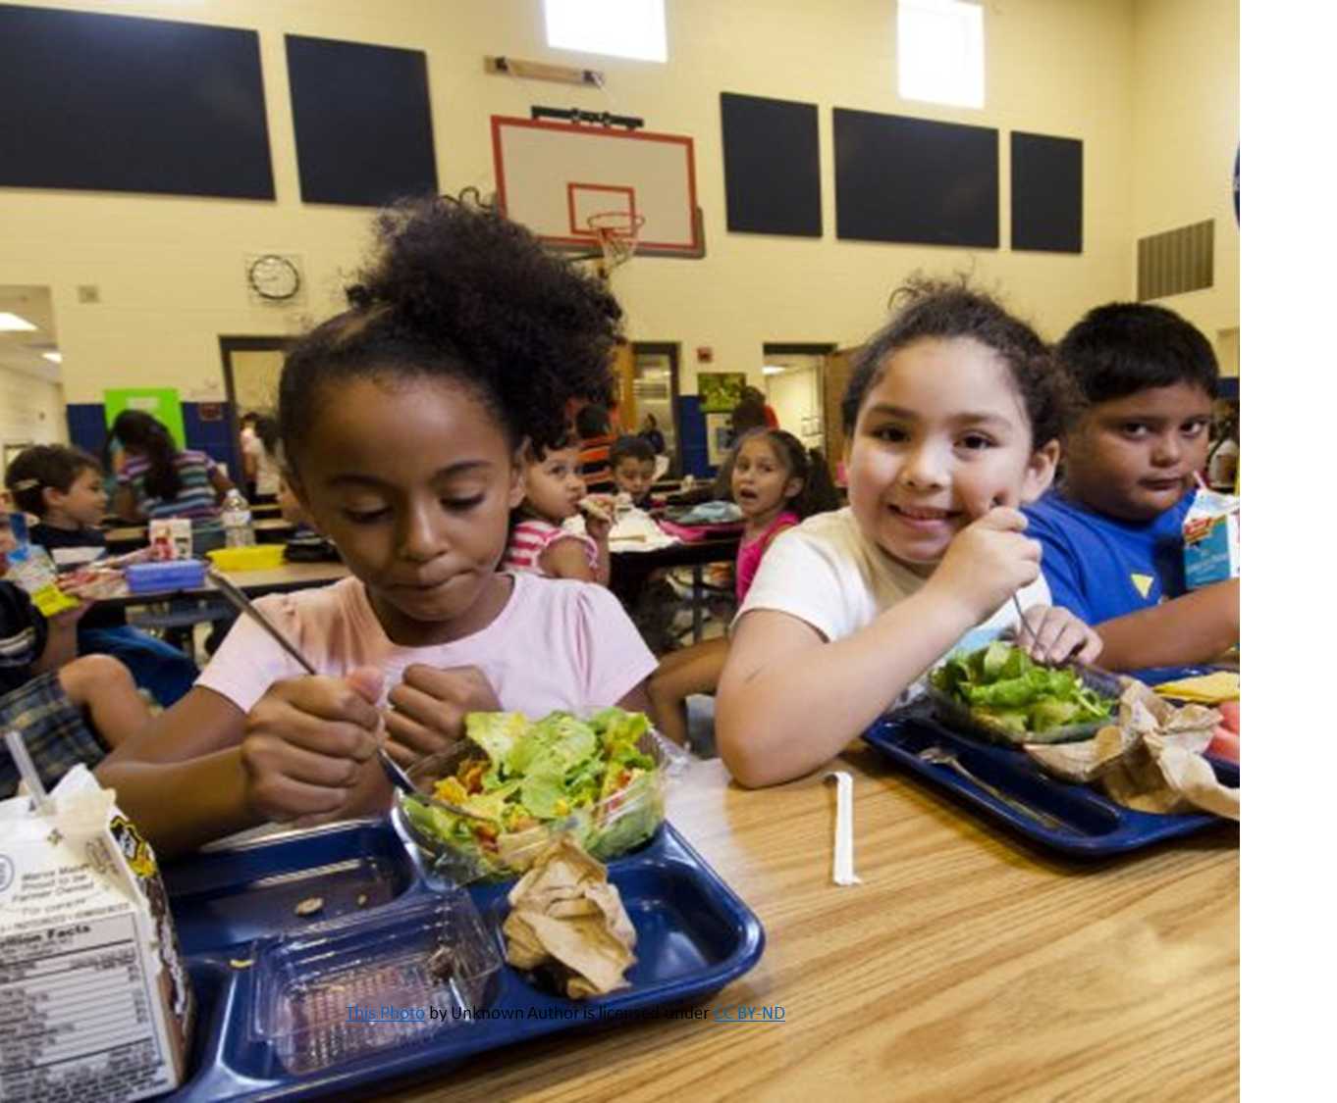
Food Waste in School
What have we done so far?
Members of the Eco Committee take the food bin from the playground up to Gardening Club on a Wednesday lunchtime.

Slide 3
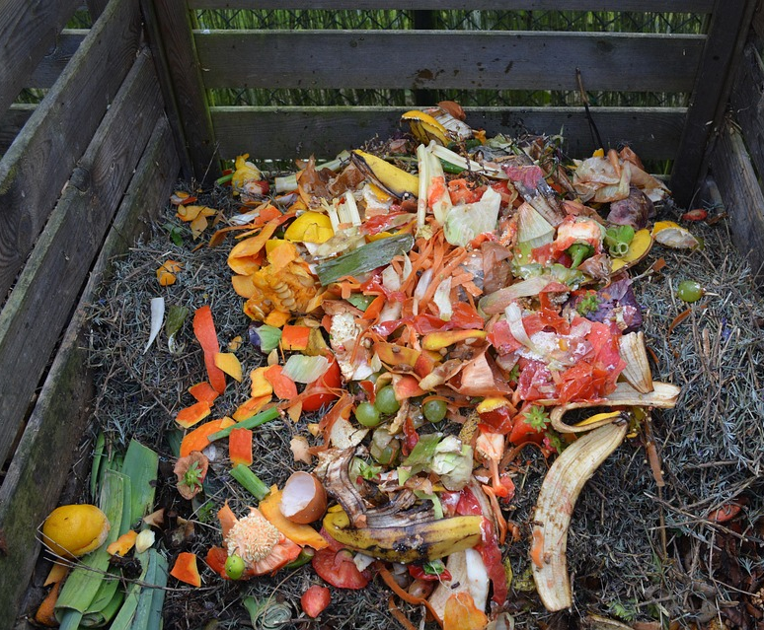
Can you remember what we can put in the food bin?
Picture Quiz

Slide 4
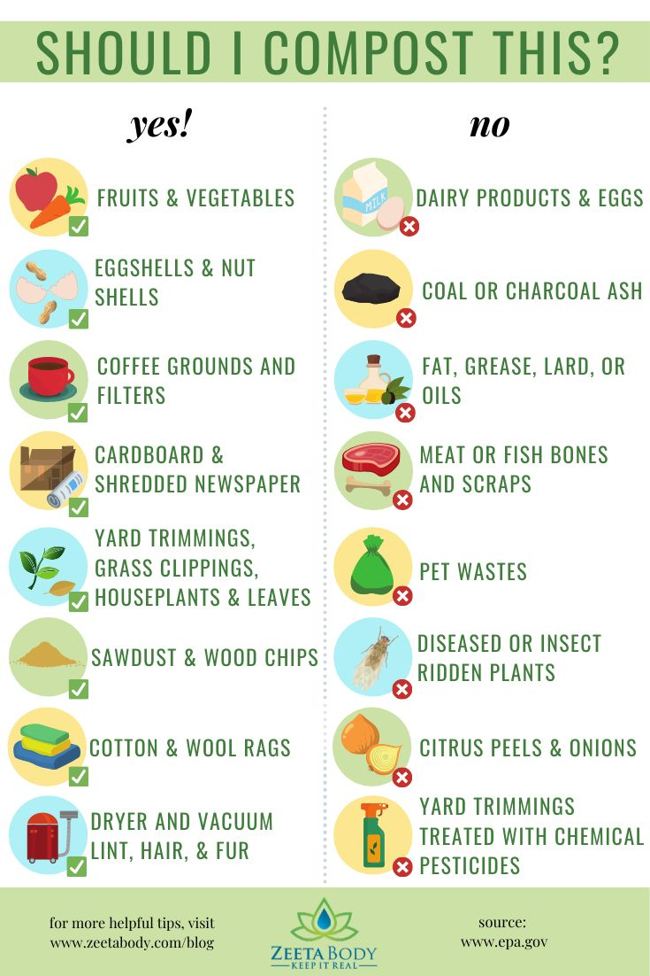
Composting at Home

Slide 5
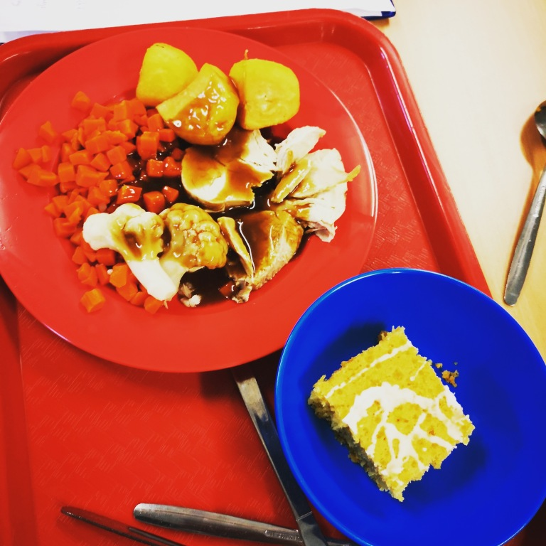
Wasting Less Food
Do you have any ideas of how we could waste less food in school?
This Photo by Unknown Author is licensed under CC BY-SA-NC

Slide 6

Fact 1
Almost half of the food waste from primary schools is fruit and vegetables.

Slide 7
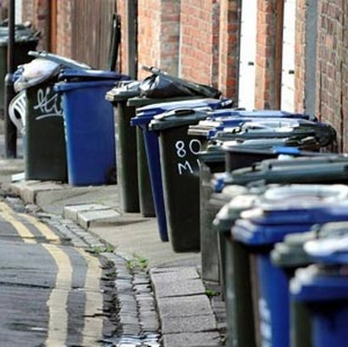
Fact 2
Can you imagine what 38 million wheelie bins look like? That’s how much edible food is thrown away every year.
This Photo by Unknown Author is licensed under CC BY-NC

Slide 8

Fact 3
The average family throws away £720 of edible food each year.
The average family of 4 could save just over £60 per month by reducing their food waste.
Imagine, what that money could be spent on instead.
This Photo by Unknown Author is licensed under CC BY

Slide 9
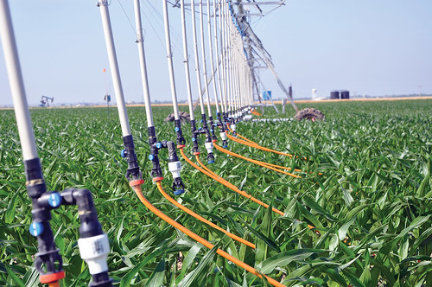
Fact 4
Millions of people across the world don’t have access to clean drinking water.
However, 25% of fresh water is used to grow food that is never eaten.
This Photo by Unknown Author is licensed under CC BY

Slide 10
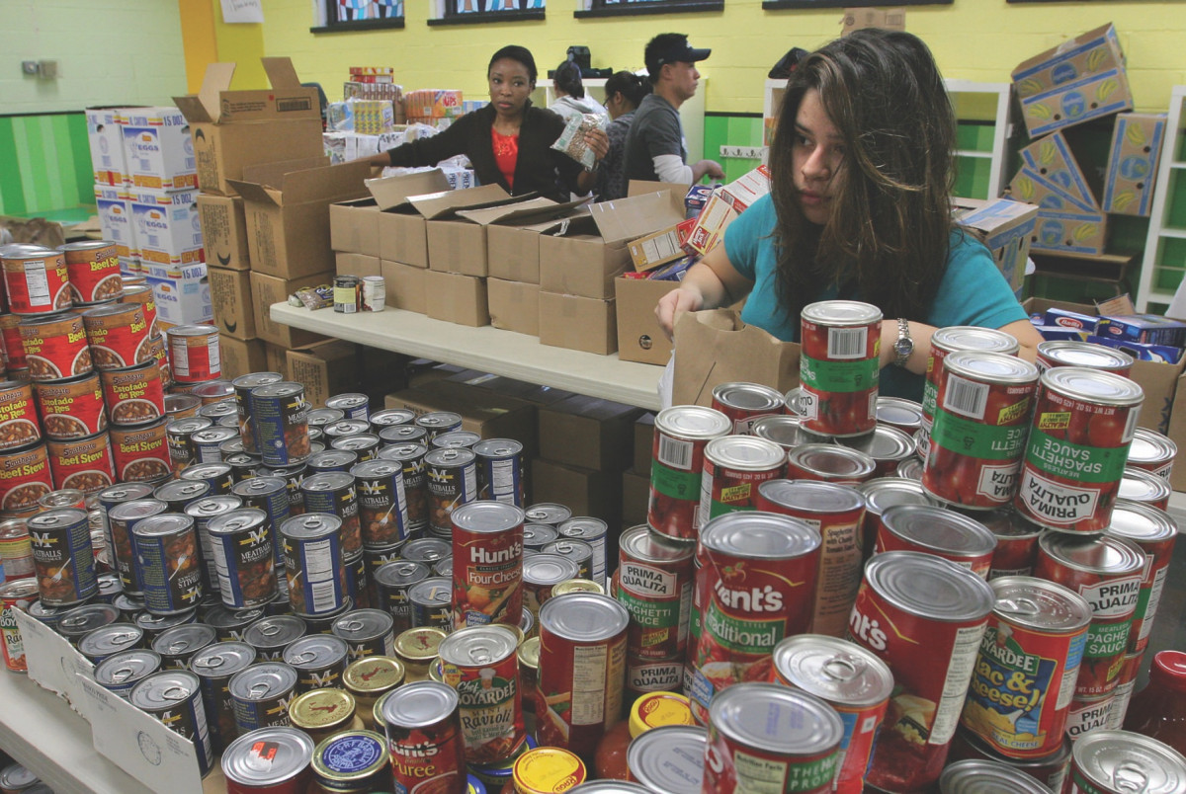
Fact 5
Over 3 million people had to use foodbanks in the UK last year.
This Photo by Unknown Author is licensed under CC BY-NC

Slide 11
Video

Slide 12
Quiz
Reception - Can you put an apple core in the compost bin?
Year 1 - What type of food is wasted most in primary school?
Year 2 – How much money per month could a family save by reducing their food waste?

Slide 13

Prayer
Dear God
Help us to take care of the world.
To not waste food.
And to share food with those who do not have enough.
Amen

